Slide 1
Edible Landscaping
Planning and Design
Claire Napawan
Department of Environmental Design
ncnapawan@ucdavis.edu

Slide 2
Learning Objectives
Understand that planning and design of any landscape is a process of synthesis that requires a thorough analysis of the intended use, client/user(s), and program/functional use of the site.
Know that aesthetics should be an important functional consideration of an edible landscape.

Slide 3
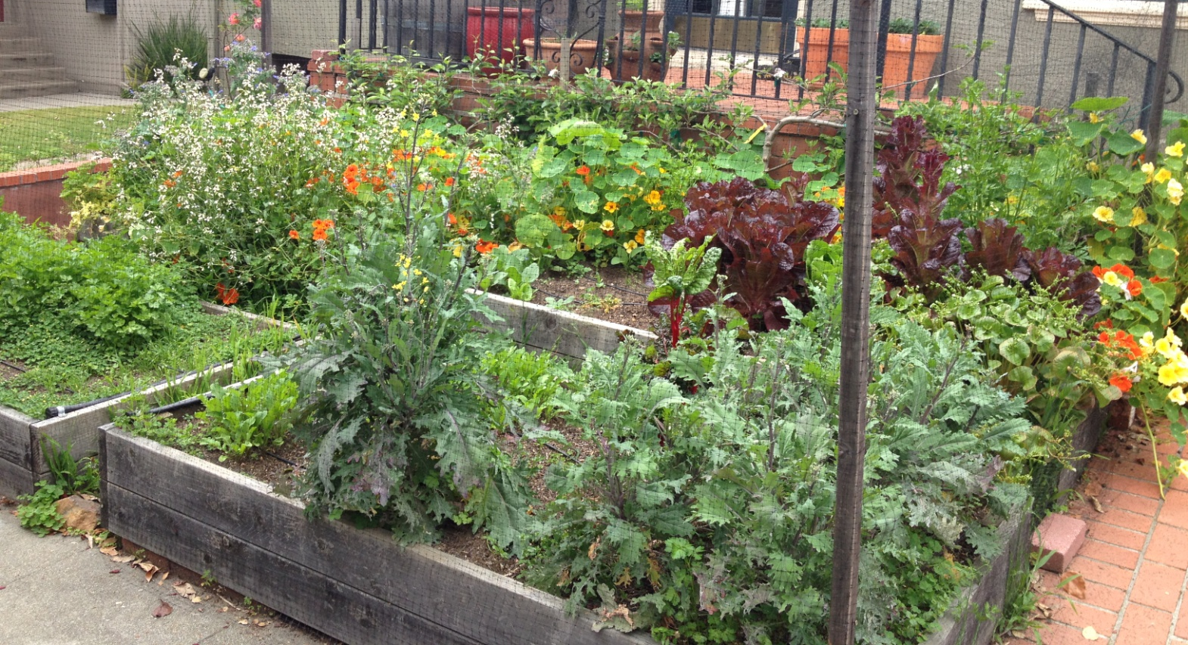
Edible Landscapes: More than a vegetable garden…
Image Source: C. Napawan
Notes:
Residential raised-bed vegetable gardening is the typical image that comes to mind for most individuals when they think of edible landscapes…

Slide 4
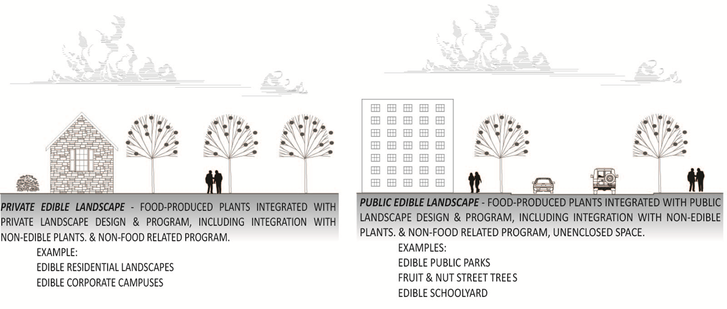
Edible Landscape Types: Balancing productive uses with existing landscape uses
Image Source: C. Napawan
Notes:
This blending is the very definition of edible landscapes; it specifically states that the landscape would integrate with food-growing an existing or alternative program (functional use). Examples range in scale and exist on both public and private landscapes, in urban, peri-urban, and suburban areas.

Slide 5
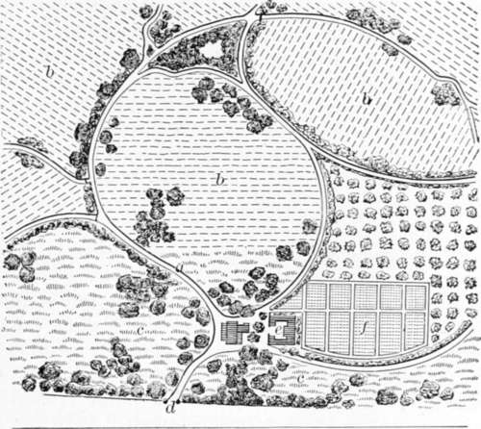
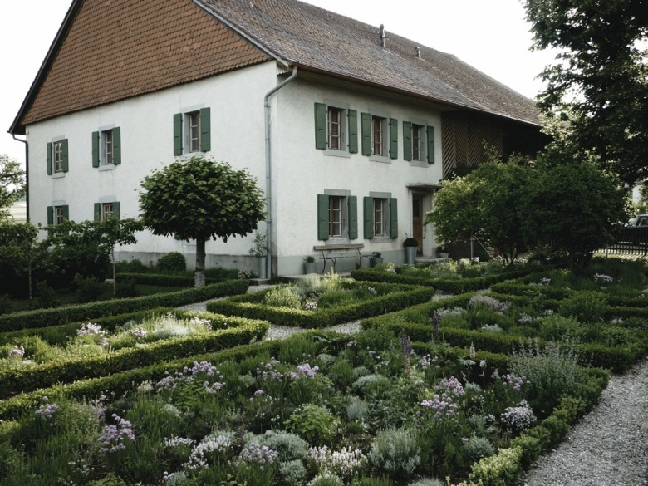
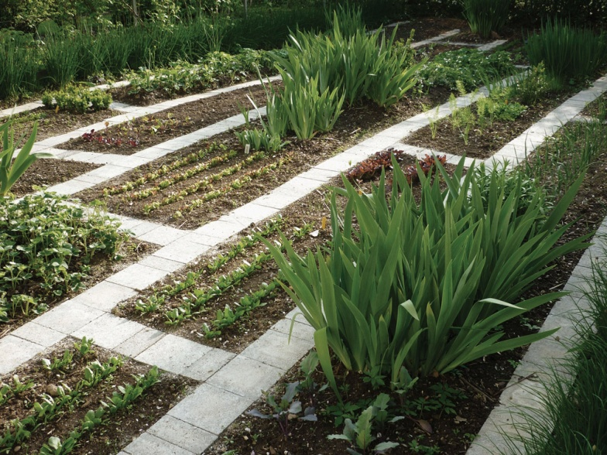
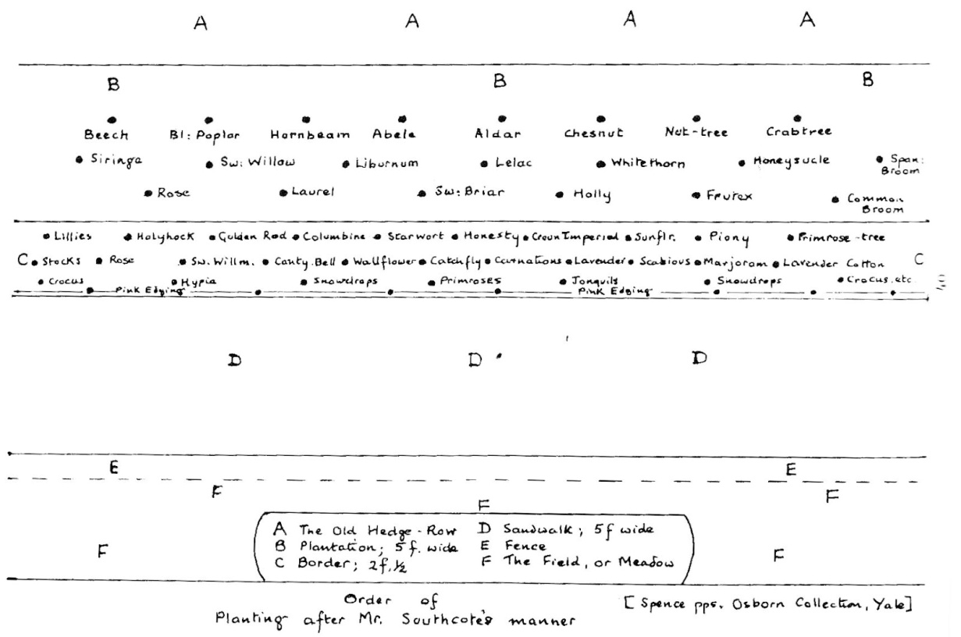
Ferme Ornee The Ornamental Farm
Image Sources: www.nationaltrust.org/uk/
Notes:
…but there are opportunities to consider a blending of both the function of food-growing with other landscape functions, including aesthetics, recreation and other program need. Ferme ornee, or ornamental farming, was popular in 18th century England and France. Initiated by the middle-classes that did not have enough property to create both functioning estate farms and pleasure gardens separate from each other, estate gardeners began merging the forms & functions of both.

Slide 6
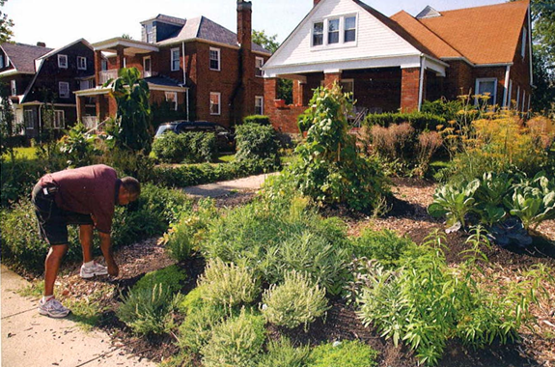
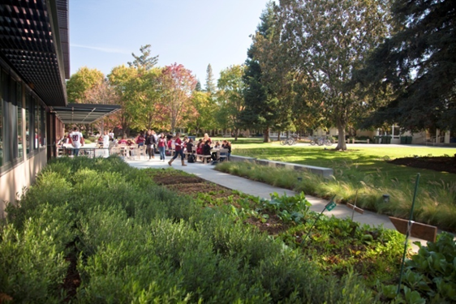
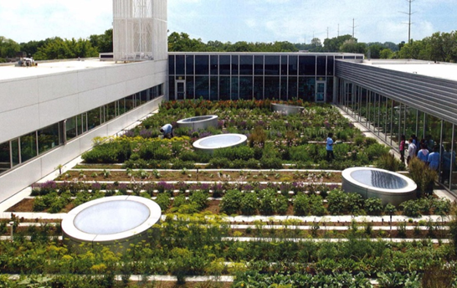
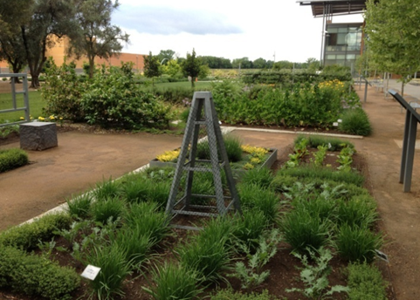
Edible Landscape Types
Residential
Educational
Institutional
Public
Image Sources: “Carrot City” by M. Gorgolewski, SWA Group, & C. Napawan
Notes:
Range of projects exist that overlap alternative programs with food growing, each case represents a balance between use/function of the site with food growing function. Requires understanding of program, site, & client/user.
Next few slides will explore a range of project types that incorporate edible plantings and programs. Each at a different scale.

Slide 7
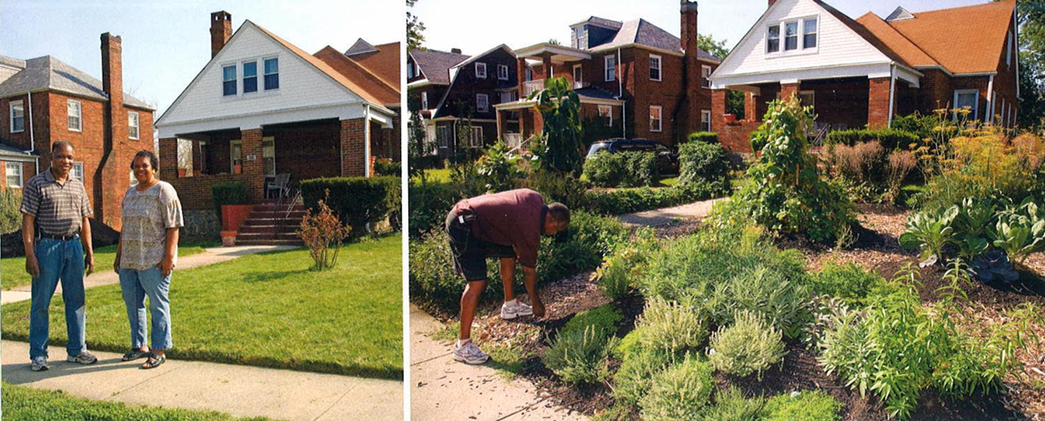
Edible Residence
Edible estates, various locations in US & UK Fritz Haeg, Artist
Image Source: “Carrot City” by M. Gorgolewski
Notes:
Artist, Fritz Haeg, challenges the notion of lawn with regionally specific edible gardens. Sites throughout the U.S. Including Baltimore, md; Lakewood, ca; Maplewood, nj. Above is an example in Baltimore, md where lawn is replaced with a range of edibles.

Slide 8
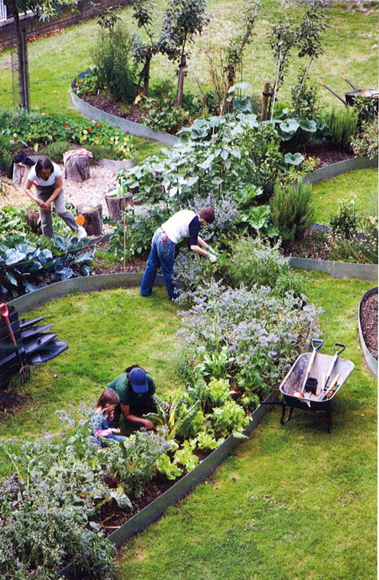
Southwark, London Council Housing Garden
Image Source: “Carrot City” by M. Gorgolewski
Notes:
Fritz Haeg was later invited by Tate modern to install edible garden at the council housing estate in southward, London. Aesthetic use was of equal concern to the food-growing potential of the landscape. Use of lawn was still a significant use of the landscape. Haeg integrated food-growing into the existing lawn to re-inforce its current use of informal, small-group gathering areas.

Slide 9
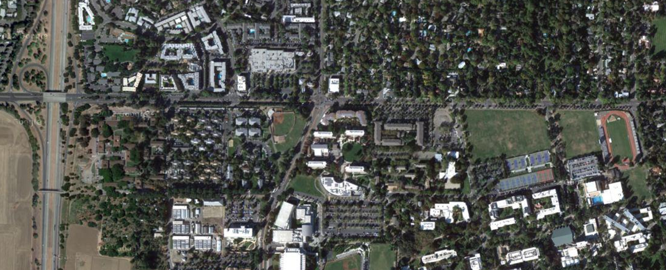
Edible Streetscape
Russell Street olive grove, UC Davis City of Davis, Davis Olive Center
Approx. 1 mile
Image Source: Google Earth
Notes:
1 mile stretch of Russell blvd, extending from hwy 113 to a street. Olives originally planted by city of Davis for street beautification; originally perceived as maintenance issue with dropping olives until 2004 when olives were harvested by campus grounds and transformed into oil & table olives.

Slide 10
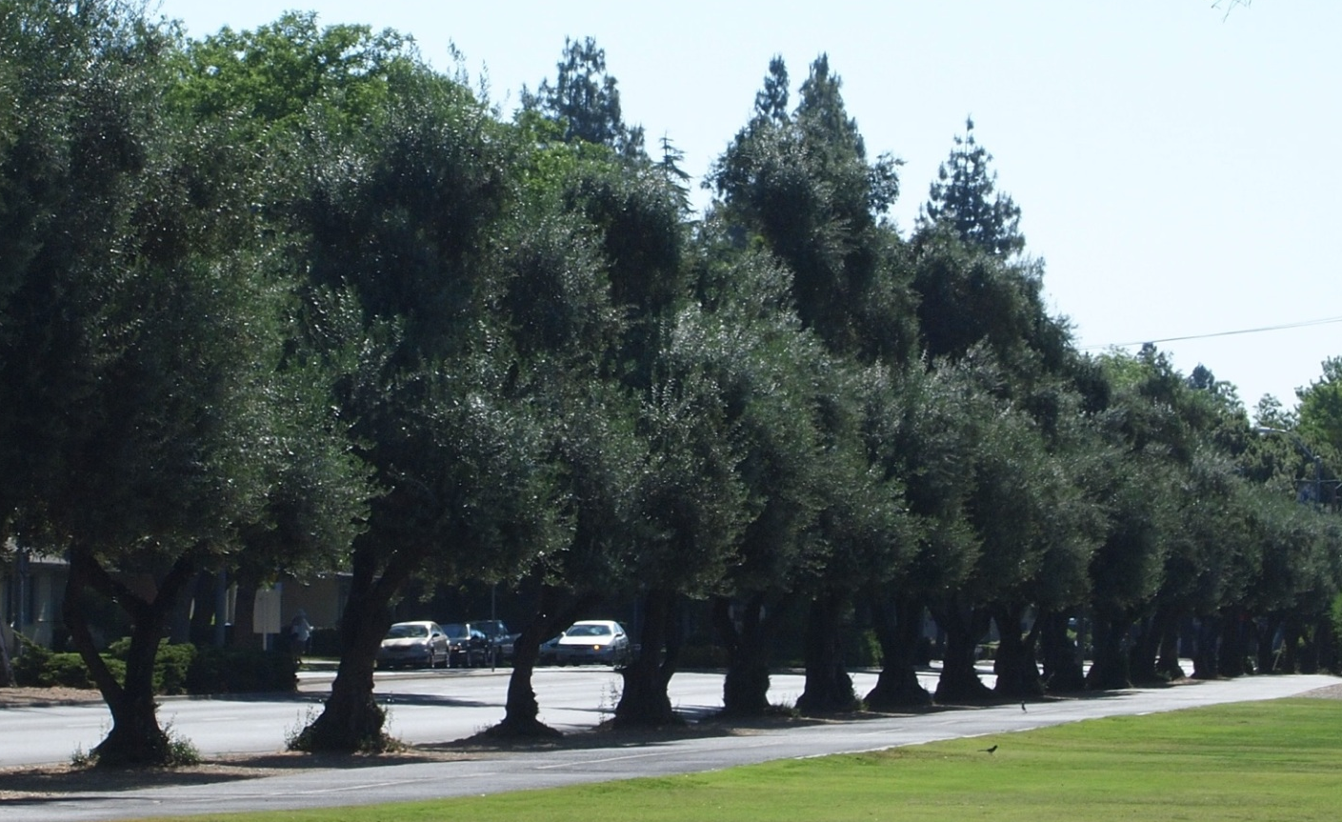
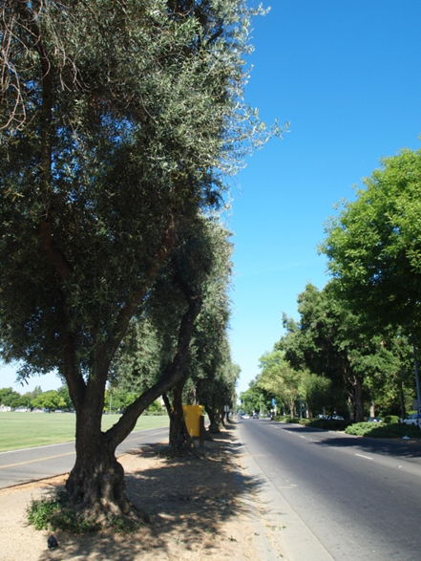
Edible Streetscape
Image Source: C. Napawan
Notes:
Still help beautify the street, maintenance issues solved, and thriving business is created. Currently the uc davis olive center produces olive oil, table olives, and olive-based beauty products.

Slide 11
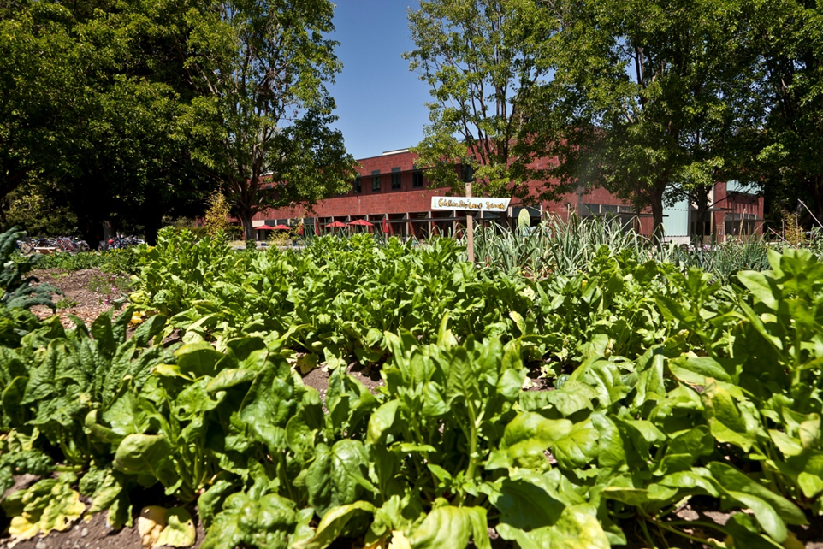
Edible Schoolyard
Sacred Heart School, Atherton, CA SWA Group, Sausalito, CA 0.25 Acres
Image Source: SWA Group
Notes:
Private school wanted an educational garden that would supply fresh produce to cafeteria. The school has a reputation of well-maintained grounds that were supported by tuition fees, so high expectations for manicured appearance.

Slide 12

Edible Schoolyard
Sacred Heart School, Atherton, CA SWA Group, Sausalito, CA 0.25 Acres
Image Source: SWA Group
Notes:
Wanted integration with existing campus, without the ‘dishelved’ look of community gardens.

Slide 13
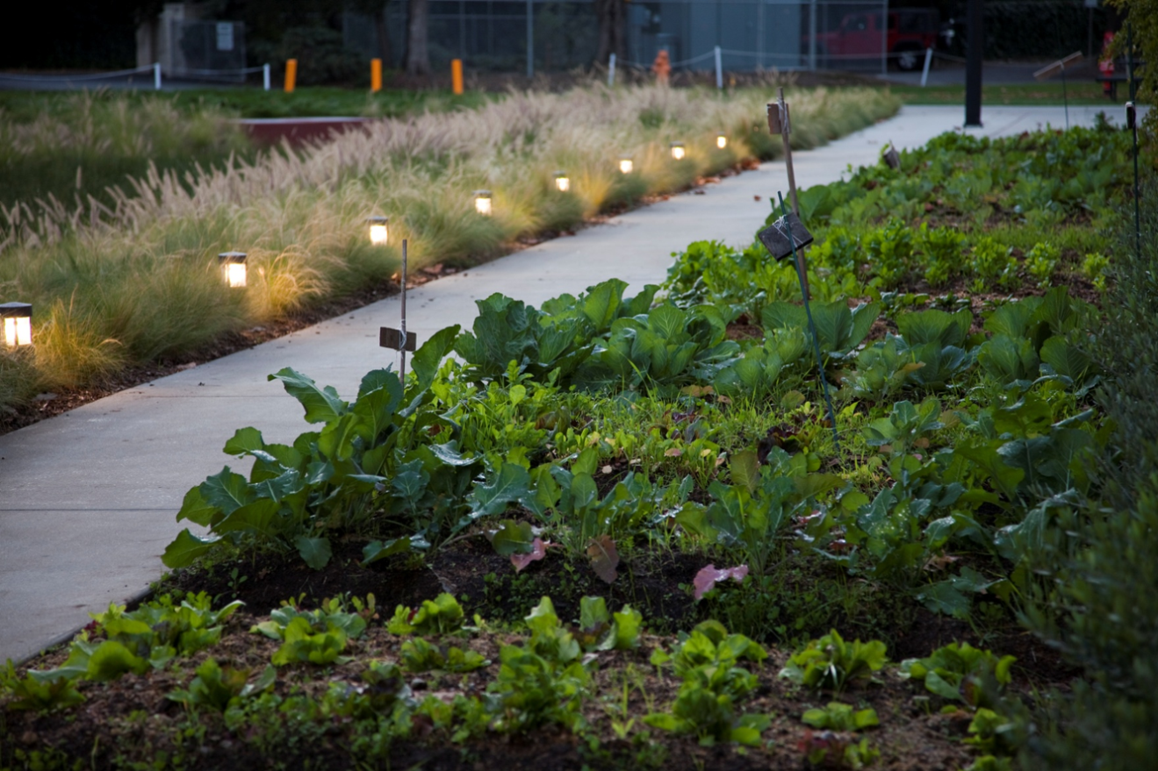
Edible Schoolyard
Sacred Heart School, Atherton, CA SWA Group, Sausalito, CA 0.25 Acres
Image Source: SWA Group
Notes:
The design team worked to create a design that integrated with ornamentals. Row crops treated like annual ornamentals, and quickly rotated from one season to the next to discourage the ‘barren’ look between seasons. Integration with non-edible ornamentals means there is consistent plant material throughout the year.

Slide 14
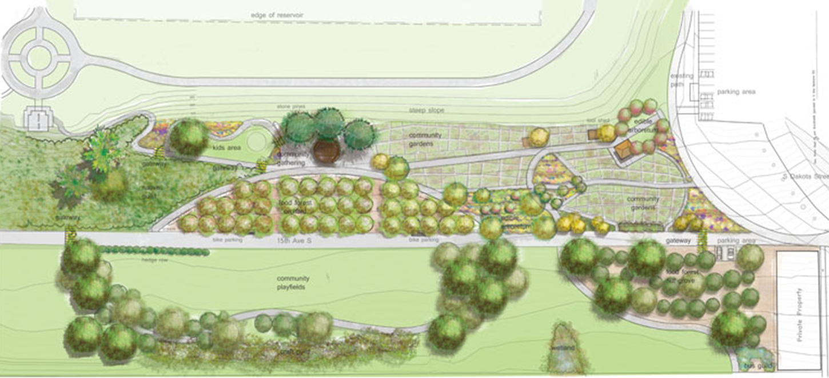
Edible Public Park
Beacon Food Forest, Seattle, WA Harrison Landscape Architects 7 Acres
Image Source: http://beaconfoodforest.weebly.com
Notes:
City wanted a public edible park but the existing climate of seattle and the presence of existing high-canopy trees required re-considering the typical edibles: corn, carrots, etc.
Re-envisioned the project as a ‘food forest’ and looked at regionally specific planting schemes that might integrate edibles

Slide 15
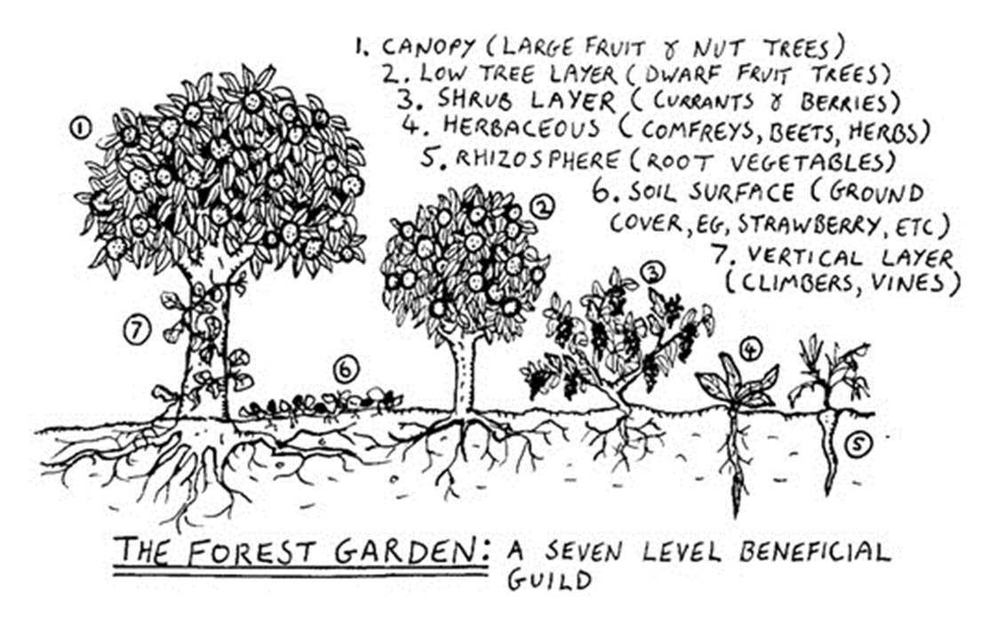
Edible Public Park
Beacon Food Forest, Seattle, WA Harrison Landscape Architects 7 Acres
Image Source: http://beaconfoodforest.weebly.com
Notes:
‘Plant guild’ approach was employed to create a woodland structure related to pacific northwest region that also provides food for foraging.

Slide 16
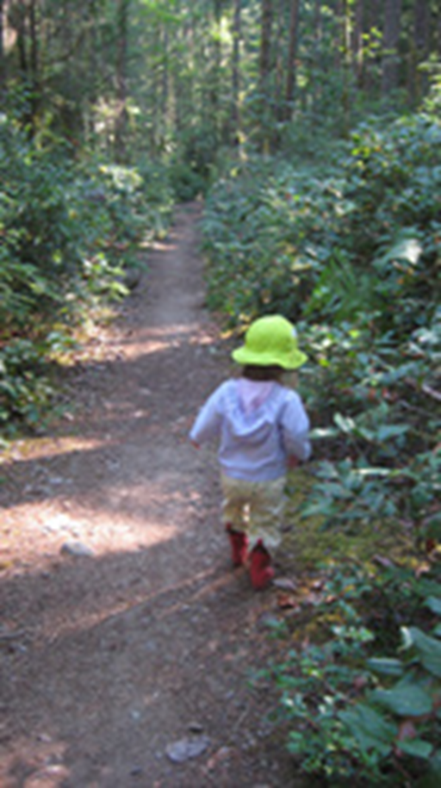
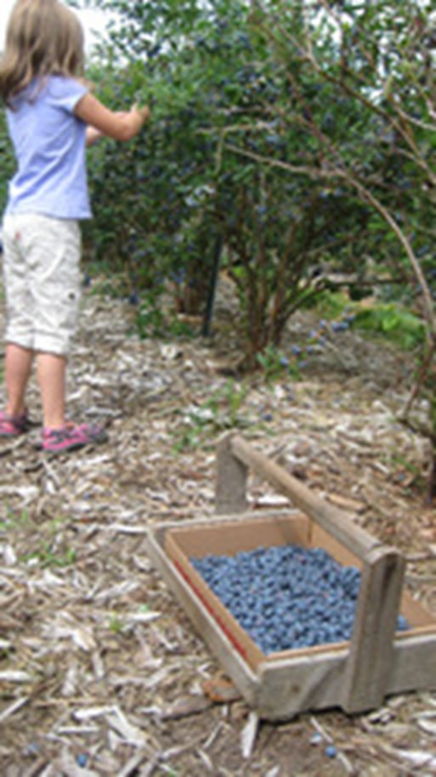
Edible Public Park
Beacon Food Forest, Seattle, WA Harrison Landscape Architects
Image Source: http://beaconfoodforest.weebly.com
Notes:
Precedent images the beacon food forest envisions for their new park. Phase 1 construction has begun, park will be comleted in 2014.

Slide 17
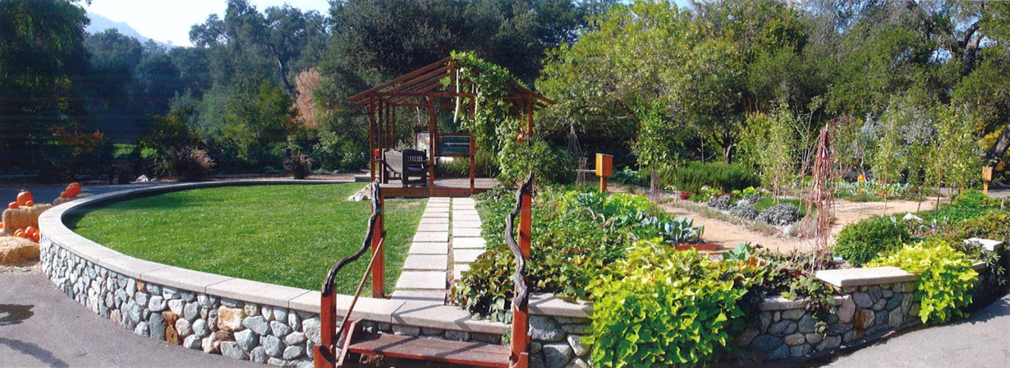
Edible Public Park
Descanso Public Demonstration Garden
Image Source: “Carrot City” by M. Gorgolewski
Notes:
Fritz Haeg again, also has designed edible public parks. Here edibles in planting beds are utilized alongside lawn and canopy trees.

Slide 18
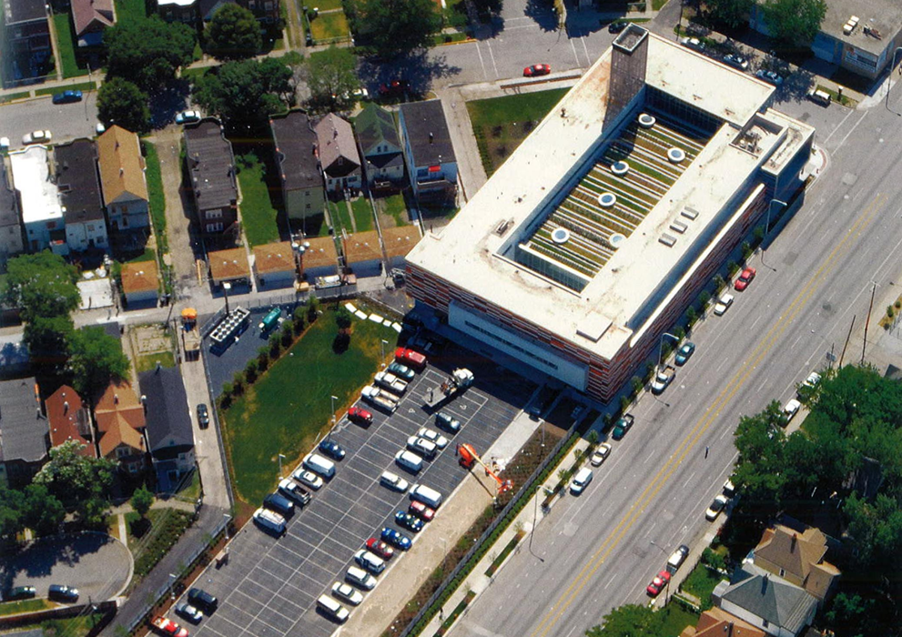
Edible Rooftop
Gary Comer Youth Center Rooftop, Chicago, IL Hoerr Schaudt Landscape Architects 8,160 SF
Image Source: “Carrot City” by M. Gorgolewski
Notes:
Very urban site that has not a lot of available land. A recreational center that wants to consider gardening a recreational activity, commensurate to basketball, etc.

Slide 19
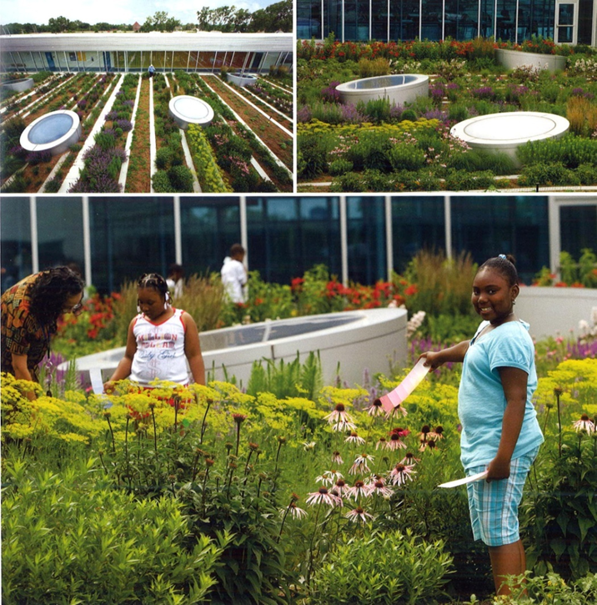
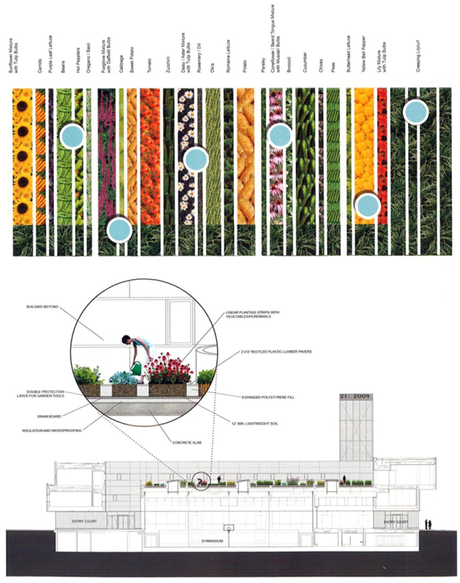
Edible Rooftop
Gary Comer Youth Center Rooftop, Chicago, IL Hoerr Schaudt Landscape Architects 8,160 SF
Image Source: “Carrot City” by M. Gorgolewski
Notes:
Rooftop is above existing gymnasium of youth center; wanted to create a green roof that integrated with healthy youth initiatives program in the building, but also visually interesting. Drew from the row-crop patterning, but also from the fenestration (window) patterning of the building surrounding to connect landscape to structure. Notice how the row-cropping pattern isn’t completely consistent – designers drew from the window patterning (or fenestration) to help drive the garden design and draw greater connections between landscape and building.

Slide 20

Edible Rooftop
Gary Comer Youth Center Rooftop, Chicago, IL Hoerr Schaudt Landscape Architects 8,160 SF
Image Source: “Carrot City” by M. Gorgolewski
Notes:
Rooftop holds 18-24 inches of soil for cabbage, sunflowers, carrtos, lettuce & strawberries. Produces over 1,000 lbs of food a year. Food is used in center’s café and distributed to local restaurants. Again, visual interest and adapting to roof-top constraints (minimal soil, micro-climatic conditions) were important driving factors, as well as food production.

Slide 21
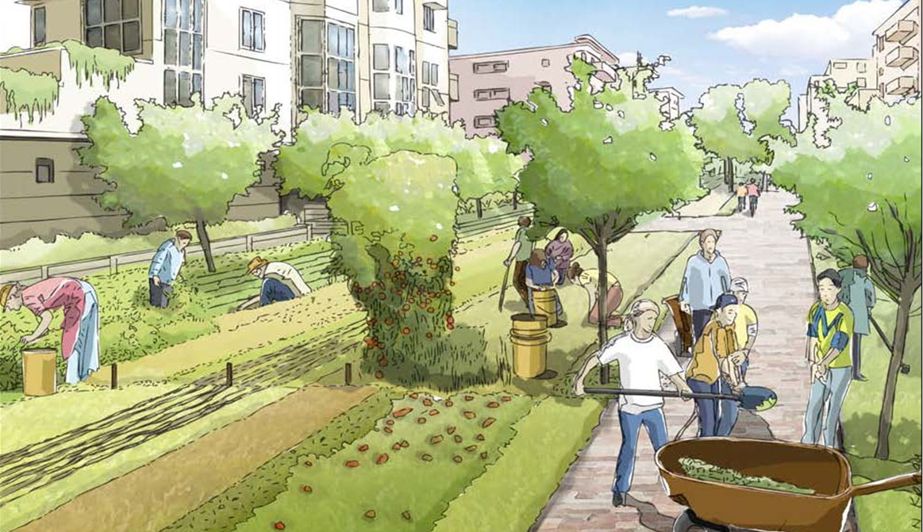
Edible Development
Mixed-Use Development, Stockton, CA SWA Group, Sausalito, CA 137 Acres
Image Source: SWA Group
Notes:
Mixed-used community that strives to meet lower emissions initiatives in the state.

Slide 22
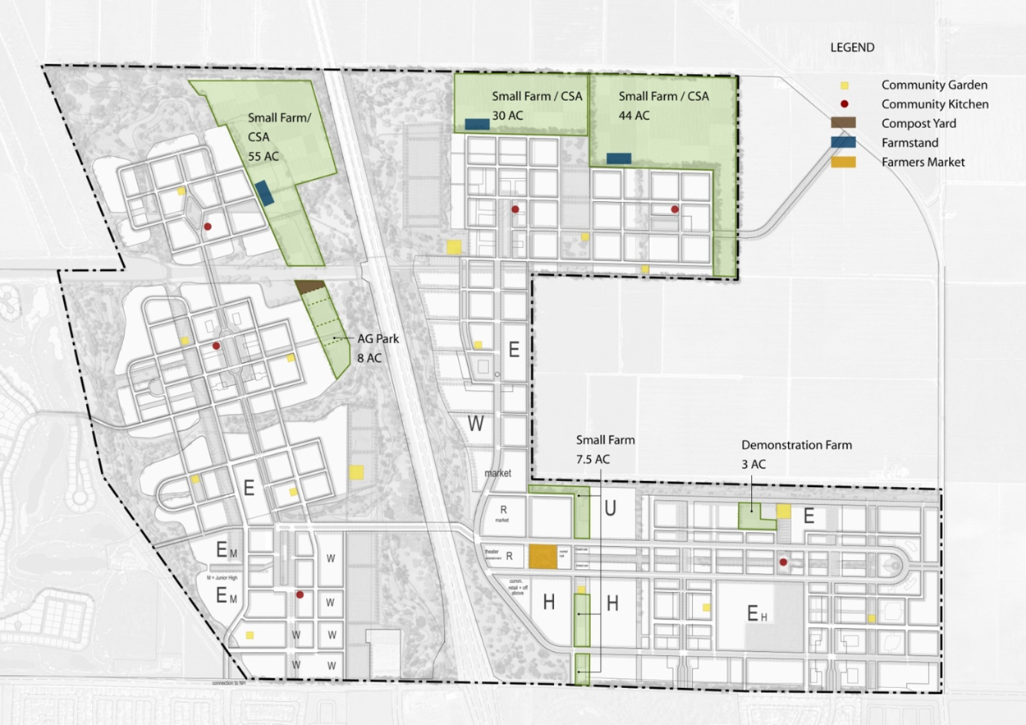
Mixed-Use Development, Stockton, CA SWA Group, Sausalito, CA 137 Acres
Image Source: SWA Group
Notes:
Most developments approach this via mixed-use, dense developments to minimize resident vehicle use & maximize transportation alternatives; this approach integrates with that also food production to minimize food distribution; utilizes a series of food-related landscape types integrated with the use types within the development. This includes community gardens, for-profit market farms, farm stands & farmer’s markets, and educational farms.

Slide 23
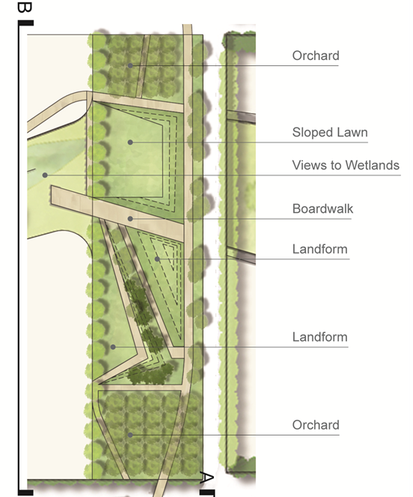
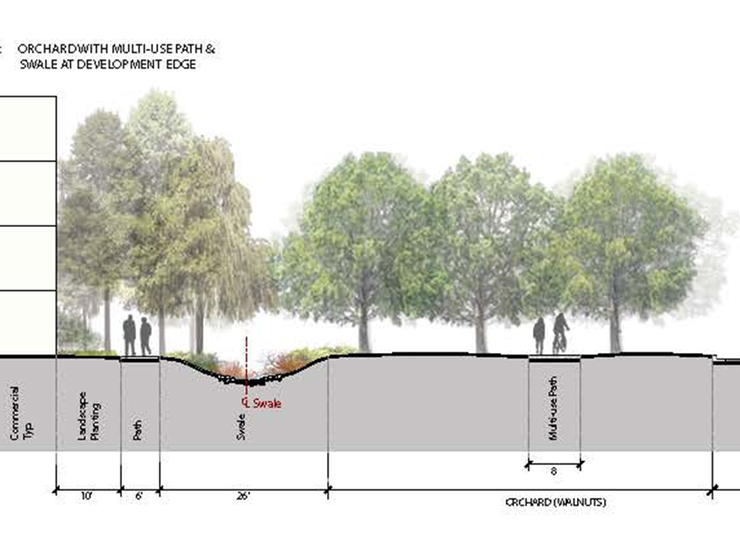
Edible Development
Mixed-Use Development, Stockton, CA SWA Group, Sausalito, CA 137 Acres
Image Source: SWA Group

Slide 24
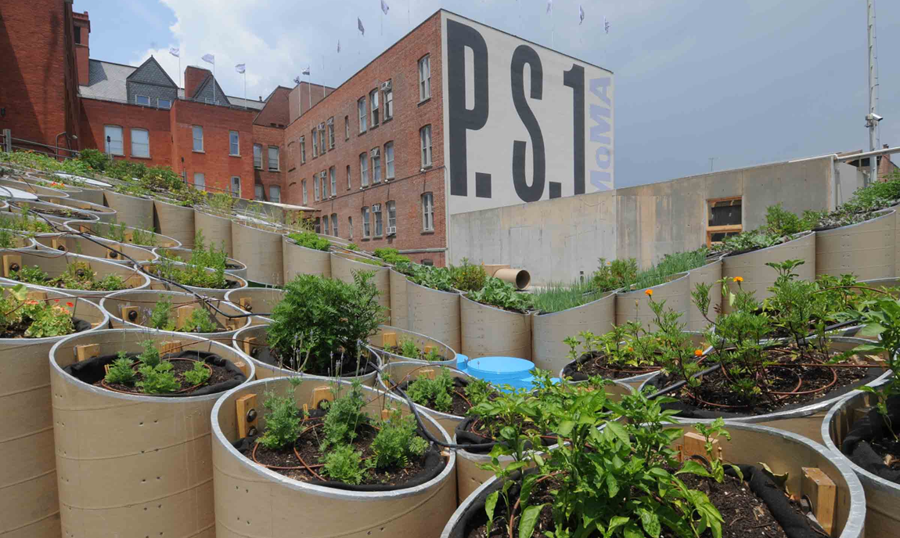
Edible Art Installation
Public Farm 1, Long Island City, NY WORKac AND MoMA PS1 23 Plant Types
Image Source: “Carrot City” by M. Gorgolewski
Notes:
Integration of temporary art installation with food production in nyc, food produced was prepared and sold in museum’s café.

Slide 25
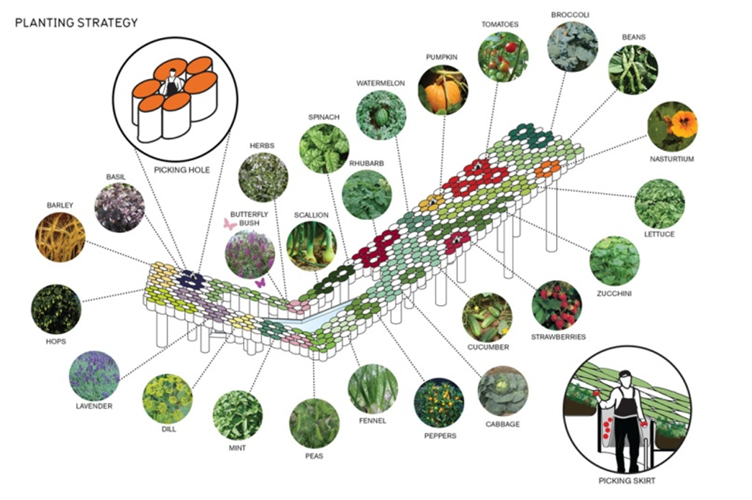
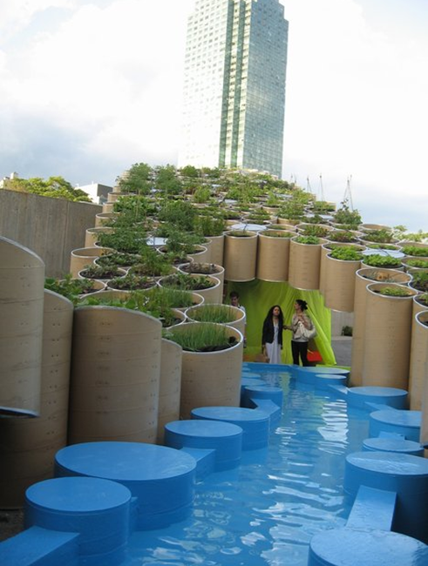
Edible Art Installation
Public Farm 1, Long Island City, NY WORKac AND MoMA PS1 23 Plant Types
Image Source: “Carrot City” by M. Gorgolewski
Notes:
ALTHOUGH SCULPTURAL, DESIGN WAS ALSO FUNCTIONAL, WITH HARVESTING TECHNIQUE FULLY CONSIDERED INTO THE DESIGN OF THE STRUCTURE. THE ANGLE AND ORIENTATIN OF THE STRUCTURE ALSO DESIGNED TO MAXIMIZE SOLAR ORIENTATION FOR PLANTS UTLIZED.

Slide 26
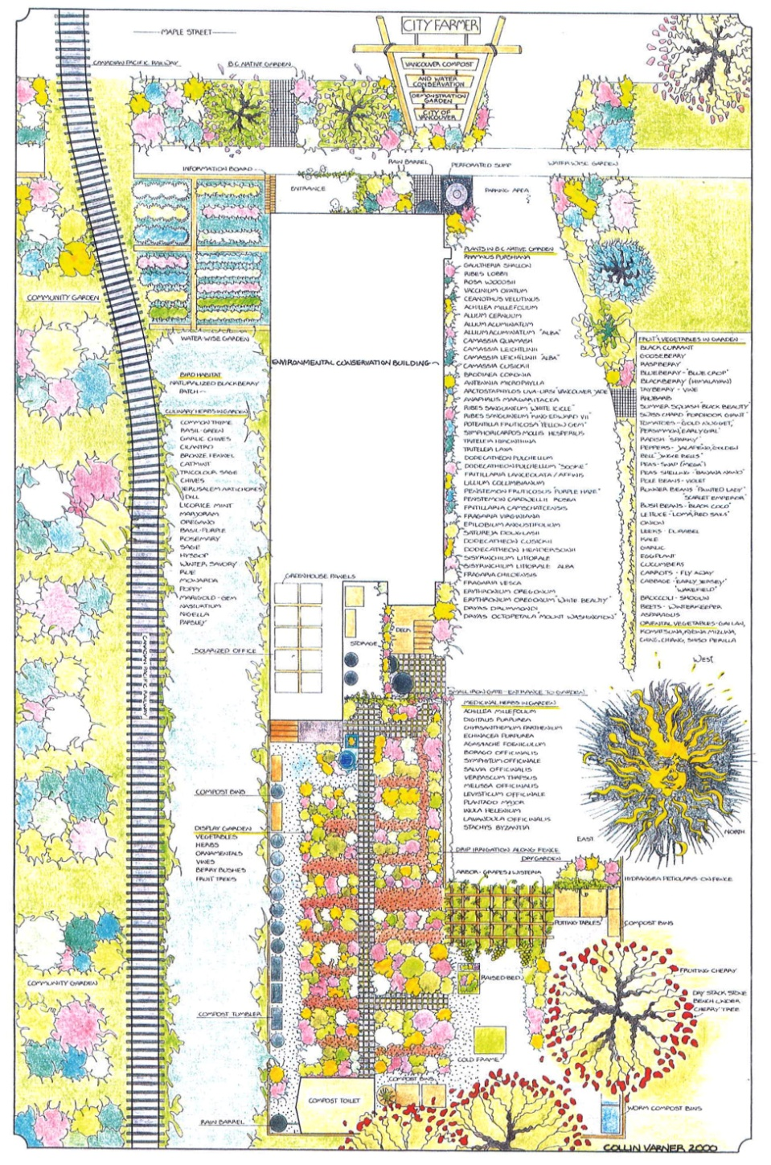
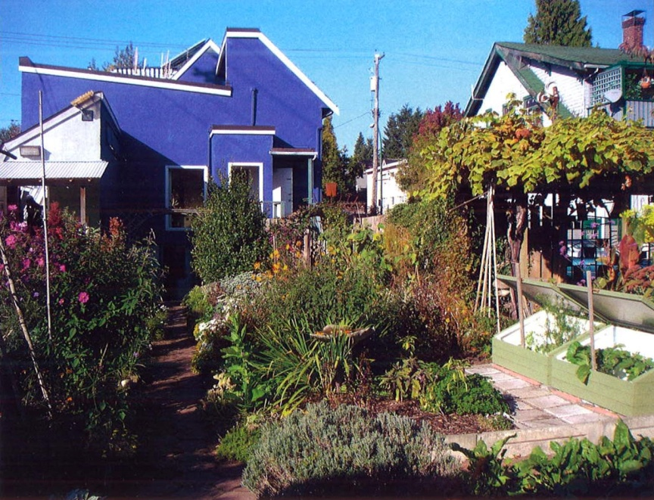
Assessing Site, Client & Program Addressing People & Place Considerations
Image Source: “Carrot City” by M. Gorgolewski
Notes:
Design is a synthesizing process. It requires the consideration of site, clients/users and program to create the appropriate balance. This includes a balance of edible plants to ornamental plants, as well as many other conditions.

Slide 27
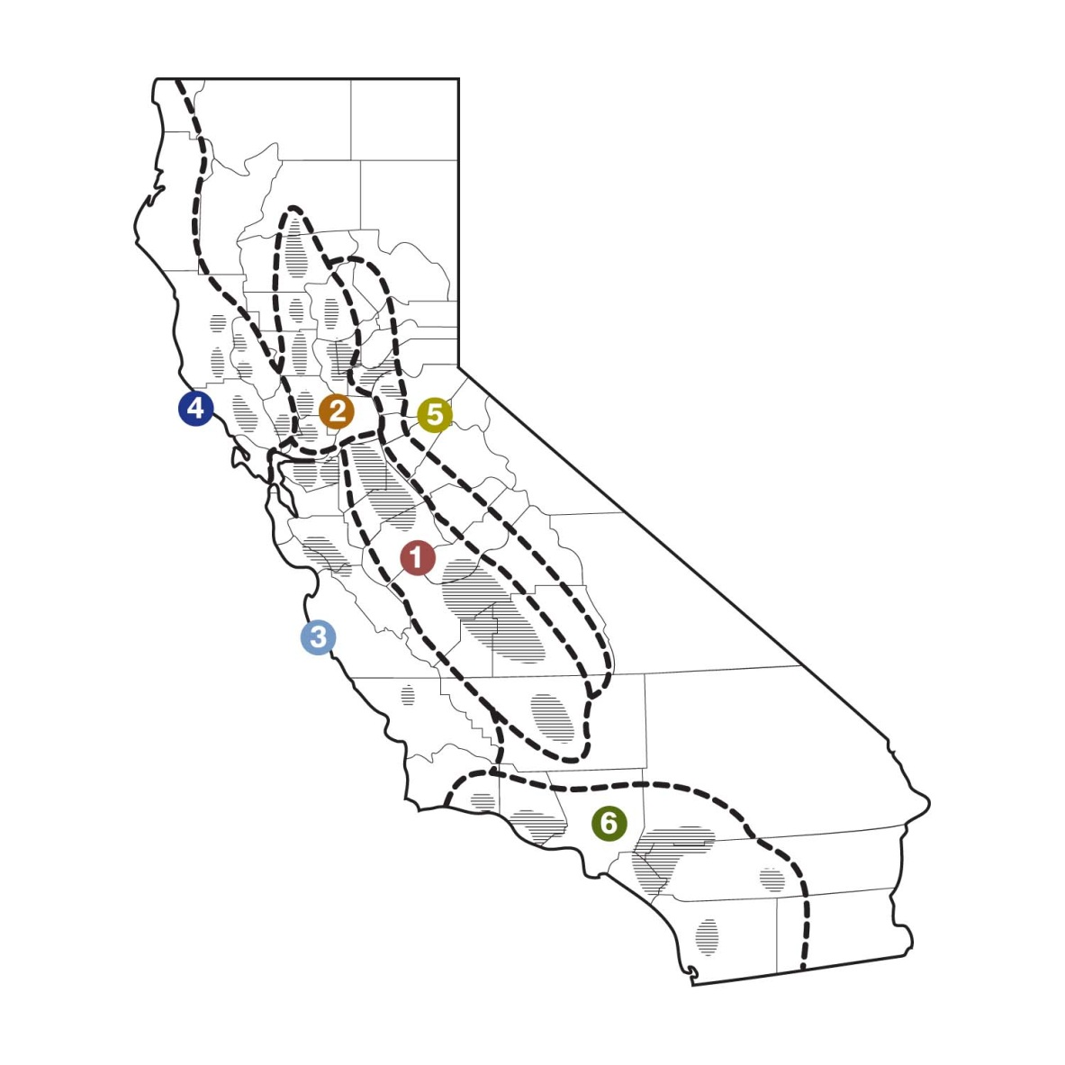
Addressing Existing Conditions: California’s Varied Climates & Growing Regions
Image Source: Adapted from Vossen, 2002

Slide 28
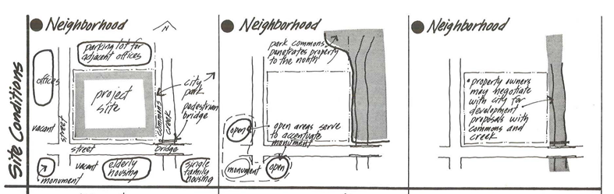
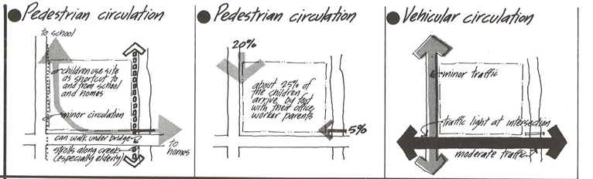
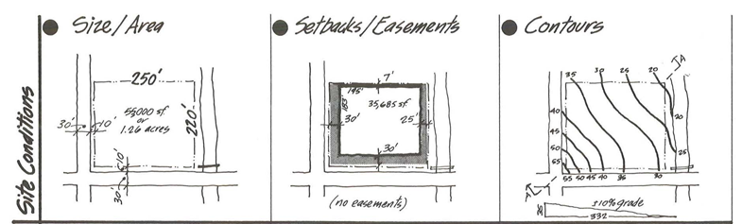
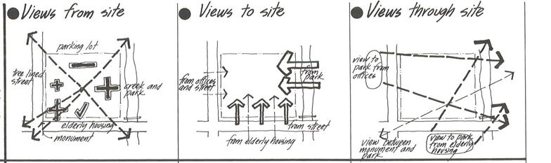
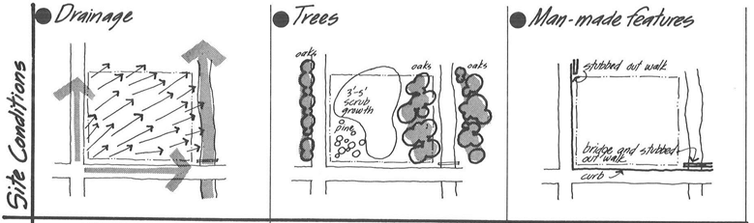
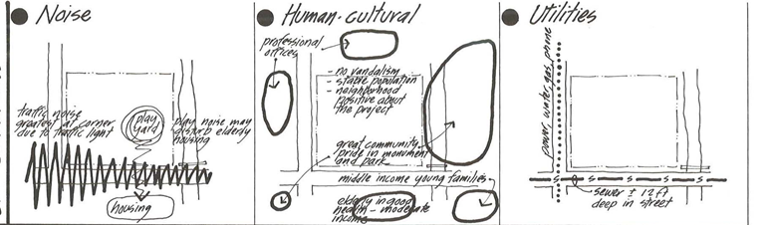
Addressing Existing Site Conditions: Scale, Adjacencies, Slope, Existing Materials, Access, & More!
Image Source: “Site Analysis” by E. T. White
Notes:
SITE ASSESMENT: at the middle scale, important to consider the existing physical attributes of the site including: scale (or size of site), adjacencies, slope, existing materials (hardscape, vegetation, structures?), and access points (visual and physical) can all have impacts on your planning & design. Scale of the site will determine how much room you have to balance the existing use of the site with edible & non-edible plantings. Site adjacencies can have impact on privacy concerns, the availability of sun, and the appropriateness of certain program given the neighbors. Slope can impact drainage and water availability, but also create needs for earthwork in creating level areas for planting & programmatic use. Detailed resources on performing site analysis can be found in the resources portion of the workbook.

Slide 29
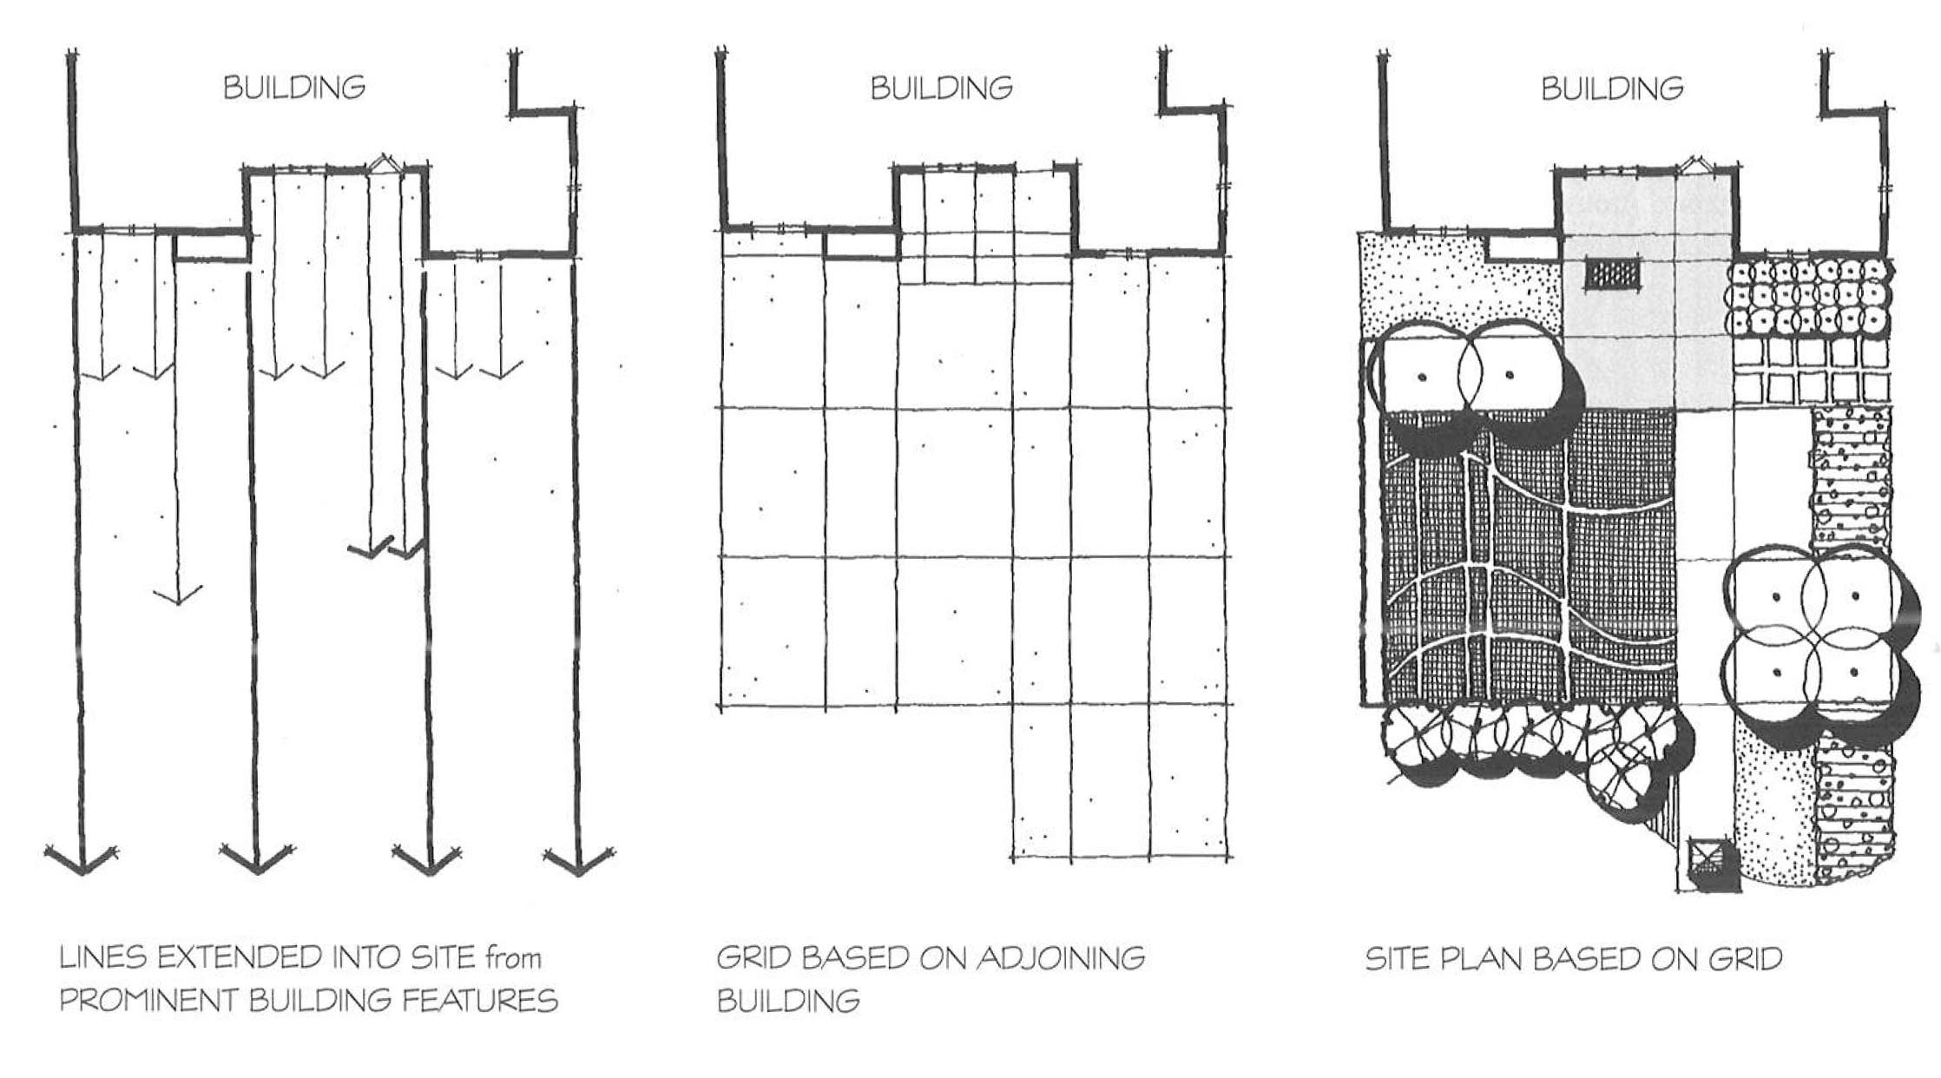
Addressing Existing Site Conditions: Existing Structures
Image Source: “Form & Fabric in Landscape Architecture” by C. Dee
Notes:
Existing structures can be an important source of information, both for determining form & function. Home layout can have an impact on how garden is designed (ie: location of the kitchen within the home, utility connections, existing maintenance/storage structures, etc.), and the building design can have impacts on the garden’s design as well. Similar to the Edible Rooftop example that drew from the window patterning to create their design.

Slide 30
Addressing Existing Site Conditions: Resource Availability
Soil – Identify if adequate soil exists on-site; confirm safety of soils for edible plants by soil testing, if located in potentially contaminated site; identify appropriate plants for soil type & condition (soil amendments discussed in forthcoming section).
Water – Identify availability of water on-site; confirm average volumes of available water; identify appropriate edible plants for water availability; determine appropriate irrigation method for water availability & desired plants (irrigation techniques & water policies discussed in forthcoming sections).
Solar Energy – Evaluate the site’s cardinal orientation and immediate adjacencies; identify appropriate plants for solar conditions present; for more detailed information on sun/shade studies:
Waste Management – Evaluate sites’ ability to handle green waste through composting; identify
Notes:
SITE ASSESMENT: also important to consider the resource availability

Slide 31
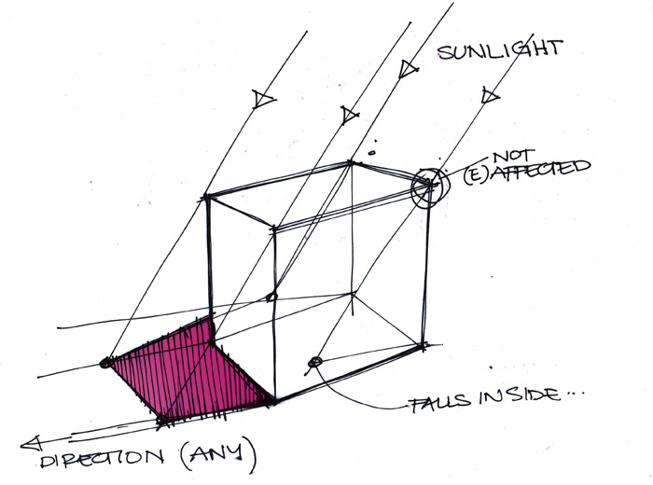
Addressing Existing Site Conditions: Solar Energy
http://www.nrel.gov/midc/solpos/solpos.html
http://aa.usno.navy.mil/data/docs/AltAz.php
Image source: http://www.idsketching.com/basic/toolbox-shadows/
Notes:
Software programs exist to calculate shadow projections using sun azimuth angles. Information is highly variable and specific to latitude, time of the day, and date of the year.
Generally speaking, shadows are cast to the North of a building. Locating gardens to the South of existing structures will maximize solar gain. Eastern sides will get morning sun, Western will get afternoon sun. If you know the sun’s azimuth (angle as it hits the earth’s surface at a given time, date, and location), you project with complete accuracy the length of a shadow.

Slide 32
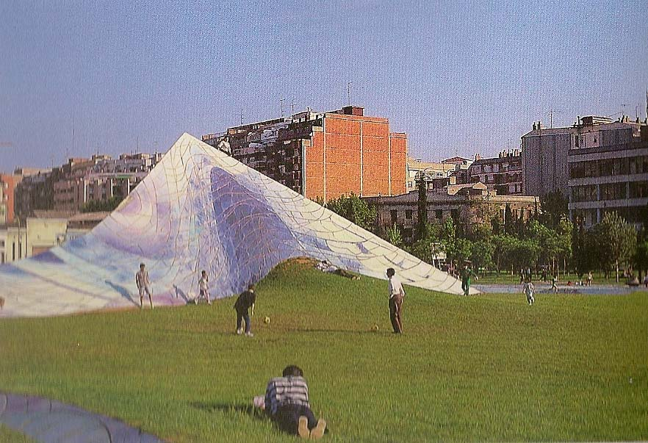
Addressing Site Program Balancing Form with Function
Active Recreation
Gathering
Gardening
Dog Run
Outdoor Films
Playground
Outdoor Classroom
Image Source: “Beverly Pepper,” edited by Spacemaker Press
Notes:
This is just a partial list of the range of program (or functional use) that can be attributed to a site, other than edible food-growing. Balancing those needs with edible plant-growing needs and with space availability is an important role of a designer or planner.

Slide 33

Assessing Client & Users Addressing Client & User Conditions
Image Source: www.dwylandscapearchitects.com
Notes:
Important to consider: NEEDS/DESIRES OF LANDOWNER/CLIENT, EXISTING LAND-USES, EXTENT OF MAINTENANCE CAPABILITY, and INTENDED USERS
Clients/users can also help you understand their intended use of the site and expectations for the design – thus help describe the existing and intended program for the site.

Slide 34
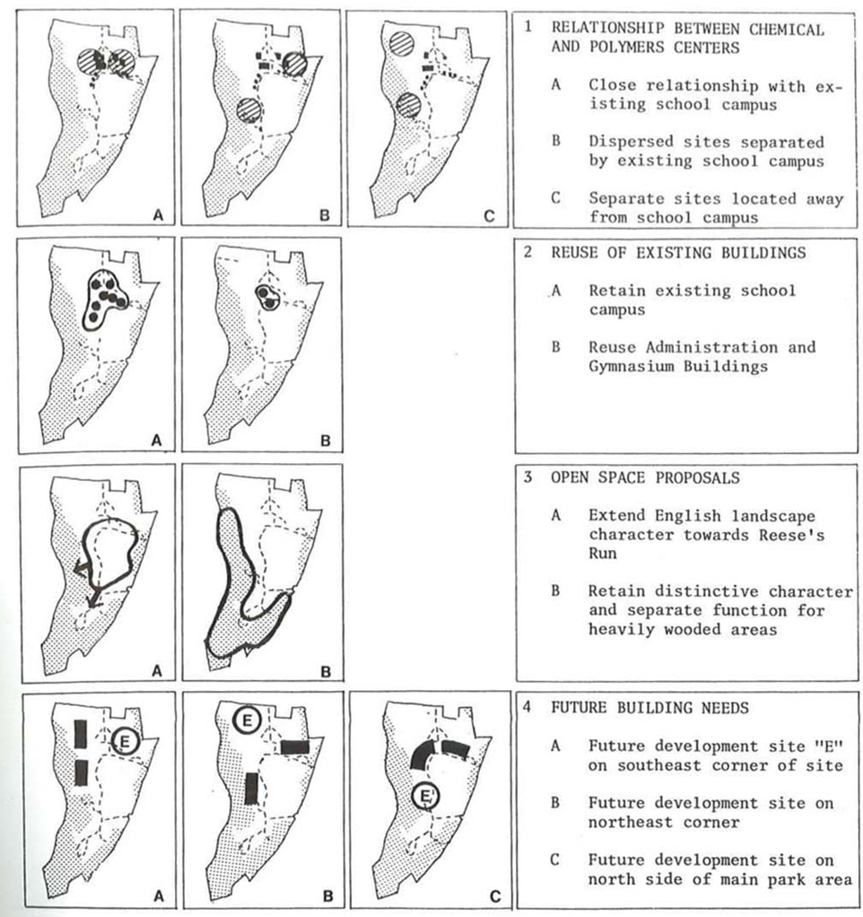
Assessing Site, Client & Program Developing Alternatives
Image Source: “Site Planning” by Lynch & Hack
Notes:
Once you’ve synthesized the opportunities & constraints of the site, needs of the clients & users, and the necessary function of the landscape, you can begin to develop design strategies. Occasionally useful to develop several alternatives to evaluate advantages/disadvantages of multiple approaches; clients appreciate choices. Multiple design team members can each come up with an approach and then compare results. With design team and client’s input, you can narrow to 1 option, or try synthesizing the best elements of several.
This is sometimes referred to as the conceptual diagramming phase.

Slide 35
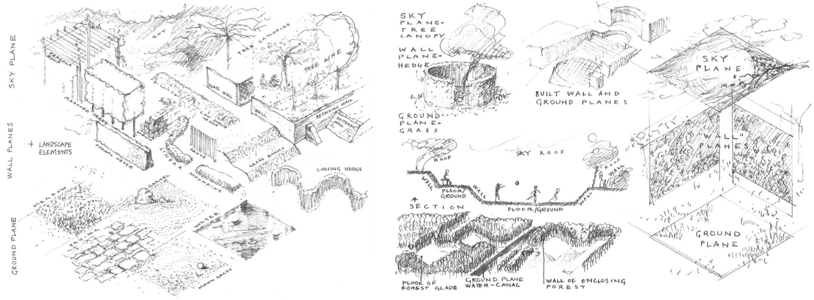
Designing Places Using Space to Inform Use, Improve Function & Create a Sense of Place
Image Source: “Form & Fabric in Landscape Architecture” by C. Dee
Notes:
After conceptually diagraming the basic organization of your site, consider appropriate spaces & forms that promote the use of the site. Think now about how the scale of plants relative to the scale of people, might help promote the concept you’ve chosen. What spaces promote the kind of functions and feelings your landscape seeks to achieve.
Consider major space-shaping elements: ground plane, wall planes (or vertical planes) and over-head or sky plane. How do these elements come together differently to create a sense of place.

Slide 36
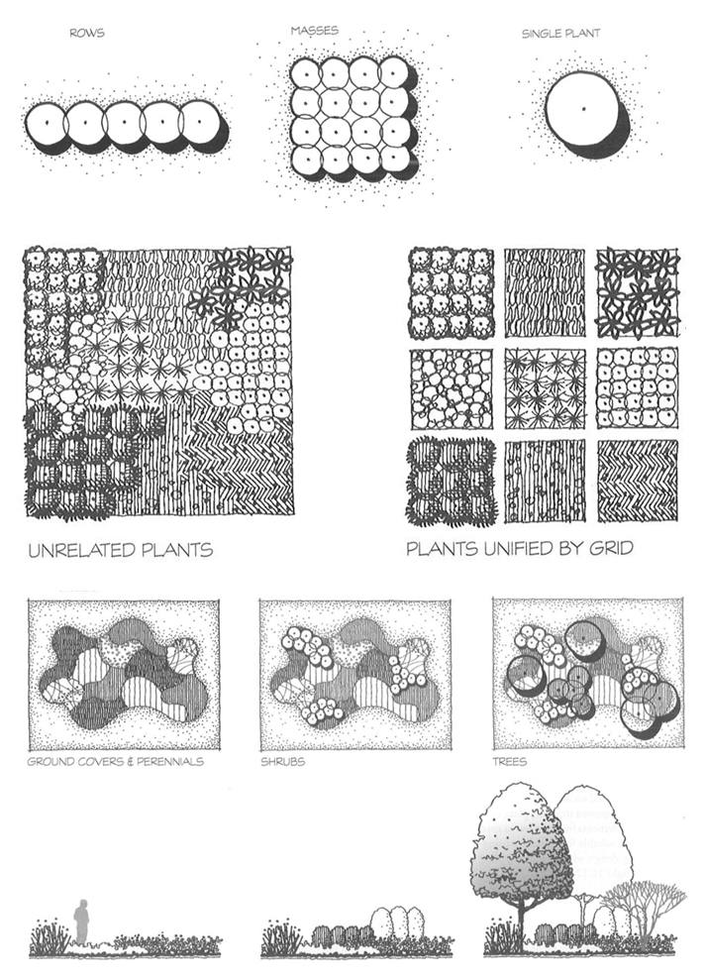
Designing Places: Using Plants to Define Space
Image Source: “Form & Fabric in Landscape Architecture” by C. Dee
Notes:
Consider how plants might create those spaces & forms.
When desiging with plants, often useful to think in layers. What 3 scales of plants that describe (ground plane, vertical planes, and overhead planes) the quality of space you are attempting to create. Remember to think not only 1-dimensionally from a plan or overhead view, but also to consider the vertical or sectional dimensions.

Slide 37
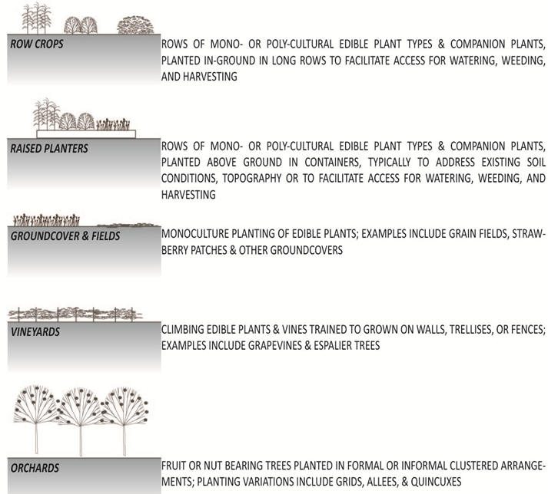
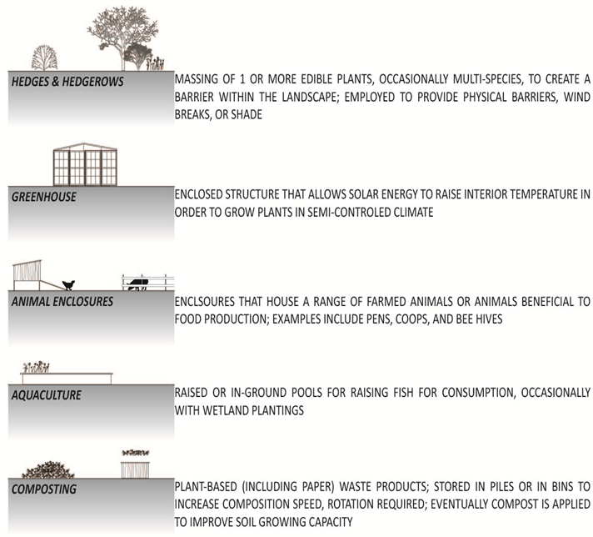
Edible Landscape Components: Recognizing Plant Forms & Symbiotic Design Opportunities
Image Source: C. Napawan
Notes:
Consider how those plants might be edible – perhaps not all, but some. Edibles landscapes have common basic forms.

Slide 38
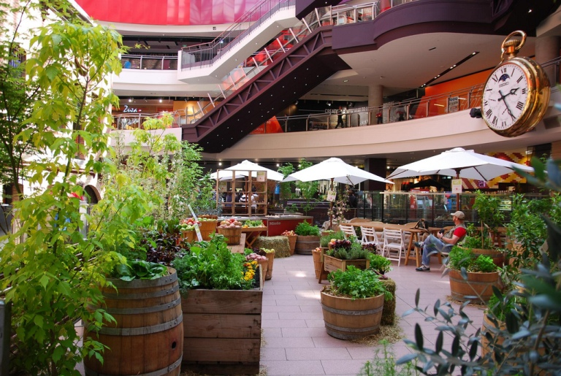


Container Planting
Image Source: C. Napawan
Notes:
Consider how container plants might be edible plants:
Container plants can transfer an interior landscape into an edible landscape and bring plants to otherwise small or constrained sites.

Slide 39





Carpets
Image Source: C. Napawan
Notes:
Consider how carpet planting might be edible plants:
Salad greens, herbs, and strawberries as ground cover plants

Slide 40




Walls
Image Source: C. Napawan
Notes:
Consider how walls & hedges might be edible plants:
Rosemary and Lavender as hedges.

Slide 41



Columns & Canopies
Image Source: C. Napawan
Notes:
Consider how columns & canopies might be edible plants:
Olives and citrus as canopy or ornamental trees.

Slide 42

Designing a Planting Palette Space-Making Through Edible Plants
Image Source: C. Napawan
Notes:
By understanding different plant types, layering them together, you can achieve a great number of spatial possibilities.

Slide 43




Designing a Planting Palette Potential Edible-Ornamental Plant Incompatibilities
apples & cedars: white pines & currants:
taxus (yew) hedges:
Image Sources: www.plantsystematics.org/ http://ohioline.osu.edu http://osufacts.okstate.edu
Notes:
but remember to consider functionality of plants as well as their forms. there are incompatibilities with some ornamentals & edibles that can cause pest problems such as the apple-cedar rust and the white pine blister rust. more details can be found on those and other edible-ornamental incompatibilities. taxus (yew) hedges are common ornamental hedges for residential foundation plantings. they produce toxic berries and should not be planted in an edible garden that might confuse individuals regarding edibility of plants.

Slide 44


Designing for Beauty A Garden Loved is a Garden that Lasts
Image Source: C. Napawan
Notes:
As well balancing the forms & function of edible plantings with the forms & function of the site needs, remember to consider aesthetics. Edible plantings sometimes have a bad reputation for looking ‘disorderly.’ Because many edibles are annual plants, they also can go through the seasonal shift: lush in the growing season, and barren other times.

Slide 45

UC Davis Good Life Garden
Image Source: C. Napawan
Notes:
But a strategy the takes into account seasonality & maintenance, alongside plant selection and space definition, can be a beautiful place year-round. Following this presentation you will hear more about specific plants & their maintenance needs.

Slide 46

Educational Role Shaping Space, Informing Use, and Changing Habits
Image Source: C. Napawan
Notes:
Aside from creating unique, productive, and beautiful places, edible landscapes can help change habits to encourage eating seasonally, eating locally, improving health & nutrition, reconnecting to natural environment, and…

Slide 47

Educational Role Food can build Community: Davis Farmer’s Market
Image Source: http://ucanr.org/
Notes:
Building community!

Slide 48
Thank you!
Questions? Claire Napawan ncnapawan@ucdavis.edu

