Slide 1
Edible Landscaping
Program made possible by ANR Competitive Grant and the Elvenia J. Slosson Endowment
Project Team: Pam Geisel, Mary Bianchi, Amanda Crump, Missy Gable, Linda Harris, Janet Hartin, Chuck Ingles, Claire Napawan, Loren, Oki, Scott Oneto, Dennis Pittenger, Sheryl Yamamoto

Slide 2
Edible Landscaping
Project Goals and Teaching Expectations
Amanda Crump and Pam Geisel

Slide 3
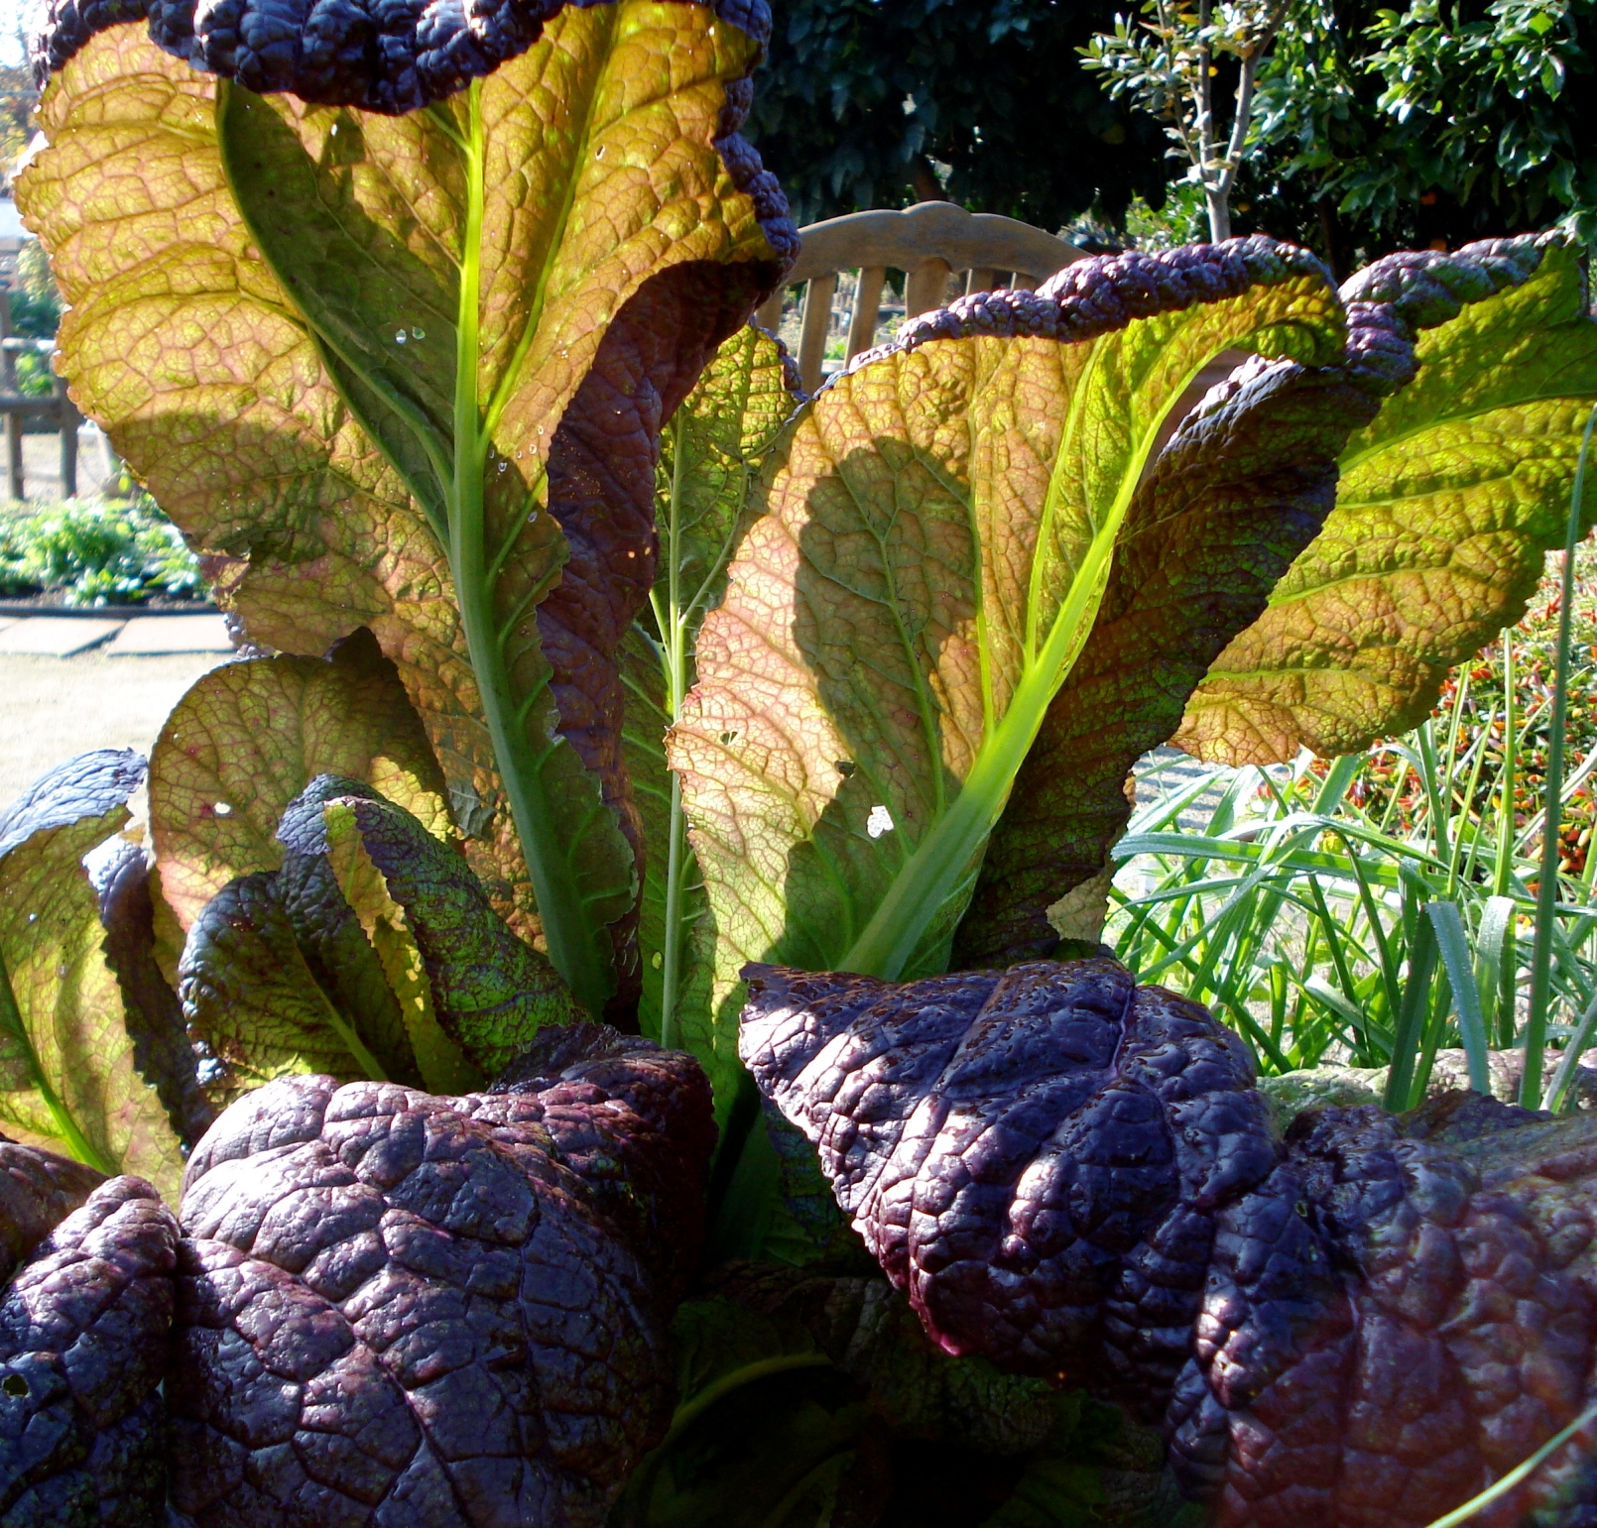
Photo: Bill Murphy, Fresno County MGs
Notes:
Thanks for coming! I would like to welcome the industry professionals in the room and I would like to welcome the Master Gardeners. I am a member of the statewide Master Gardener Advisory Board and once upon a time, I worked with the Master Gardeners of Fresno County. One of them took this photo.
I joined this team of edible landscape trainers because Pam and I are both interested in how gardening education makes an impact on Californians.

Slide 4
Objectives of this Edible Landscaping Train-the-Trainer Program
Develop edible landscaping materials
  Due out next year as an ANR publication
  Available to you after training
Deliver science-based curricula in edible landscape plants and practices
Educate the public via Master Gardeners
Understand how training impacts Californians
  Both the Master Gardeners and the people they train
Notes:
Our goals for this program are three-fold. First, we have gathered the materials needed to create a nice ANR publication on edible landscaping. You will see the components of it during the next two days. Second, we are using this train-the-trainer approach to enable you to answer the public’s questions about gardening. Finally, we hope to broaden our understanding of the impact of gardening education through the Master Gardener program.

Slide 5
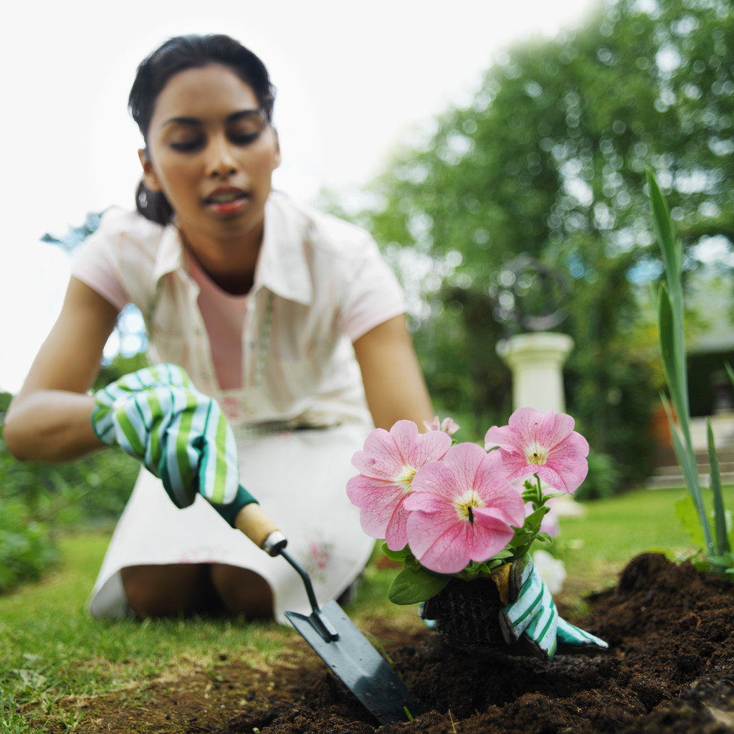
Why?
Notes:
Californians and gardeners throughout the country are interested in learning about their landscapes more than ever. You all know about the popularity of the White House garden, of course. But our interests in gardening in California are very broad and varied – much like our landscapes. We are also at a point in California where we have to be more sustainable, I believe.

Slide 6
Why train the trainer?
20, 42, and 77
Notes:
How many of you participated in our Sustainable Landscape Train-the-Trainer program or a subsequent sustainable landscaping training? Well, we surveyed the people who were trained by the Master Gardeners for one year to see how the training worked. Here’s what we found:
20% of the respondents revamped their irrigation methods and some removed their lawn. One told us that they reduced their lawn and subsequently reduced their water bill by two-thirds.
42% of the respondents decided to promote biodiversity by leaving portions of their garden undisturbed as a place for wildlife to live and prosper. This is significant in part because they recognized that wildlife was more important than a completely manicured landscape.
77% of the people who weren’t composting before the training started within three months. Can you imagine how much waste has been diverted from the landfill because of that?
We are hoping to repeat those results and do even better this time. We picked train the trainer because you are really the ones who understand your county needs best.

Slide 7

How?
Attend this training
Along with the other MGs from your county who attend, offer a training for the rest of the MGs in your county.
Train the public.
Help us with our survey by signing people up.

Slide 8
What is expected?
Work with your coordinator and MGs to decide what is needed in your county. These should be completed by March, 2013
  One day workshop?
  One hour workshop?
  Hands-on workshop in a demonstration garden?
  Series of workshops?
Decide how best to teach your county
  Hands-on?
  PowerPoint?
  Take home projects?
  Combination?

Slide 9
What will you get from this workshop?
An overview of the science we think is important for people to understand about edible landscaping
  Note that some of this will not be new to you but will be new to your clientele
Some examples of ways to teach this
  Group Project
  Turning Point
  PowerPoint
  Garden Tour

Slide 10
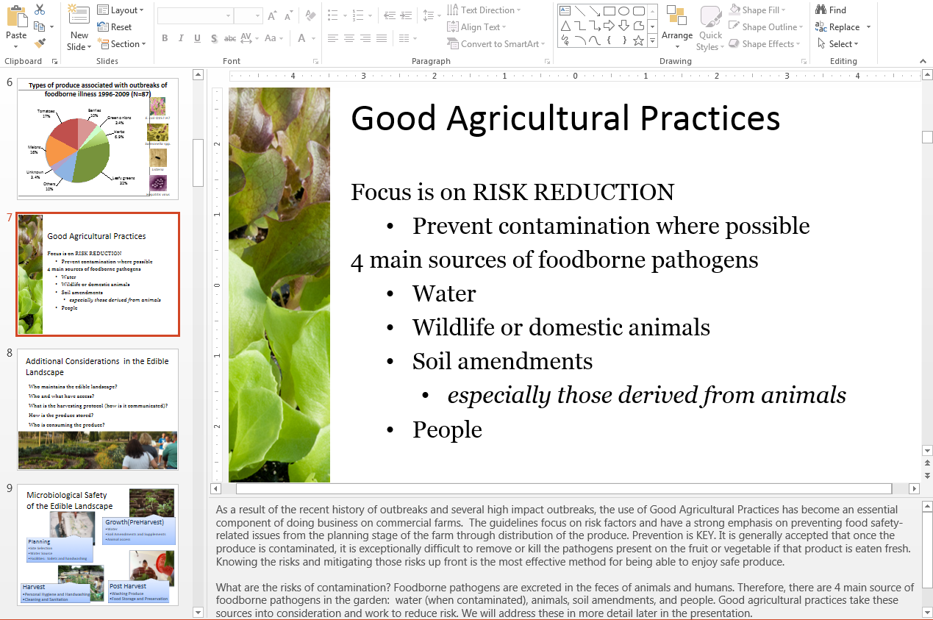
Notes:
This is an example of a PowerPoint. We’ve provided you with all of these powerpoints and photos and resources. In each powerpoint slide, we have detailed words.

Slide 11
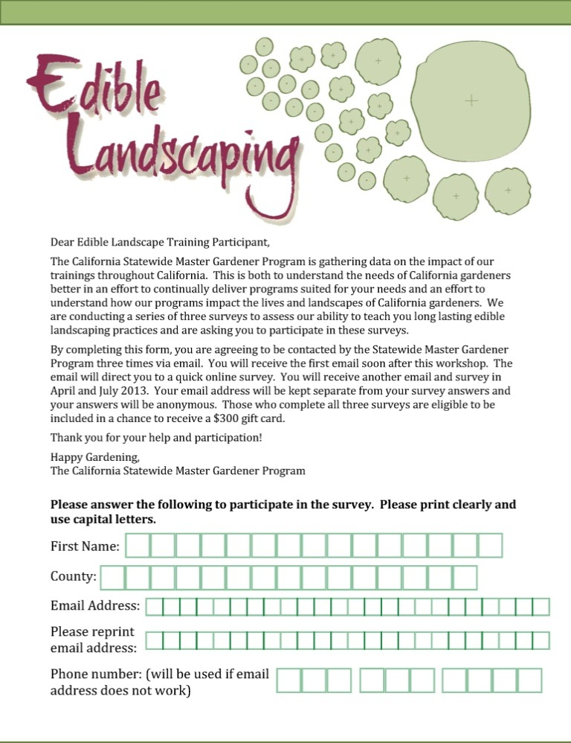
How do I recruit people for the survey?
Downloadable from repository
  Can send some to your county
Does everyone have to do the survey?
  No, it is voluntary to complete
Survey is anonymous.
Surveys will go out shortly after training, in April 2013 and July 2013.
Notes:
This is also downloadable and we will send you some if you need them (i.e. you don’t want to print them).

Slide 12
Thank you!
Questions?
Pam Geisel
pgeisel@ucanr.edu
Amanda Crump
acrump@ucdavis.edu
Notes:
3/2016: Pam Geisel is now retired.

