Slide 1

Collaborative Tools

Slide 2


What is Collaborative Tools? Collaborative Tools (CT) is a source for communicating information, staying in touch with workgroups and keeping current with ongoing projects.
Notes:
Collaborative Tools is a source for communicating information, staying in touch with workgroups and keeping current with ongoing projects. This is a user friendly, easy to navigate and very useful tool for communications or sharing of document and ideas.
Collaborative Tools is a private system, meaning only the people invited to join will have access to the discussions and the documents posted. Group members must log into the system in order to participate.
Any member can be made an administrator of the group, which allows access to discussion moderation, event creation and other features.

Slide 3
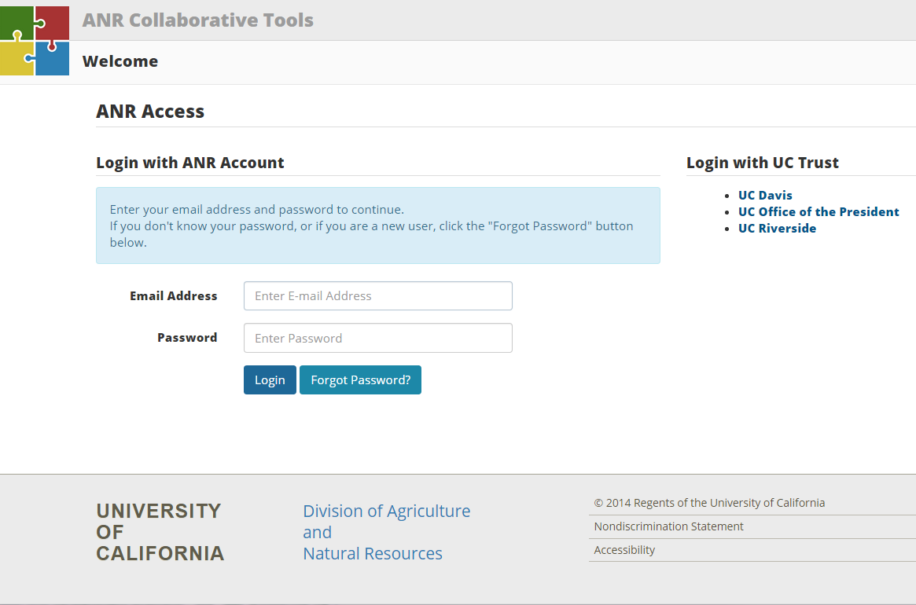
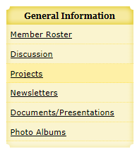
How do I access Collaborative Tools?
  Via the UC ANR Portal ucanr.edu/portal
  Via Collaborative Tools ucanr.org/collaborate/
  Via VMS >> General Information >> Discussion
Notes:
To enter Collaborative Tools, open your browser of choice.
There are two ways to get to Collaborative Tools:
1. The ANR Portal is located at http://ucanr.org/portal. After logging into the ANR Portal, select the group you would like to participate in. If you do not have any groups listed on your Portal, the link to Collaborative Tools will be in the right column under Useful Tools.
2. If you do not use the ANR Portal, go to http://ucanr.org/collaborate. If you are logging in without the Portal, you will come to a login page for Collaborative Tools. (Note: Not only does it log you into Collaborative Tools, it also logs you into the ANR Portal)
After logging into Collaborative Tools, you can visit your home page at any time.
This page allows you to create new discussion groups, go directly to existing discussion groups, manage your profile, and return to the ANR Portal.

Slide 4
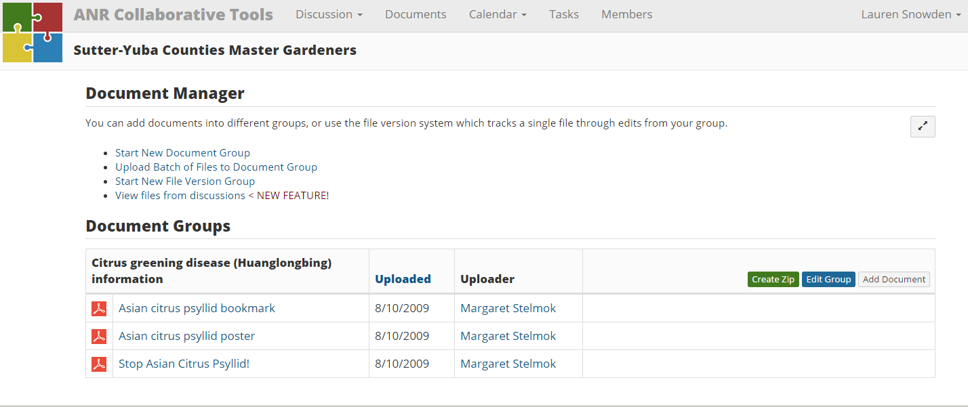
Once you have accessed the site…
Use Collaborative Tools to:
  Edit Your Profile
  Send a message or idea to the entire group
  Post Documents
Notes:
Once you have accessed the site you can use Collaborative Tools to:
Edit Your Profile
Send a message to the entire group
Post Documents
The screenshots are the Document Manager Page, where you can post or look at documents posted to Collaborative Tools and the Discussion List Page, where you can view, comment or start a discussions on Collaborative Tools.

Slide 5
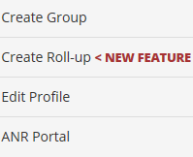
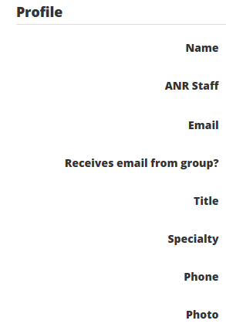
Editing Your Profile
On the right-hand side of the upper navigation bar, click your name and click Edit Profile.
Change your name, email, photo and other profile information.
You can also view your entire message history
Notes:
When first logging into Collaborative tools you will want to Edit your profile.
On the right-hand side of the upper navigation bar, click your name and click Edit Profile.
Change your name, email, photo and other profile information.
You can also view your entire message history

Slide 6
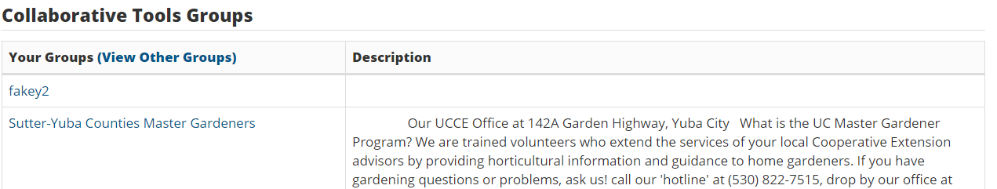
Groups
Users may have access to more than one group.
Before posting be sure to check what group you are in.
Notes:
Users may have access to more than one group. (e.g. UC Master Gardener El Dorado and UC Master Food Preserver El Dorado).
Before posting be sure to check what group you are in.
To determine what group you are in look to the right on the Collaborative Tools Puzzle Pieces. This screen shot shows you are in the Master Gardener Coordinators Collaborative Tools Group. To switch to a different group simply click the ANR Collaborative Tools located next to the Puzzle Pieces and you will be routed to a list view of the Collaborative Tools Groups you have access to. From this page you may access the group you would like to view and or post to.
NOTE: Only the administrator of a group can grant access or invite members to join. Administrators and owners are at the county level, not the statewide office.

Slide 7


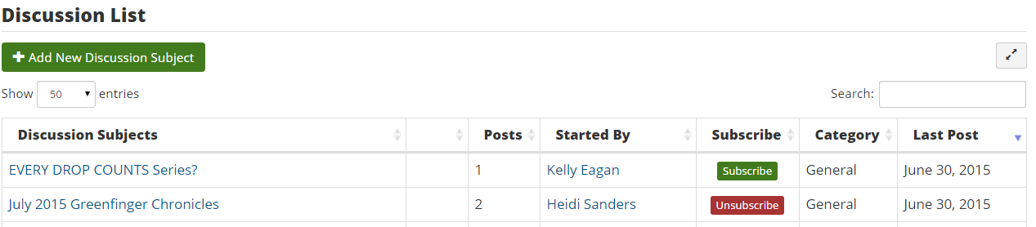
Posting- New or Existing
Option 1: Add a New
Discussion Topic:
Option 2: Add to an Existing Discussion:
Notes:
You have made sure you are in the correct group so now you are ready to post.
Option 1: Add a New Discussion Topic
Adding new messages is the most important function of Collaborative Tools. To begin a new discussion subject, click the "Add a New Discussion Subject" button.
Option 2: Add to an Existing Discussion
To add a message to a discussion subject that already exists, click into the subject and then click the "Add to discussion" button.
NOTE: You cannot edit a message once it is posted; however, moderators can delete individual messages from a discussion.

Slide 8
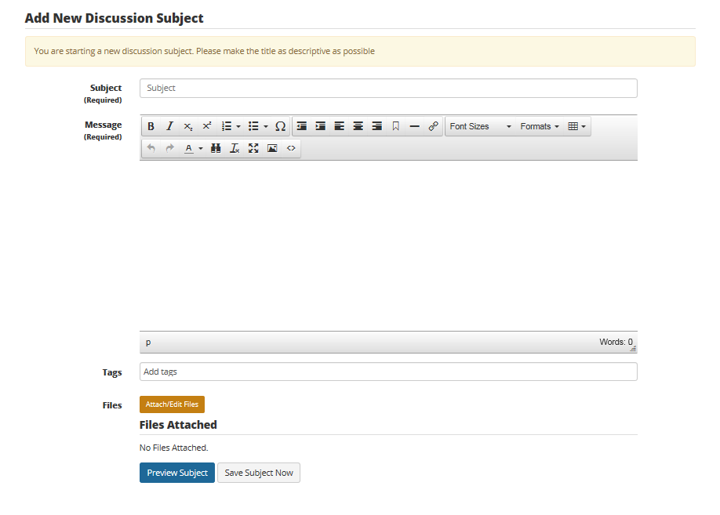

Adding a New Discussion
Once in your group, click Add New Discussion Subject to create a brand new discussion in the group
Notes:
This is good to use if you have a new topic or question that you would like to present. Everyone will receive a message that you have posted a new topic and can post feedback on this discussion board.
Fill out the form, and be sure to complete the required fields. Add any documents or photos to the subject message. Save it.
The subject has been added to the group, and emails have been delivered to all members of that Collaborative Tools group.
TAG IT: Discussions can be tagged. Tags are a useful way to group related posts and quickly tell readers what the discussion is about. Essentially tags are keywords used to classify content making it more searchable. Tags are generally chosen informally by the item’s creator.
On the Collaborative Tools Groups list, click your group name. This will take you to that group's Discussion List.
Click Add New Discussion Subject.
Enter a Subject.
In the Message box, type a message.
If you like, you may enter tag names in the Tags textbox. Tags will help organize your group's discussions.
Click Upload File if you'd like to include an attachment.
Click Preview Subject to read your post without posting to the Discussion List.
Click Save Subject Now to post your message to the Discussion List.

Slide 9
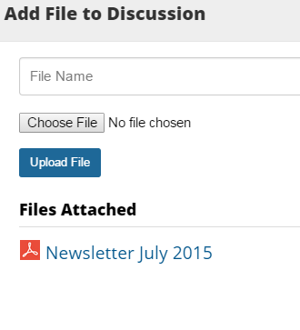
Adding a file
Click Attach/Edit File
Fill in the File Name or what you want the name of the document to appear as
Click Choose File and find the file on your computer
Once you have selected a file, click Upload File
After you have uploaded all the files click Close
Notes:
Adding a file to a discussion is simple and help effectively communicate information.
Click Attach/Edit File
Fill in the File Name or what you want the name of the document to appear as.
Click Choose File and find the file on your computer.
Once you have selected a file, click Upload File
After you have uploaded all the files click Close

Slide 10


Previewing Message
Once you have filled in all the fields you can preview your message to see what it will look like or you can click Add Message Now:
Collaborative Tools does have spell check:
Notes:
Once you have filled in all the fields you can preview your message to see what it will look like or you can click Add Message Now.
Collaborative Tools does have spell check. The red sguiggly line indicates that it is a misspelled word. To correct either retype or sampling right click the word for a pop of menu of suggested correctly spelled words.

Slide 11
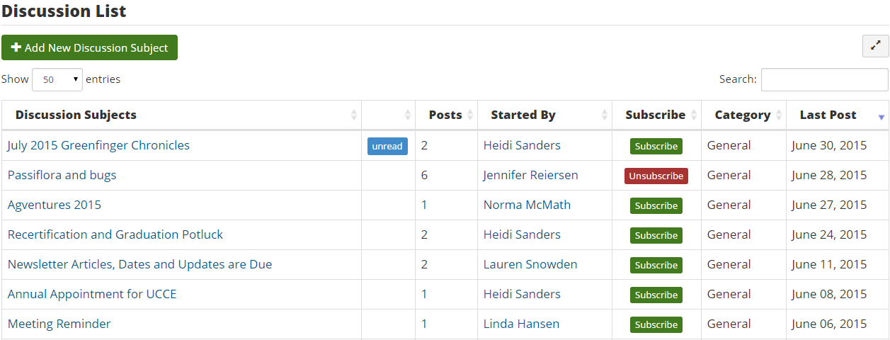
Discussion List
Notes:
Once you have added your message you can see it immediately on the Discussion List Page.

Slide 12
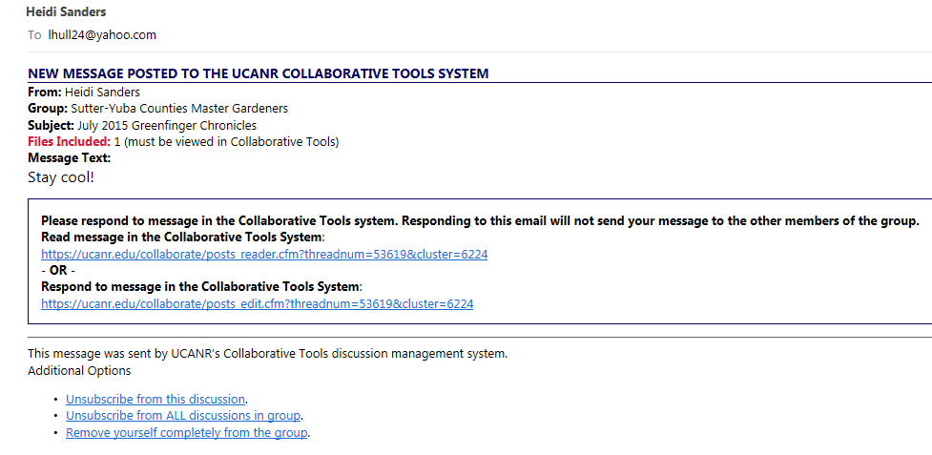
Email Messages
Notes:
When you post a new discussion or add to a discussion in Collaborative tools the system notifies everyone that is a part of that group letting them know something new has been posted.
This is a screenshot of Collaborative Tools Post Email after someone posted a New Discussion Topic. They also included a file.
The new message email is delivered every time a new subject is created or a message is added to a subject. It contains the text from the message, an indication if there are documents associated with the message, and two links back to Collaborative Tools.
One link goes to the message in Collaborative Tools, and the other link goes directly to a form so the member can respond to the message.
Members can manage the receipt of emails in two ways, either by unsubscribing to individual subjects, or turning off emails for the entire group.
To view the file or respond to the message you must go to Collaborative Tools. Do not click reply or reply to all in your e-mail.
The rest of the group will not get your message and it will not be posted to collaborative tools
Instead click on the blue link at the bottom of the message in the rectangle box and reply back in collaborative tools. If the user has already logged into the ANR Portal or Collaborative Tools, the emails with return links will give them one-click access into the group. If no log on is found, the user will be momentarily stopped and asked for a username and password. Once successfully logged in, they will be routed to the page initially requested.

Slide 13
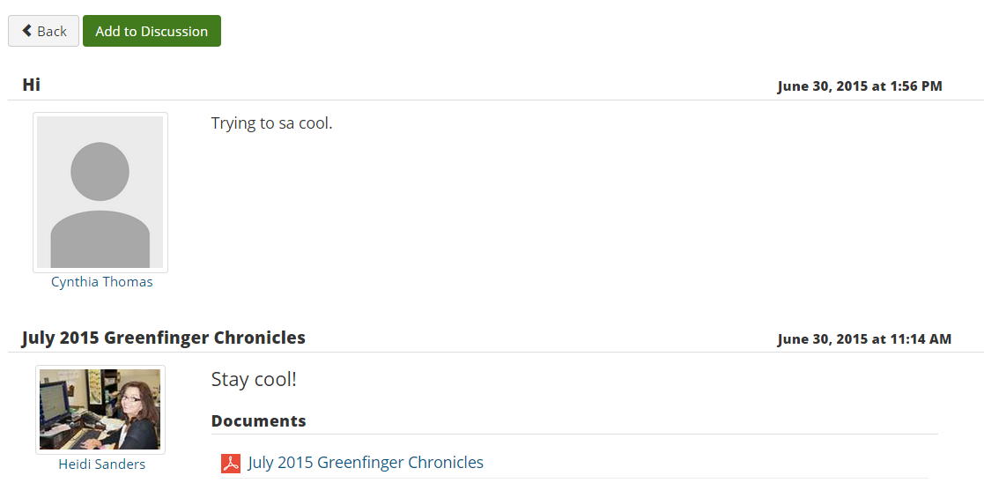
Discussion List
Notes:
From the Discussion List page select the Discussion subject you would like to respond to or post something about.

Slide 14
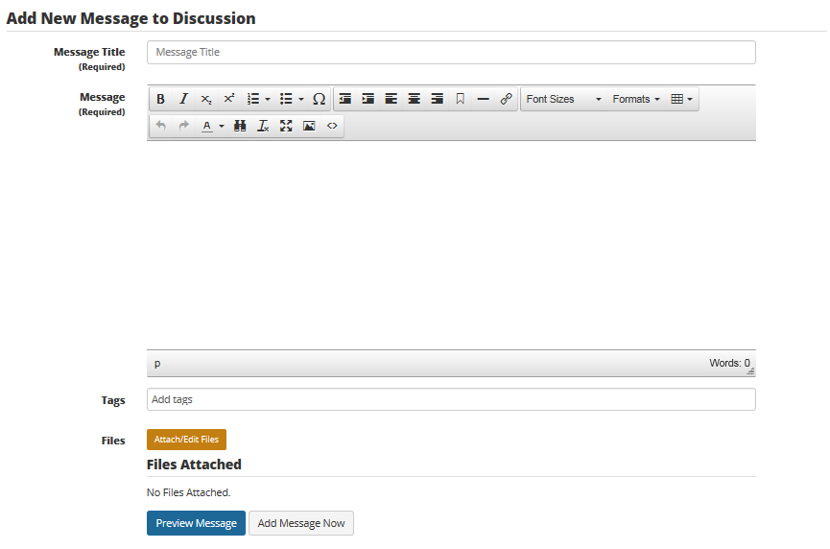
Adding to an Existing Discussion
Click Add to Discussion to respond or comment on that specific discussion
Notes:
Use this option to add to an existing discussion or respond to a question asked.
To add a message to a discussion subject that already exists, click into the subject and then click the "Add to discussion" button.
Complete the form, which is very similar to other one, and save your message. It is now posted, and emails have been delivered to the group's members.
From the General Discussion List, select the title of the discussion you wish to reply to.
Click Add to Discussion.
In the Message Title box, type a title.
In the Message box, type your message.
You may add tags to your message using the Tags textbox. Tags may help organize your posts.
Click Preview Subject to read your post without posting to the Discussion List.
Click Save Subject Now to post your message to the Discussion List.
Once your message has been posted, if you change your mind, you may click Delete to remove your message.

Slide 15
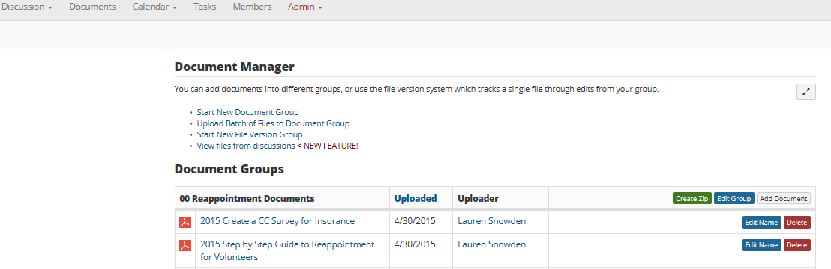
Posting Documents
Notes:
Collaborative Tools features a file management system, allowing you to store documents for your group and track versions of documents as they are developed.
The file system does NOT automatically send emails when documents are uploaded. You must create a message to alert your group members that the files are uploaded if you want to let them know.
Go to the Collaborative Tools homepage.
Under the Collaborative Tools Groups list, click your group name.
In the top navigation bar, click Documents
Add a Document to an Existing Document Group
Click Add Document.
Enter a name for your file in the File Name textbox.
Click Browse and navigate to the file you wish to upload.
Click Upload.

Slide 16
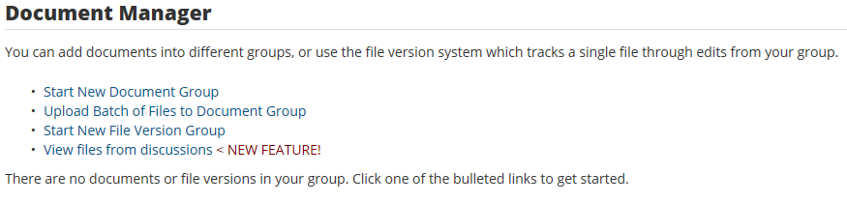
Document Upload Options
Notes:
Document Group- Creates a Group or File for the individual documents to be grouped in.
Click "Documents" to enter the file management system.
You have three main options: Start Document Group, Upload Batch of Files to Document Group and Start New File Version Group.
Click 'Start Document Group' to upload general files to your group. You will need to name the group, the file, and find the file on your computer to begin.
Once the group is created, you can continue to add files to it, edit the group name, or delete the group.
Click 'Upload Batch of Files to Document Group' to upload many files at once. You must upload a zip file with your documents to use the batch uploader.
Collaborative Tools will expand your zip file and import all of the documents and images inside of it. It use the original name of the file, so be sure to name all of your documents accurately prior to uploading the zip file.
Click 'Start New File Version Group' to begin a new version group. The version groups will track different versions of the same document as you develop it. This is useful for authors contributing to a single article and administrators developing division documents. Once you've uploaded the initial version, you will be able to upload new versions of the document.

Slide 17
Collaborative Tools Etiquette
Be respectful of the rights and opinions of others. Be willing to agree to disagree and move on
Stay on topic
Be transparent and honest
Add value: Be part of the conversation, but don’t take it over
Avoid hateful speech, personal attacks, flaming, profanity, vulgarity and abusive language
Keep private contact information (e.g. home phone number, address) out of your posts.

Slide 18
Questions?
Contact: Enter Contact Information Here

