Slide 1
Landscaping and Home Design for Wildfire Defense
Presented by UCCE Master Gardeners of [NAME]County
August 24, 2015
Content Credit: Yana Valachovic, UCCE Forest Advisor & County Director - Humboldt and Del Norte
Robin Stanley, UCCE Master Gardener of El Dorado County
Steve Quarles, UCCE Advisor Emeritus
Notes:
** Before giving presentation – please watch the original presentation from Yana Valachovic for information and details that pertain to these slides, LINK: https://uc-d.adobeconnect.com/_a841422360/p72wo3t2hjc/?launcher=false&fcsContent=true&pbMode=normal **. Questions? Contact the UC Master Gardener Program statewide office, mg.ucanr.edu

Slide 2
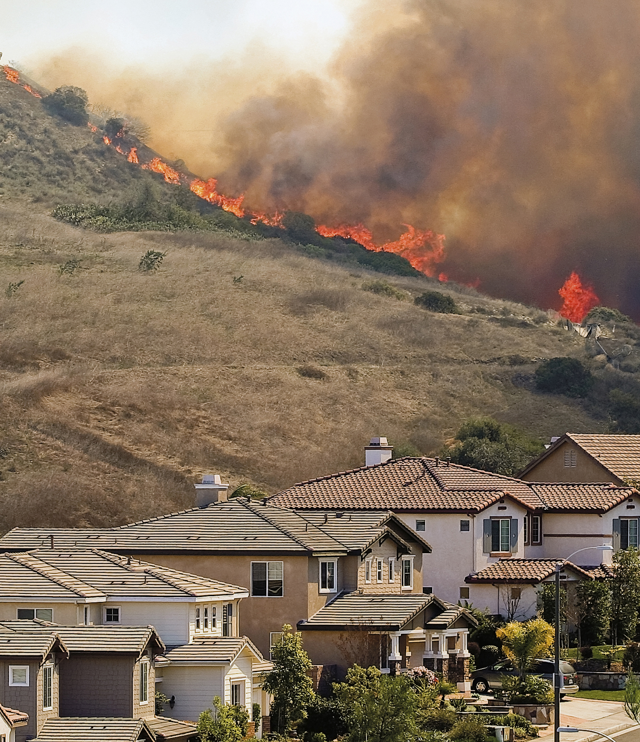
Table of Contents:
Wildfire context
How homes burn from wildfire
Defensible space
Interaction between the vegetation, landscaping and home condition
Resources

Slide 3
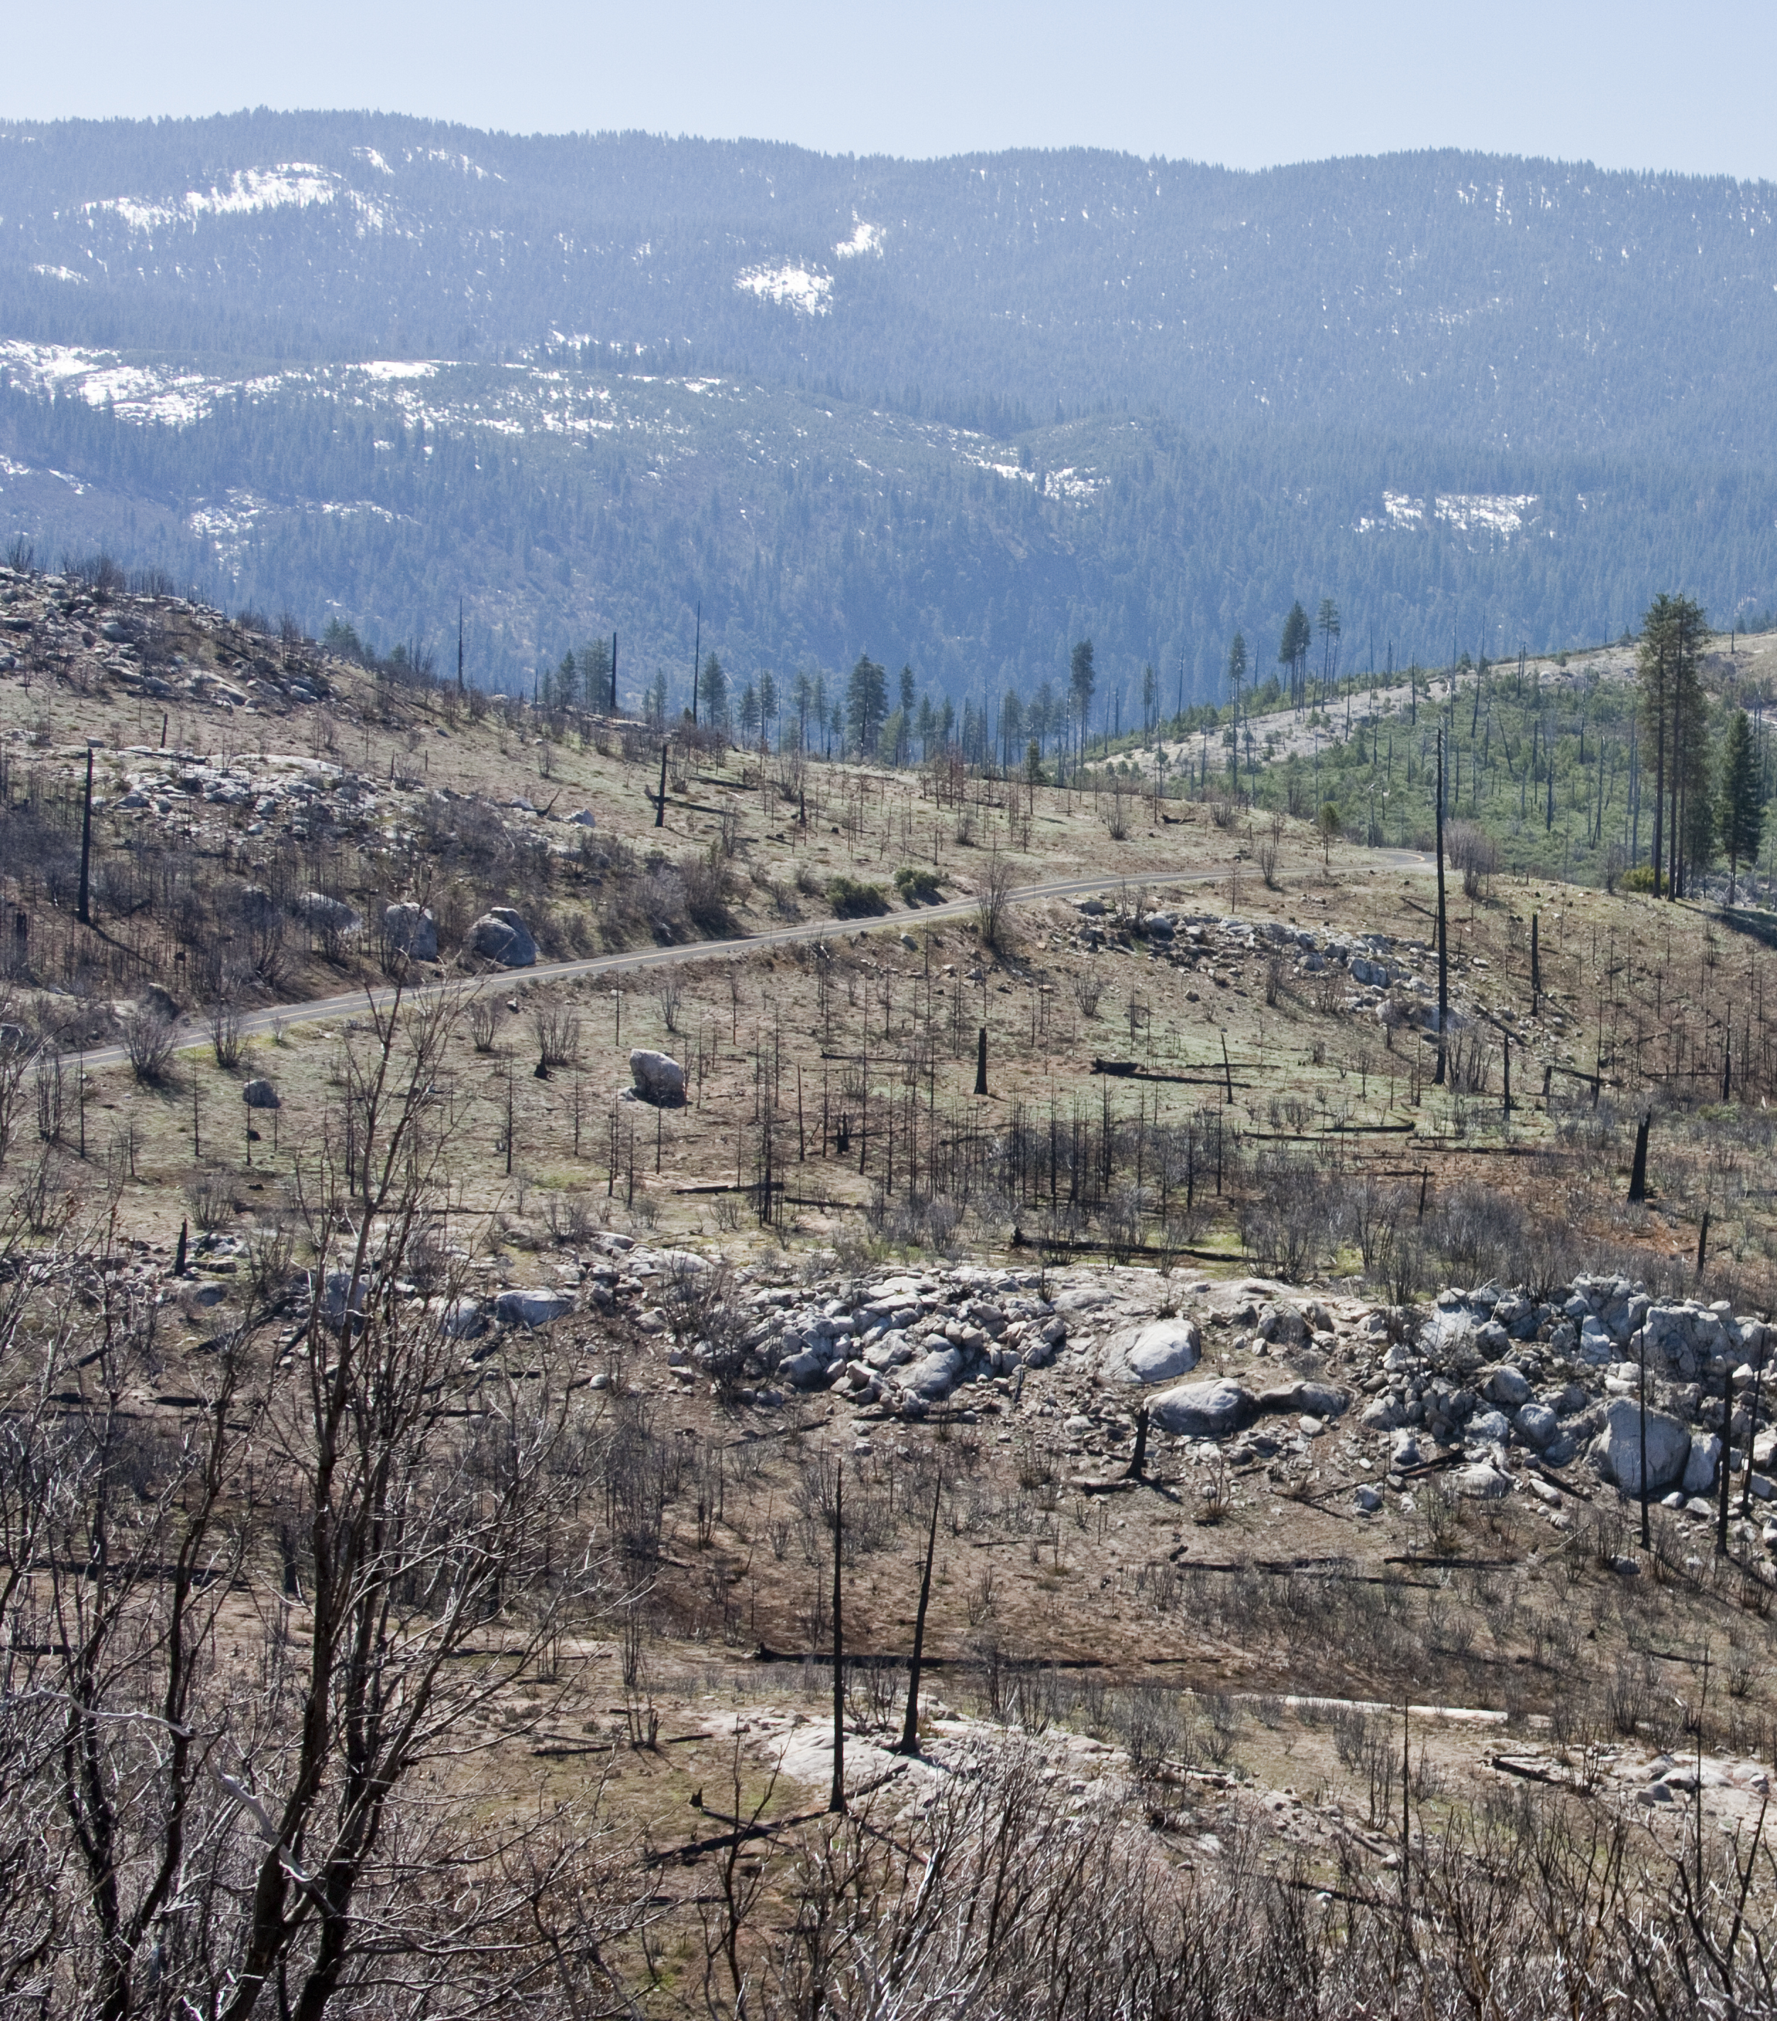
Wildfire is important!
Some plant species need fire to germinate, establish or reproduce
Keeps forests and rangelands open
Maintains oak woodlands
Can promote wildlife habitat
Removes fuels to reduce the occurrence of high intensity wildfire
Photo credit: Michael Poe, UC ANR
Notes:
NOTES: Yosemite National Park wildfire damage

Slide 4
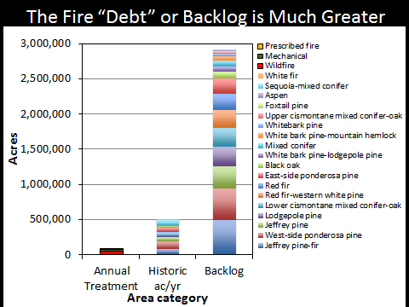
Fuels are growing faster than we are treating them …
Graphic courtesy of Malcom North (USDA Forest Service)

Slide 5
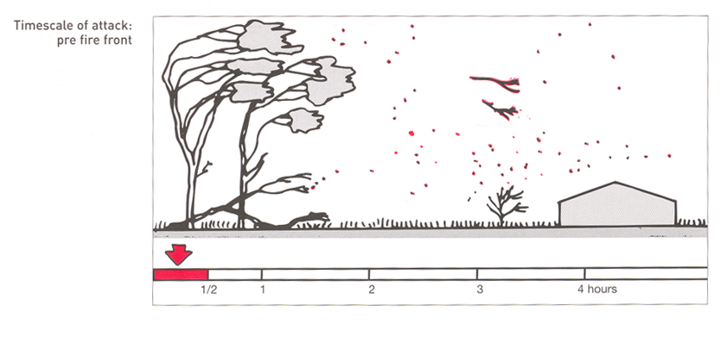
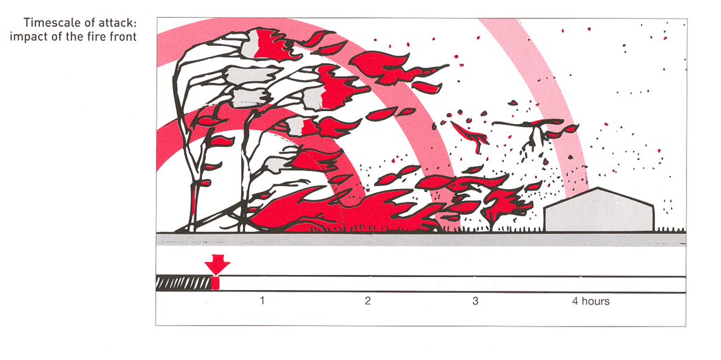
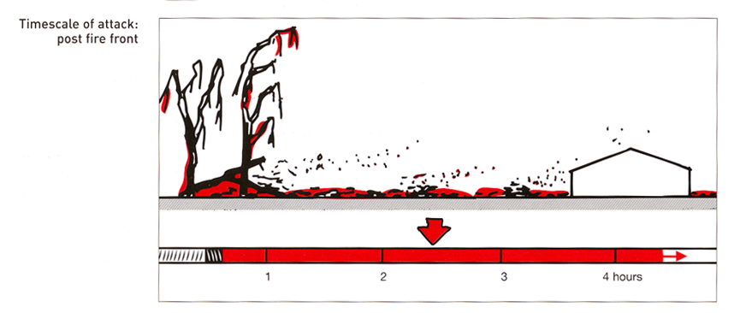
Stages of wildfire
Photo credit: Landscape and Building Design for Bushfire Areas. Ramsay & Rudolph, CSIRO
Notes:
A building will be exposed to the main flame front of a wildfire for a relatively short period of time – 5 to 10 minutes at the most.
2. / 3. A building will be exposed to pre- and post-fire for a much longer time.

Slide 6
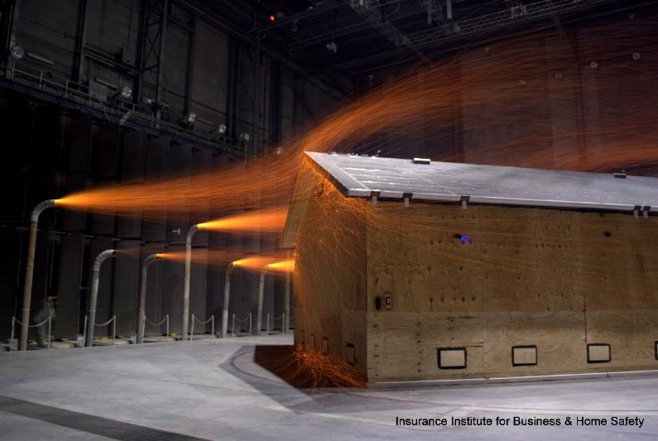
How does a house burn from wildfire?
Ember / Firebrand
Photo credit: Insurance Institute for Business and Home Safety
Notes:
A house can burn from any of these types of exposures:
ember/firebrand
Radiant heat
Flame contact

Slide 7
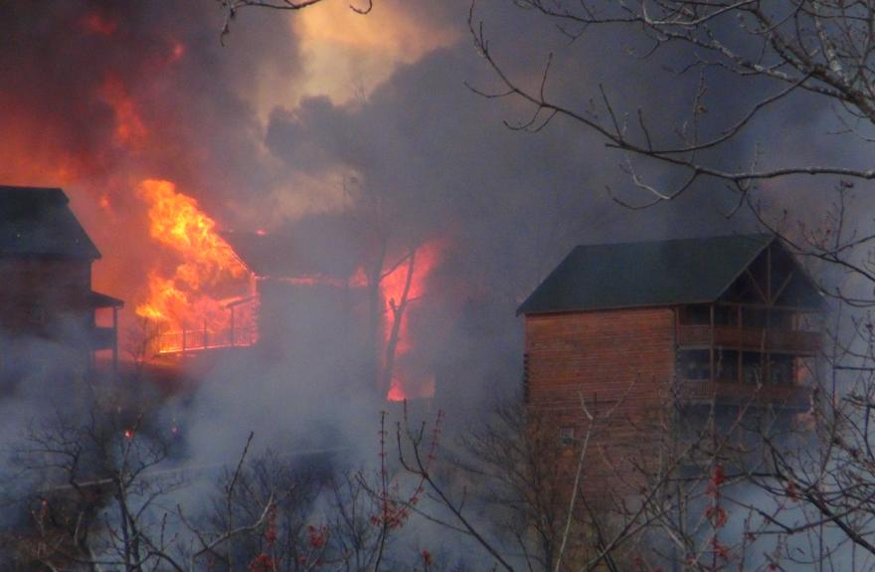
How does a house burn from wildfire?
Ember / Firebrand
Radiant Heat
Photo credit: Tennessee Division of Forestry
Notes:
A house can burn from any of these types of exposures:
ember/firebrand
Radiant heat
Flame contact

Slide 8
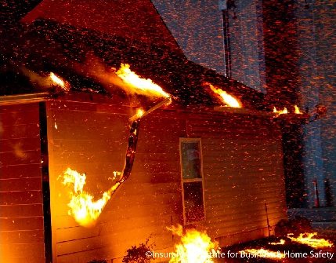
How does a house burn from wildfire?
Flame Contact
Flame Contact
Photo credit: Insurance Institute for Business and Home Safety
Notes:
A house can burn from any of these types of exposures:
ember/firebrand
Radiant heat
Flame contact

Slide 9
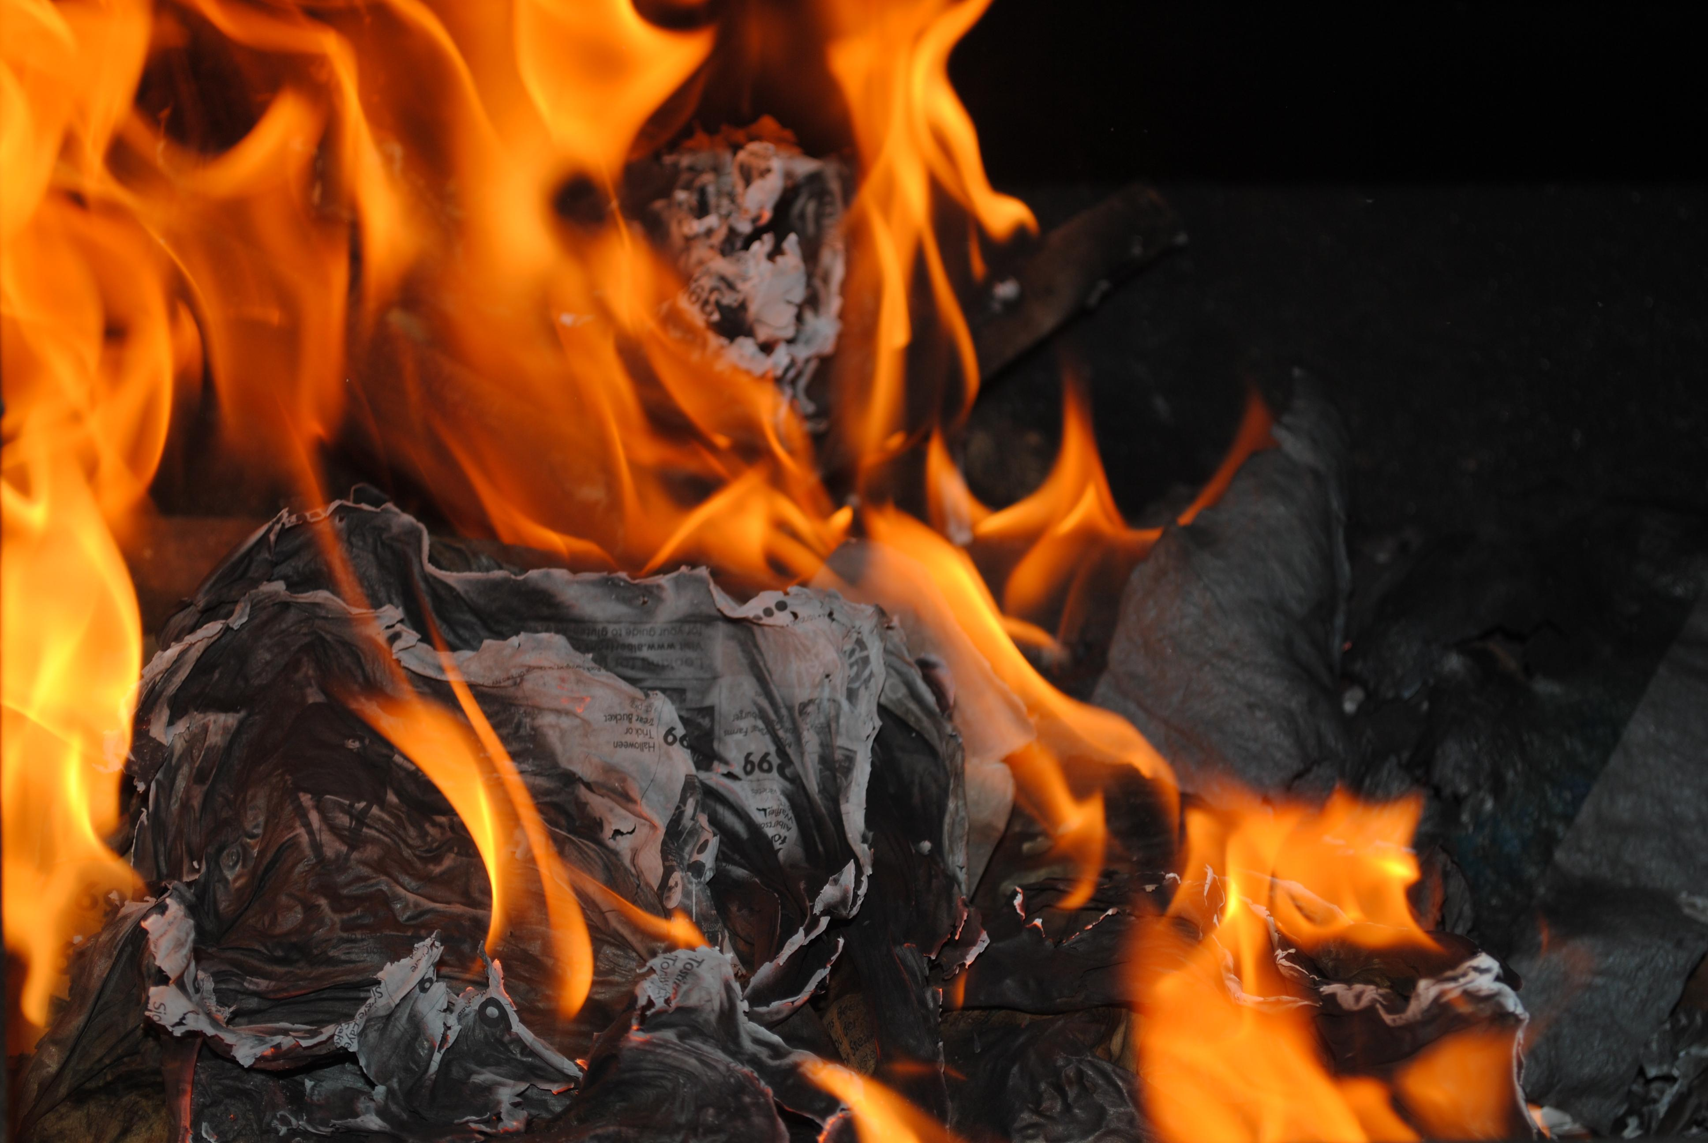
Know the basics of fire:
Fuel + Oxygen + Heat = Fire
Which of these three can you control?
Fuel is… anything that will burn
Dry or dead vegetation
Wood siding, roofing, fencing
Trees
Woody shrubs or perennials
Landscape mulch
Photo credit: MorgueFile.com – 46birds

Slide 10
The fuel challenge …
Long-distant embers can ignite fuel on your house
Ground fire can approach your house
We’ll focus on landscape fuel issues first, and house vulnerabilities second.

Slide 11
California Law (2008)
State law extended the defensible space around your home from 30 to 100 feet. This doesn’t sound like much, just 70’, but compare the area:
area with 30’ clearance = 2,826 ft²
vs.
area with 100’ clearance = 31,400 ft²
11X MORE AREA!

Slide 12
Flame Contact
Photo Credit: CAL FIRE
Notes:
Defensible space zone (30 feet)

Slide 13
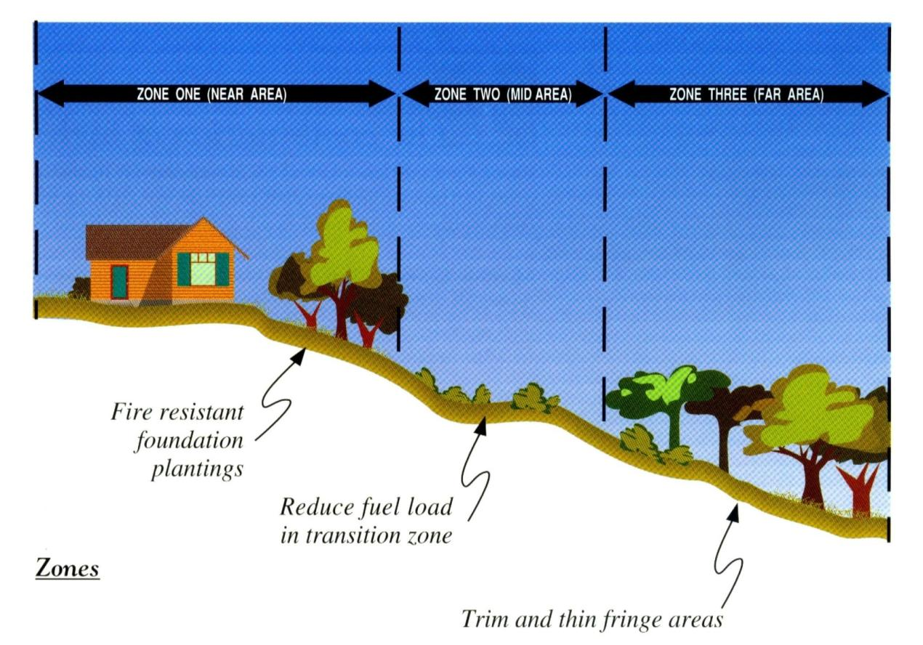
Understand the zones …

Slide 14
What does the law say?
Zone spacing depends on the slope, height of vegetation and fire risk:
Steeper slope = more spacing
Taller vegetation = more spacing
More fire prone = more spacing
Identify your two zones:
0 - 30 feet - Defensible Space Zone
30 - 100 feet - Reduced Fuel Zone

Slide 15
Spacing
6 ft to 20 ft. depending on slope and vegetation size/type (2x)
x
2 X
x
30 ft. or more
depending on slope and vegetation type and size
10 ft. to 30 ft.
depending on slope and vegetation type and size
Over 40%
6 x
x
20-40% slope
4 x

Slide 16
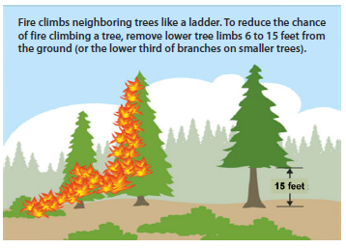
Eliminate fuel ladders

Slide 17
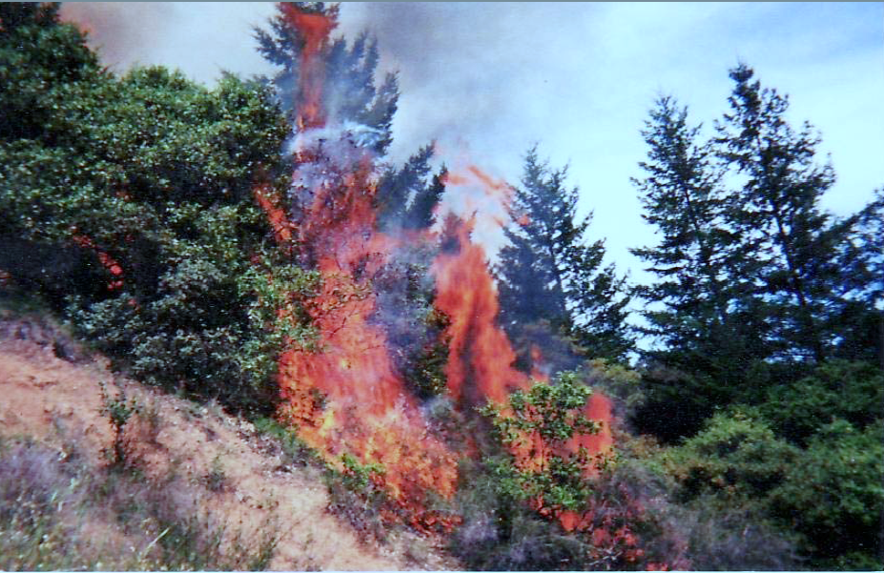
Photo credit: UCCE Master Gardeners of El Dorado County

Slide 18
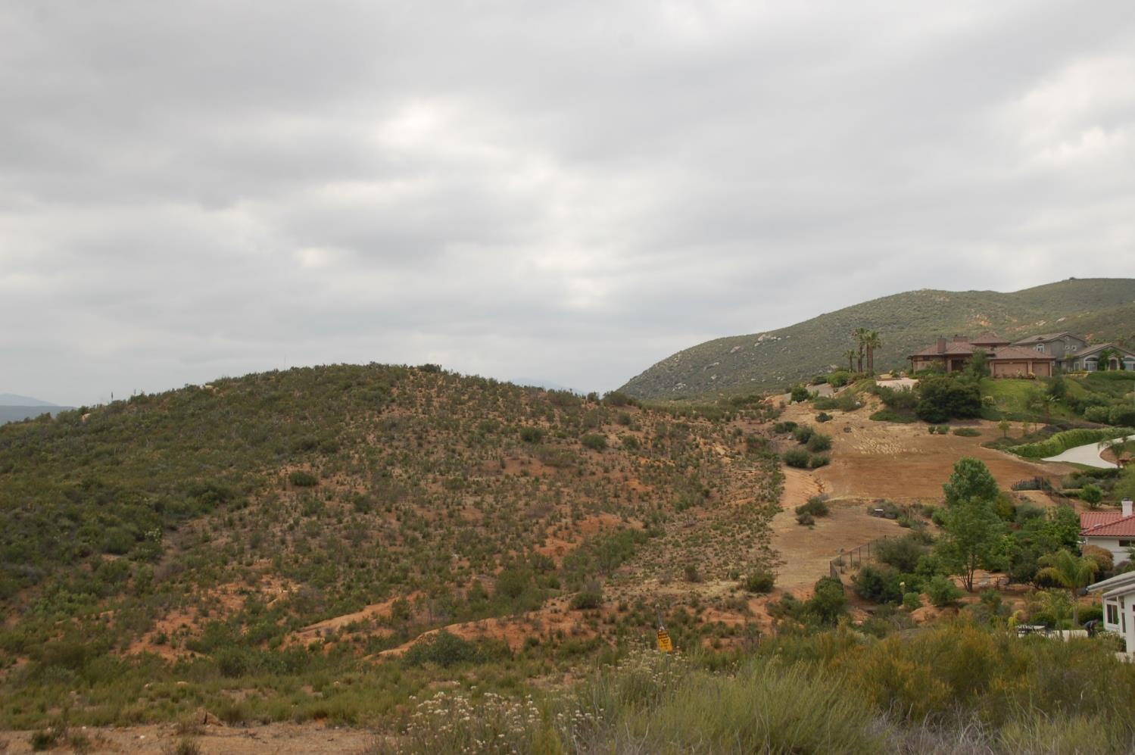
Photo credit: Insurance Institute for Business and Home Safety

Slide 19
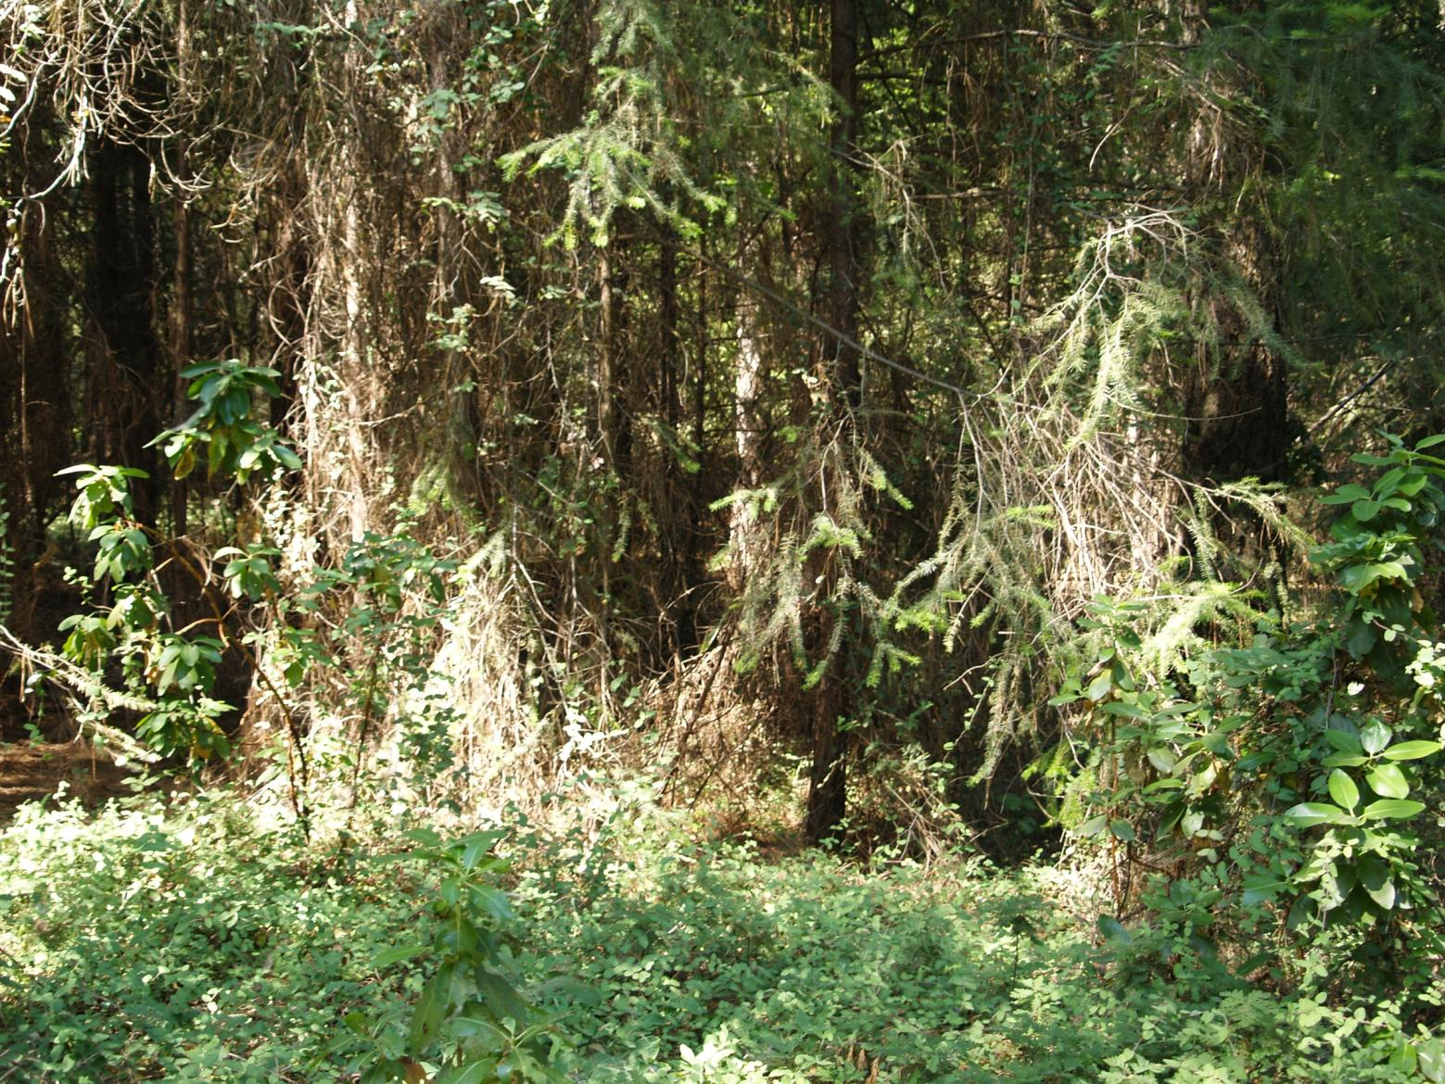
Photo credit: UCCE Master Gardeners of El Dorado County

Slide 20
Photo credit: UCCE Master Gardeners of El Dorado County

Slide 21
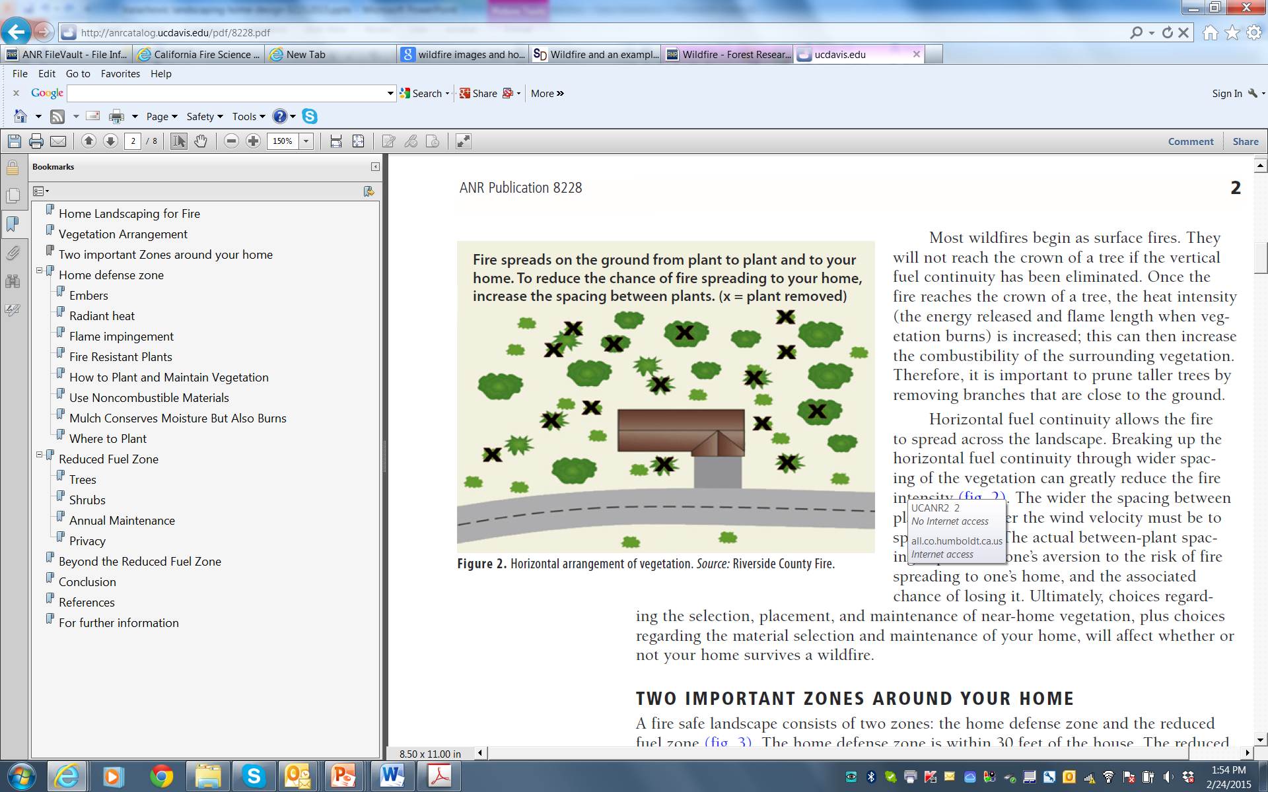
Home defense zone

Slide 22
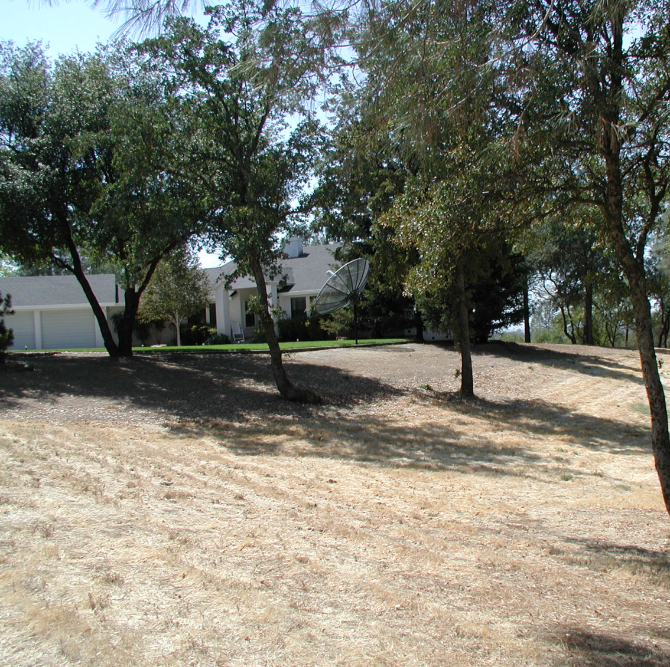
Thin and separate
Create islands
Cut grass
Favor trees away from the house
Photo credit: UCCE Master Gardeners of El Dorado County

Slide 23
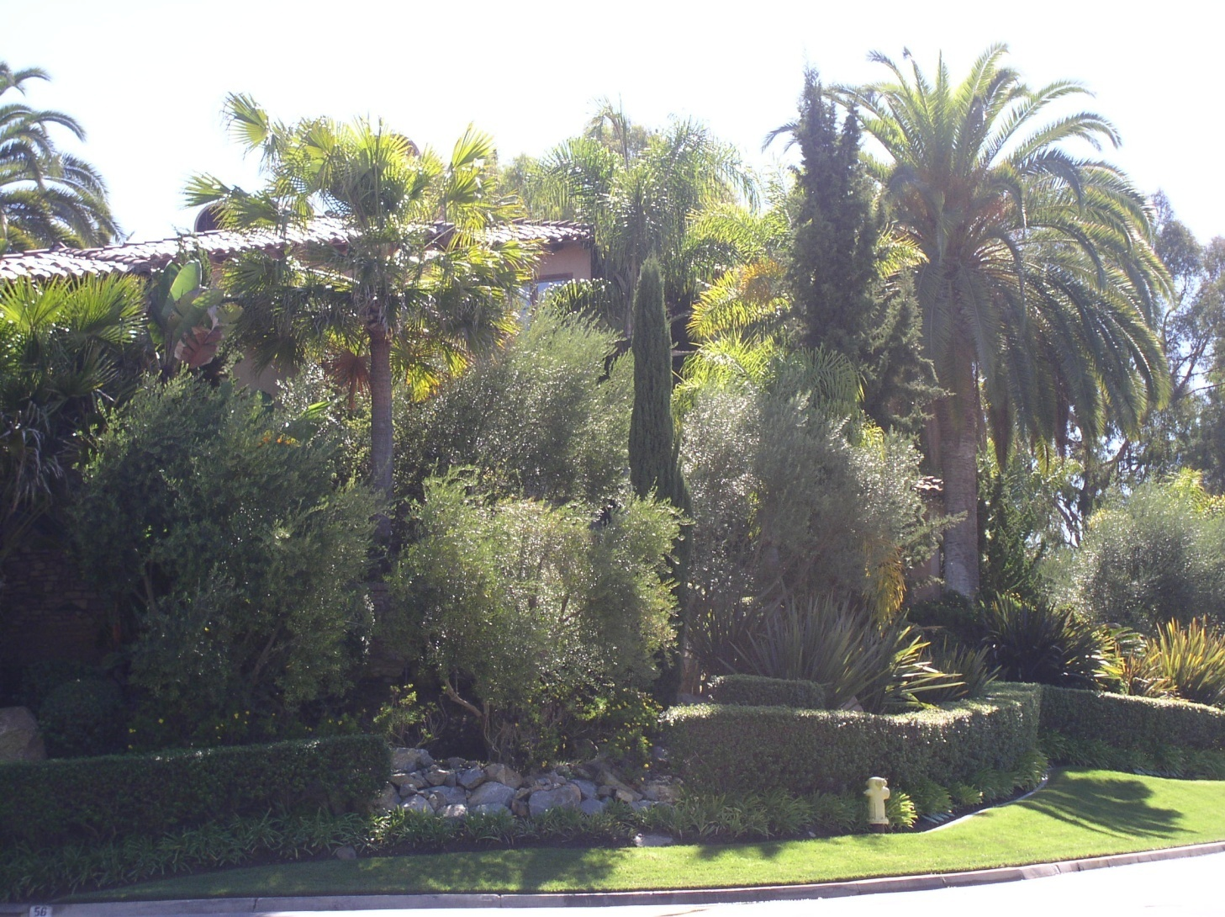
DON’T overplant!
Photo credit: Rancho Santa Fe Fire Protection District

Slide 24
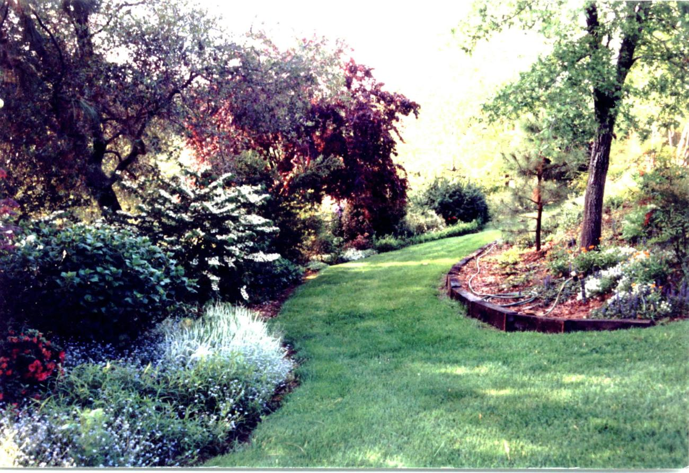
Incorporate a fuel mosaic
Photo credit: UCCE Master Gardeners of El Dorado County

Slide 25
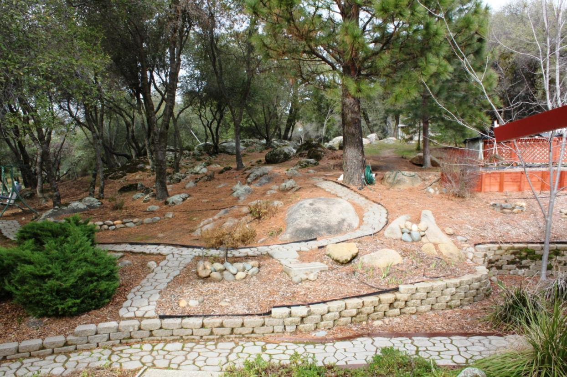
Incorporate nature and hardscape
Photo credit: UCCE Master Gardeners of El Dorado County

Slide 26
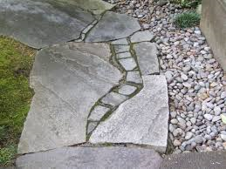
Consider hardscape
Photo credit: UCCE Master Gardeners of El Dorado County

Slide 27
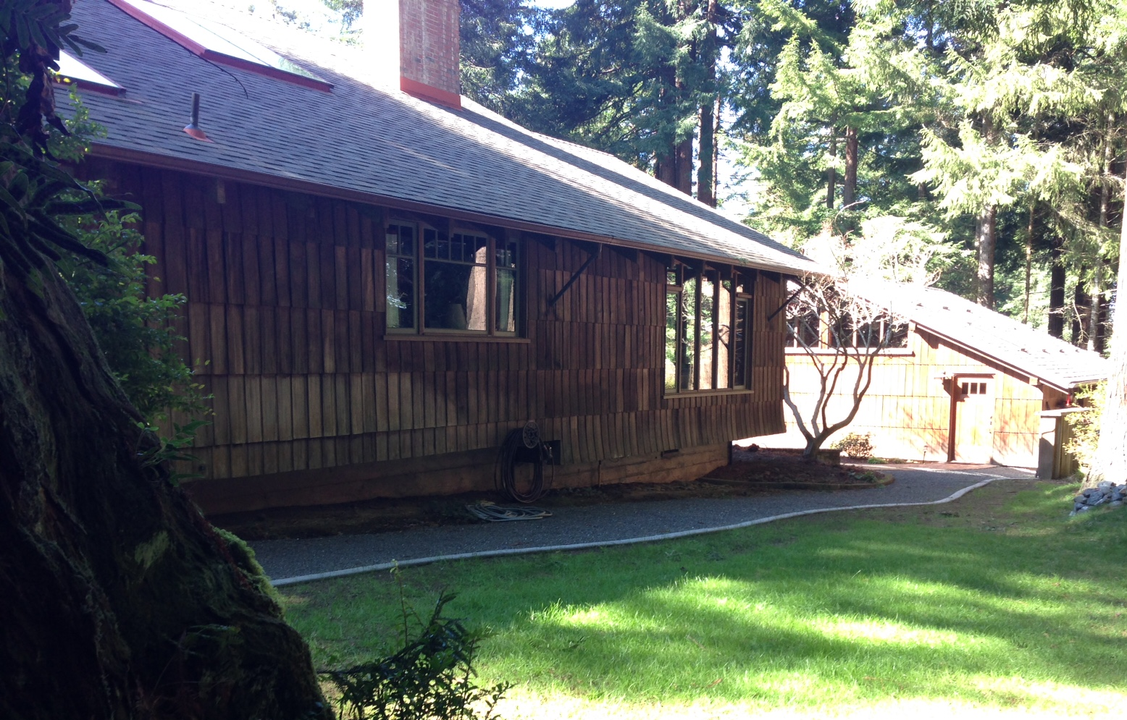
Separate vegetation from the house

Slide 28
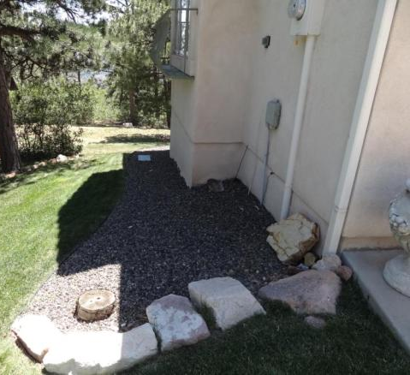
0 - 5 feet “noncombustible zone” to reduce chance of flame contact exposure
Photo credit: Insurance Institute for Business and Home Safety
Notes:
BACK of home – appropriate defensible space around house

Slide 29
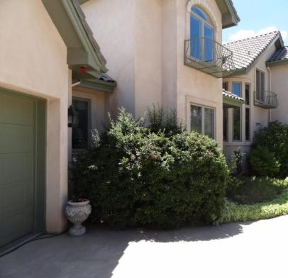
Effective defensible space must be present on all sides of the home
Photo credit: Insurance Institute for Business and Home Safety
Notes:
FRONT of home – does not have accurate defensible space

Slide 30
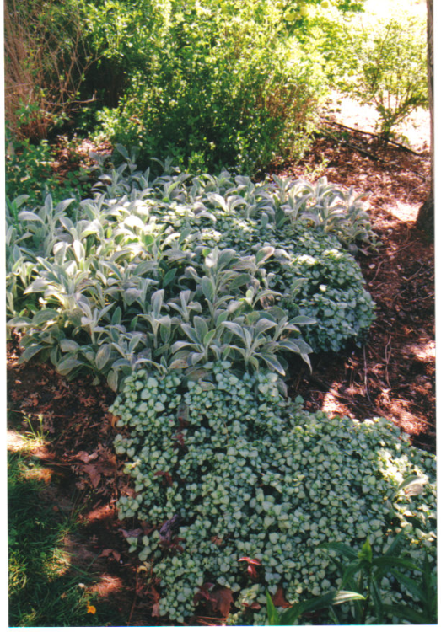
Near the house, keep it green and healthy
… but don’t forget to conserve water!
Photo credit: UCCE Master Gardeners of El Dorado County

Slide 31
Fire resistant plant lists?
All plants can burn regardless of how they are marketed
Fire safe landscaping requires maintenance (pruning, irrigation, clean-up)
Select low growing, open structured, less resinous, higher moisture content plants
Native and drought tolerant plants can be options, if maintained well

Slide 32
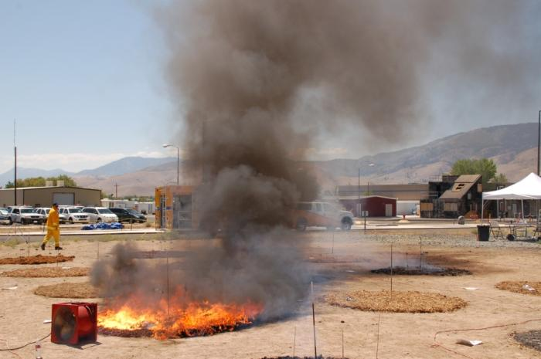
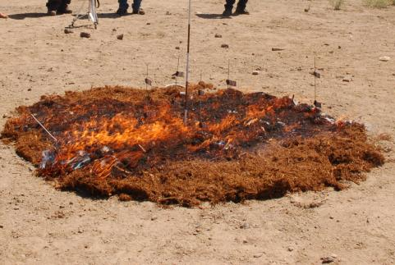
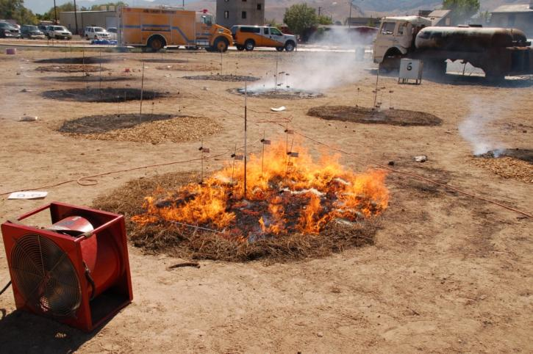
Bark mulch
Rubber mulch
Pine needle mulch
Mulch helps plants retain moisture, but it will burn too!
Use hardscape, rock mulch or lawns < 5 feet from the home.
Photo credit: University of California Cooperative Extension

Slide 33
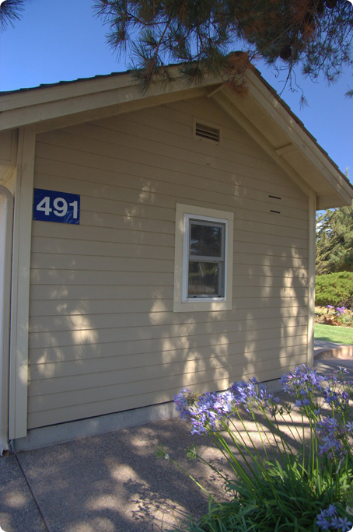
Where to not plant
Under vents and eaves
Adjacent to siding
Under or near decks
Inside corners

Slide 34
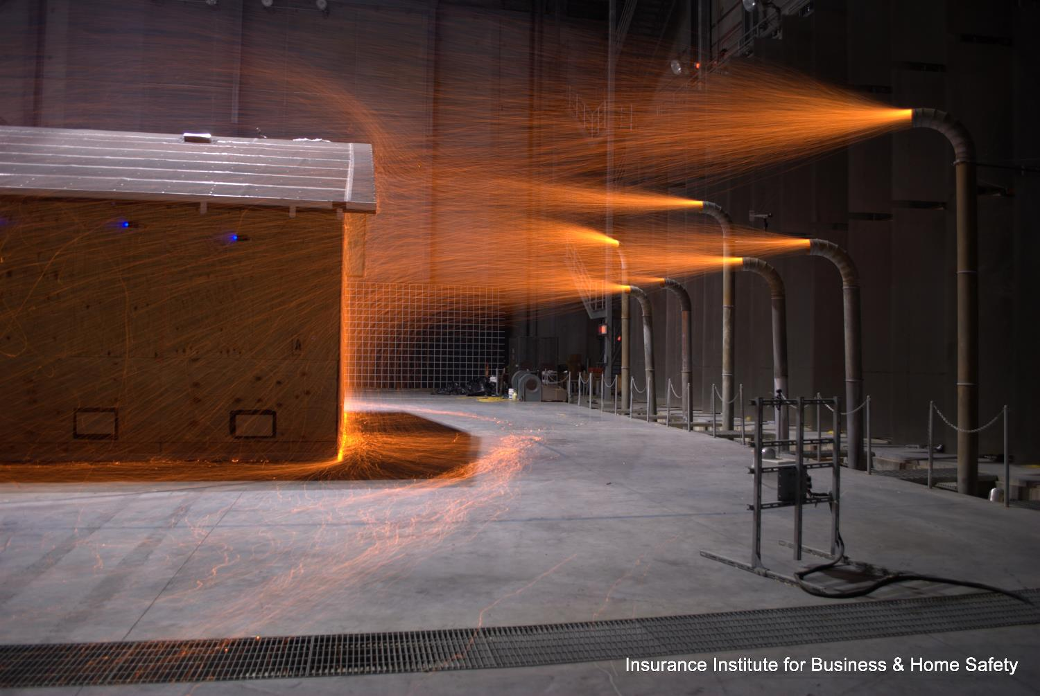
Simulated embers exposure on a house

Slide 35
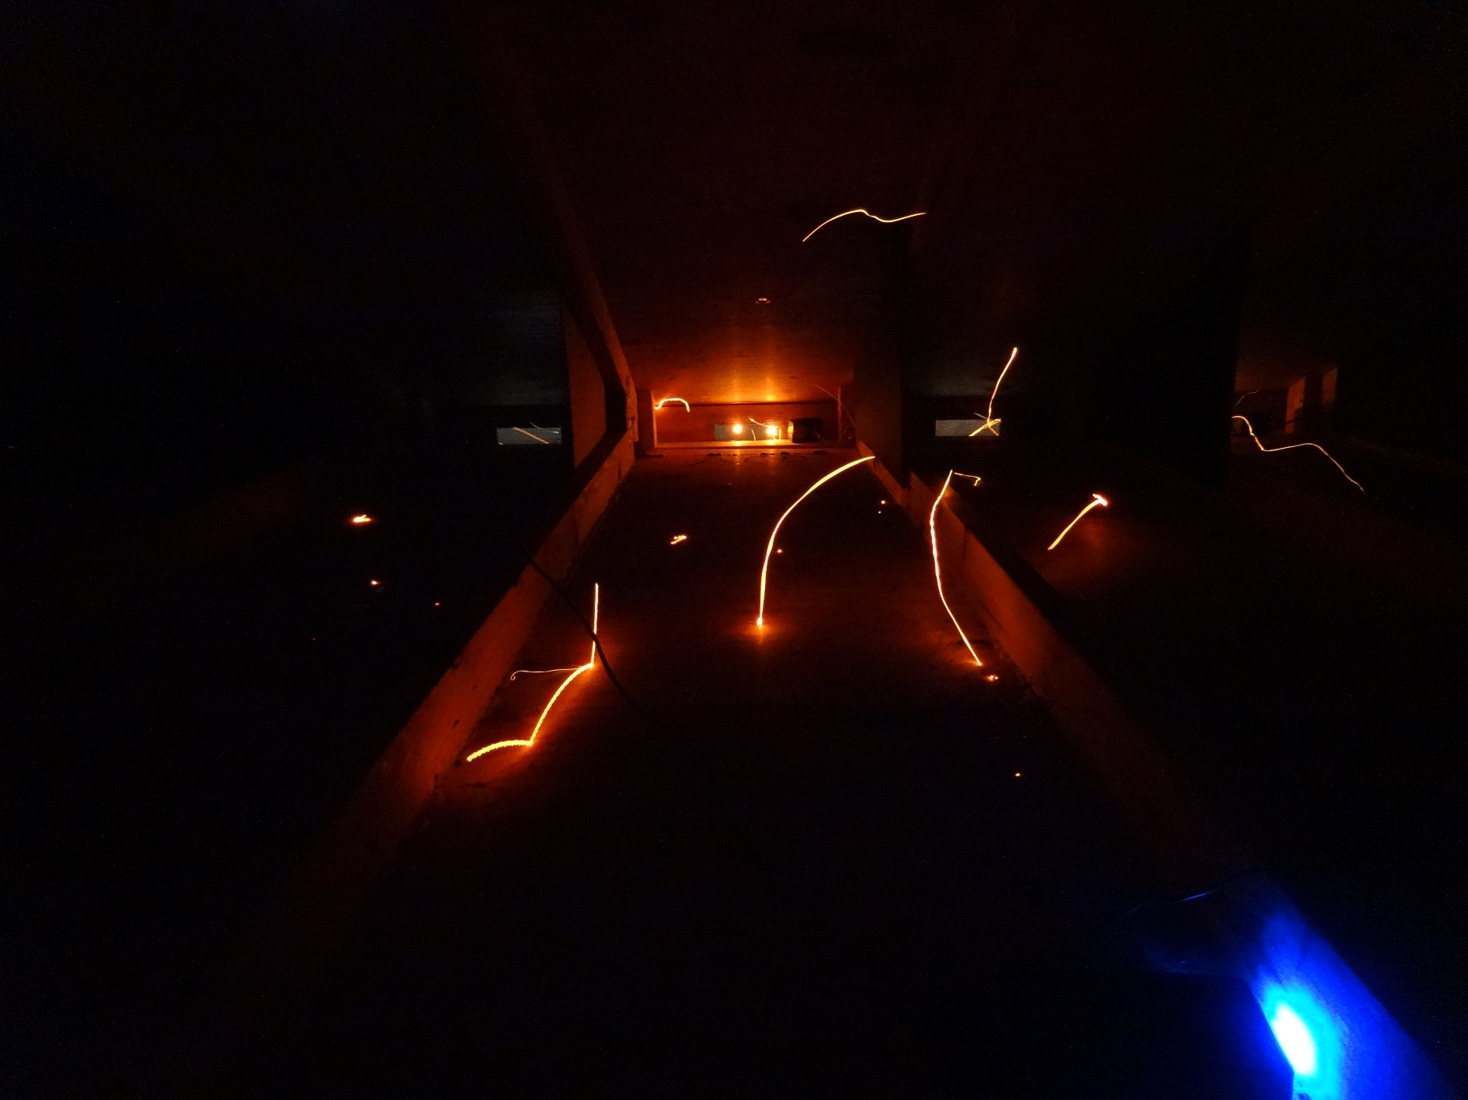
Open eave vents:
Vulnerable to ember entry
More so than vent in a soffited eave

Slide 36
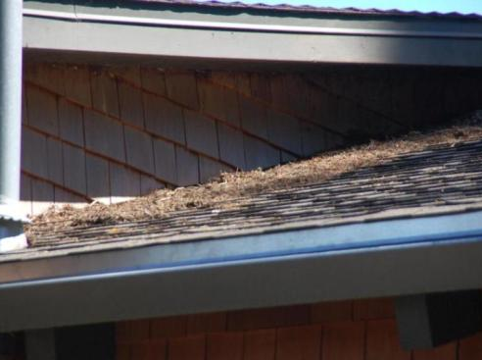
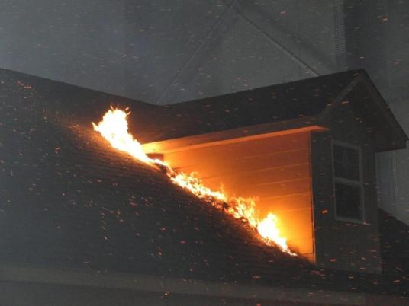
Litter accumulation creates exposure to the wall unit (not protected with roofing).

Slide 37
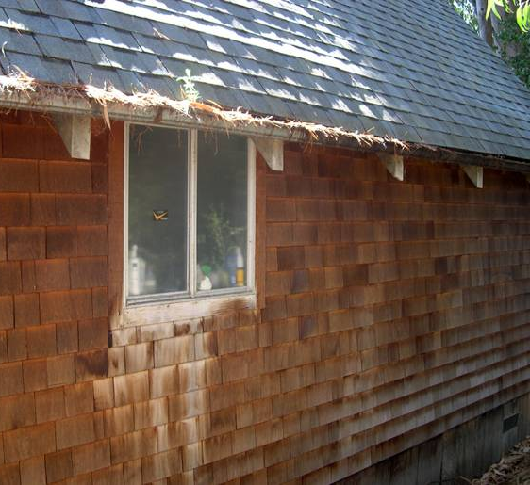
Embers can ignite litter in rain gutters
Photo credit: Insurance Institute for Business and Home Safety

Slide 38

Plastic gutters
vs.
Metal gutters
Photo credit: Insurance Institute for Business and Home Safety

Slide 39
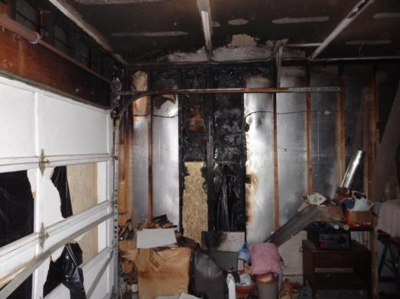
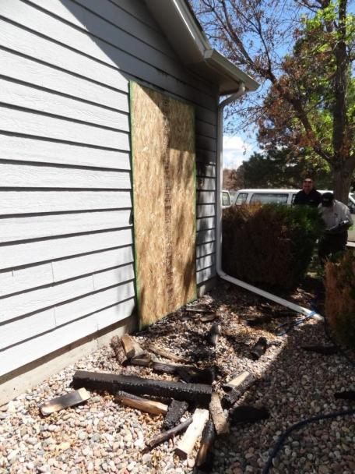
INSIDE
Firewood stored too close to the house, led to fire inside the garage.
Hardboard Siding
Photo credit: Insurance Institute for Business and Home Safety

Slide 40
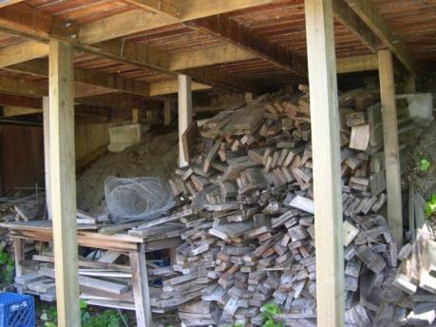
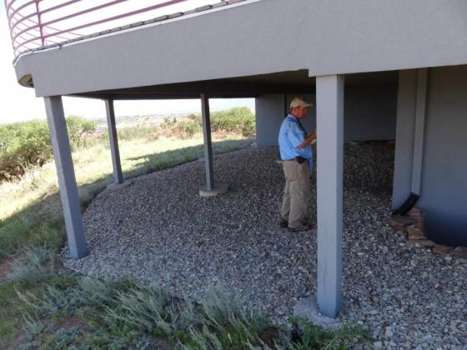
Photo credit: University of California Cooperative Extension
INSIDE
Stored building materials under a deck is vulnerable
Photo credit: Insurance Institute for Business and Home Safety

Slide 41
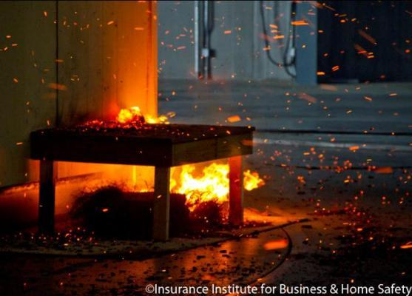
Firewood under a deck

Slide 42
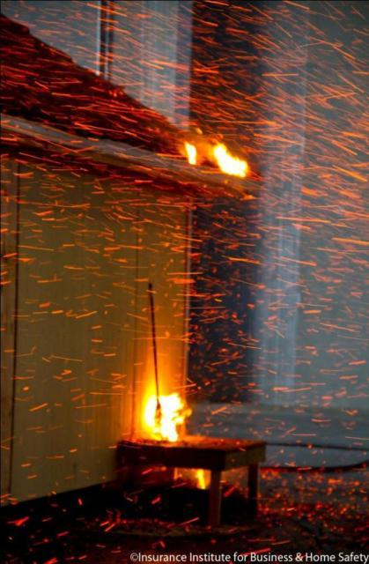
Broom

Slide 43
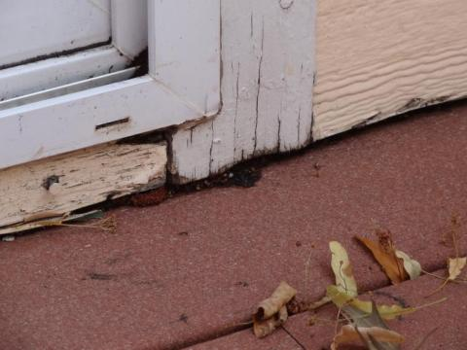

Slide 44
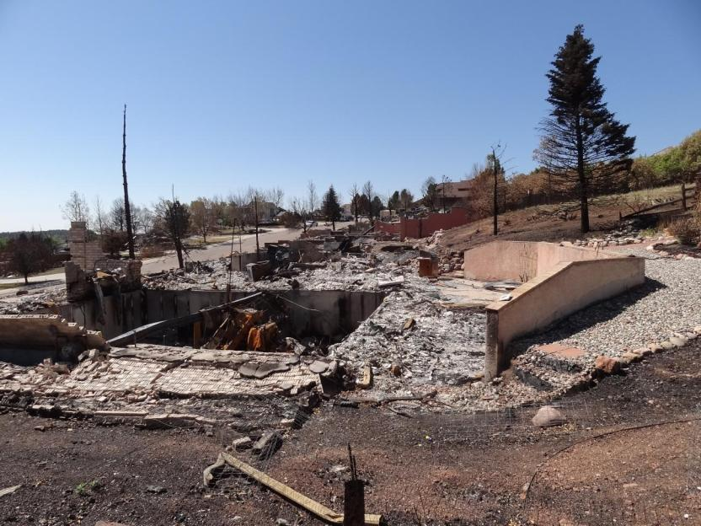
INSIDE
A neighbor’s house could be in the 5 -30 foot zone- their condition can affect your survival.
Photo credit: Insurance Institute for Business and Home Safety

Slide 45
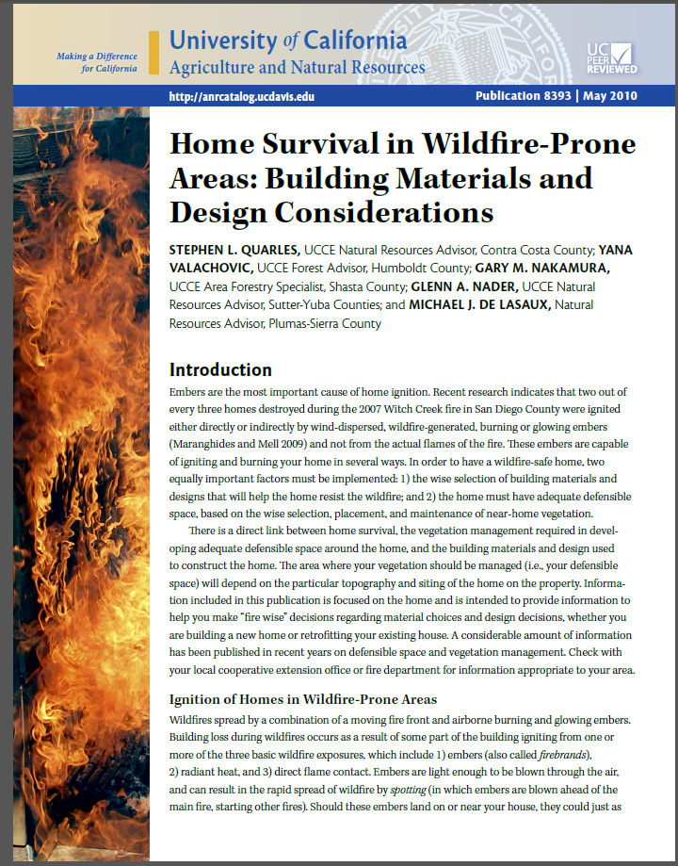
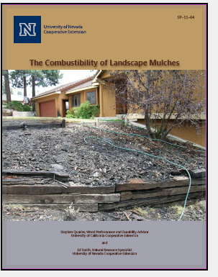
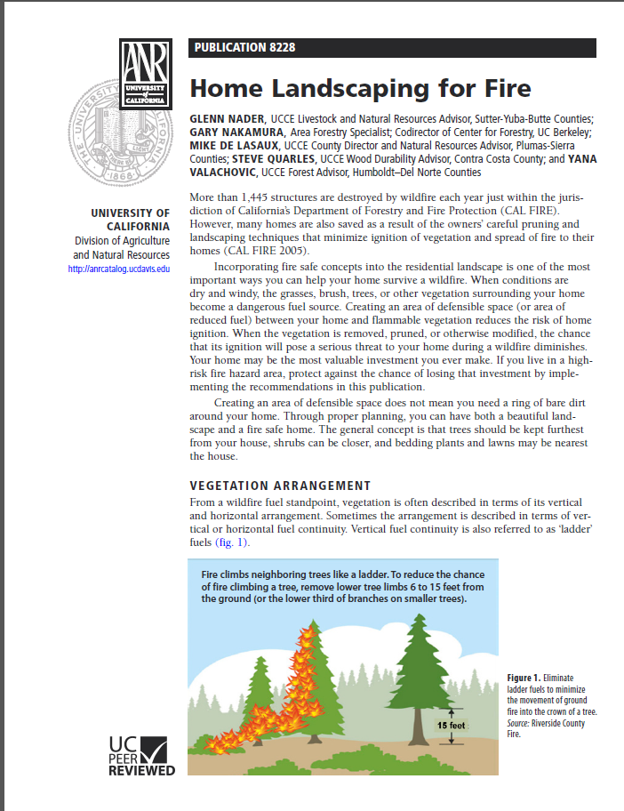
INSIDE
For more information visit:
ucanr.edu/sites/forestry/Wildfire

Slide 46
Conclusions
Landscape
Fire safe landscapes can be beautiful, safe, maintain privacy and save water
Placement of vegetation is key (away from vents, eves and decks)
Maintenance is essential
0 – 5 feet (non-combustible materials only)
5 – 30 feet (lean, green and clean)
30 – 100 feet (reduced fuel zone)

Slide 47
Conclusions
House
Remove stored fuels and debris, clean gutters, maintain or improve roofing (class A)
Choose fire resistant building products during your next house project

Slide 48
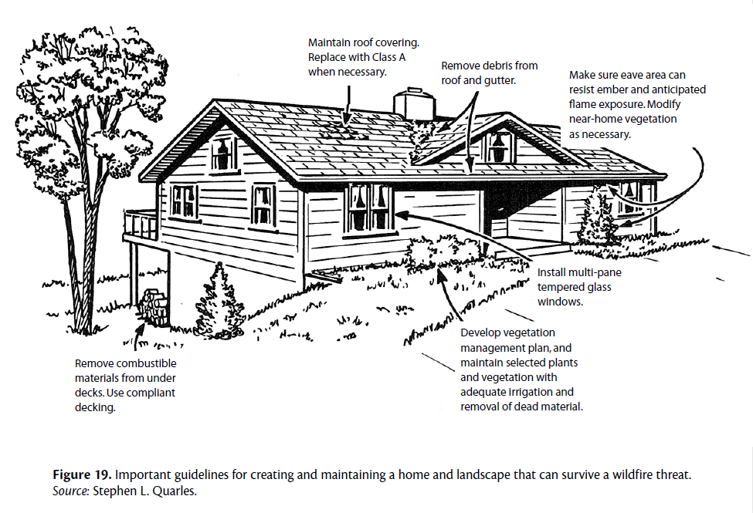
Photo credit: Home Survival in Wildfire Prone Areas

Slide 49

UCCE Master Gardeners are here to help! Contact us:
Website: [Insert] Phone: [Insert]
Email: [Insert]

Slide 50
Thank you! Questions?

