Slide 1
Keeping Landscapes and Garden Plants Alive Under Drought or Water Restrictions
Source: Janet Hartin and Ben Faber, UC Cooperative Extension
Presented by: [NAME]
[Title]

Slide 2

This Information Will Help You:
Recognize the signs of drought
Reduce water waste
Prioritize which plants to water when there just isn’t enough water to go around
Think ahead in preparation for a bright sustainable future

Slide 3
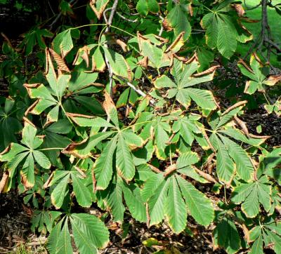
Recognizing Early Signs of Drought Stress is Important Because:
Irreversible damage can occur that no amount of watering will correct
Mature fruit trees and landscape trees are worth saving!

Slide 4
Common Symptoms of Drought Include:
Wilting or drooping leaves that do not return to normal by evening
Curled or chlorotic (yellow) leaves that may fold or drop
Foliage that becomes grayish and loses its green luster
New leaves that are smaller than normal
Lawns that retain a footprint for several minutes

Slide 5
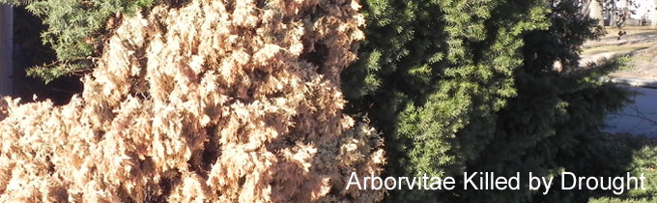
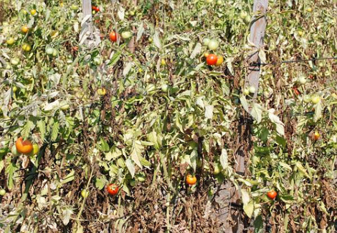
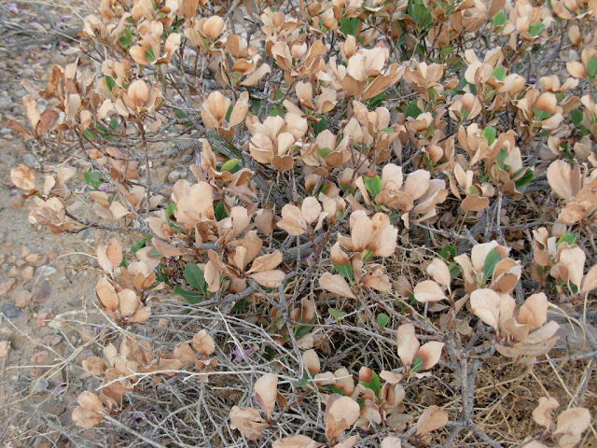
The Effects of Drought
© University of California

Slide 6
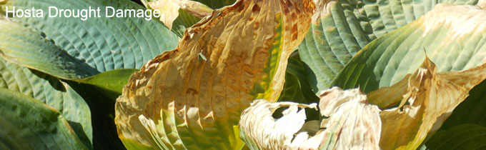
The Effects of Drought
© University of California

Slide 7
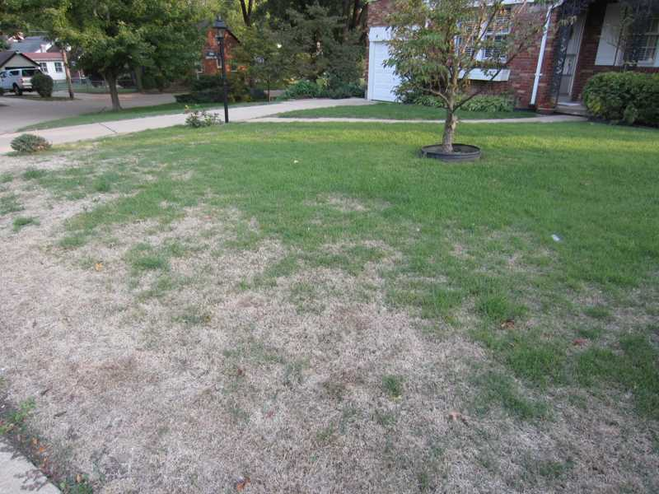
The Effects of Drought
Turf Drought Damage

Slide 8
Suggested Methods To Maintain Various Landscape Plants During Water Restrictions and Severe Drought

Slide 9
Ornamental Trees
Most homeowners wisely choose to use whatever water is available to save their mature landscape ornamentals and fruit trees
One or two deep irrigations with a garden hose several weeks apart in spring and summer will often keep these valued plants alive through summer, especially if roots are relatively deep

Slide 10
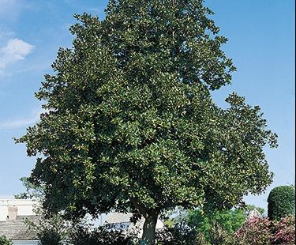
Ornamental Trees Cont.
Although mature trees can often survive one season with only one or two deep waterings during the spring and summer, two seasons without enough water can result in severe drought stress and even death
Drought-stressed trees can be more prone to damage from diseases and insects

Slide 11
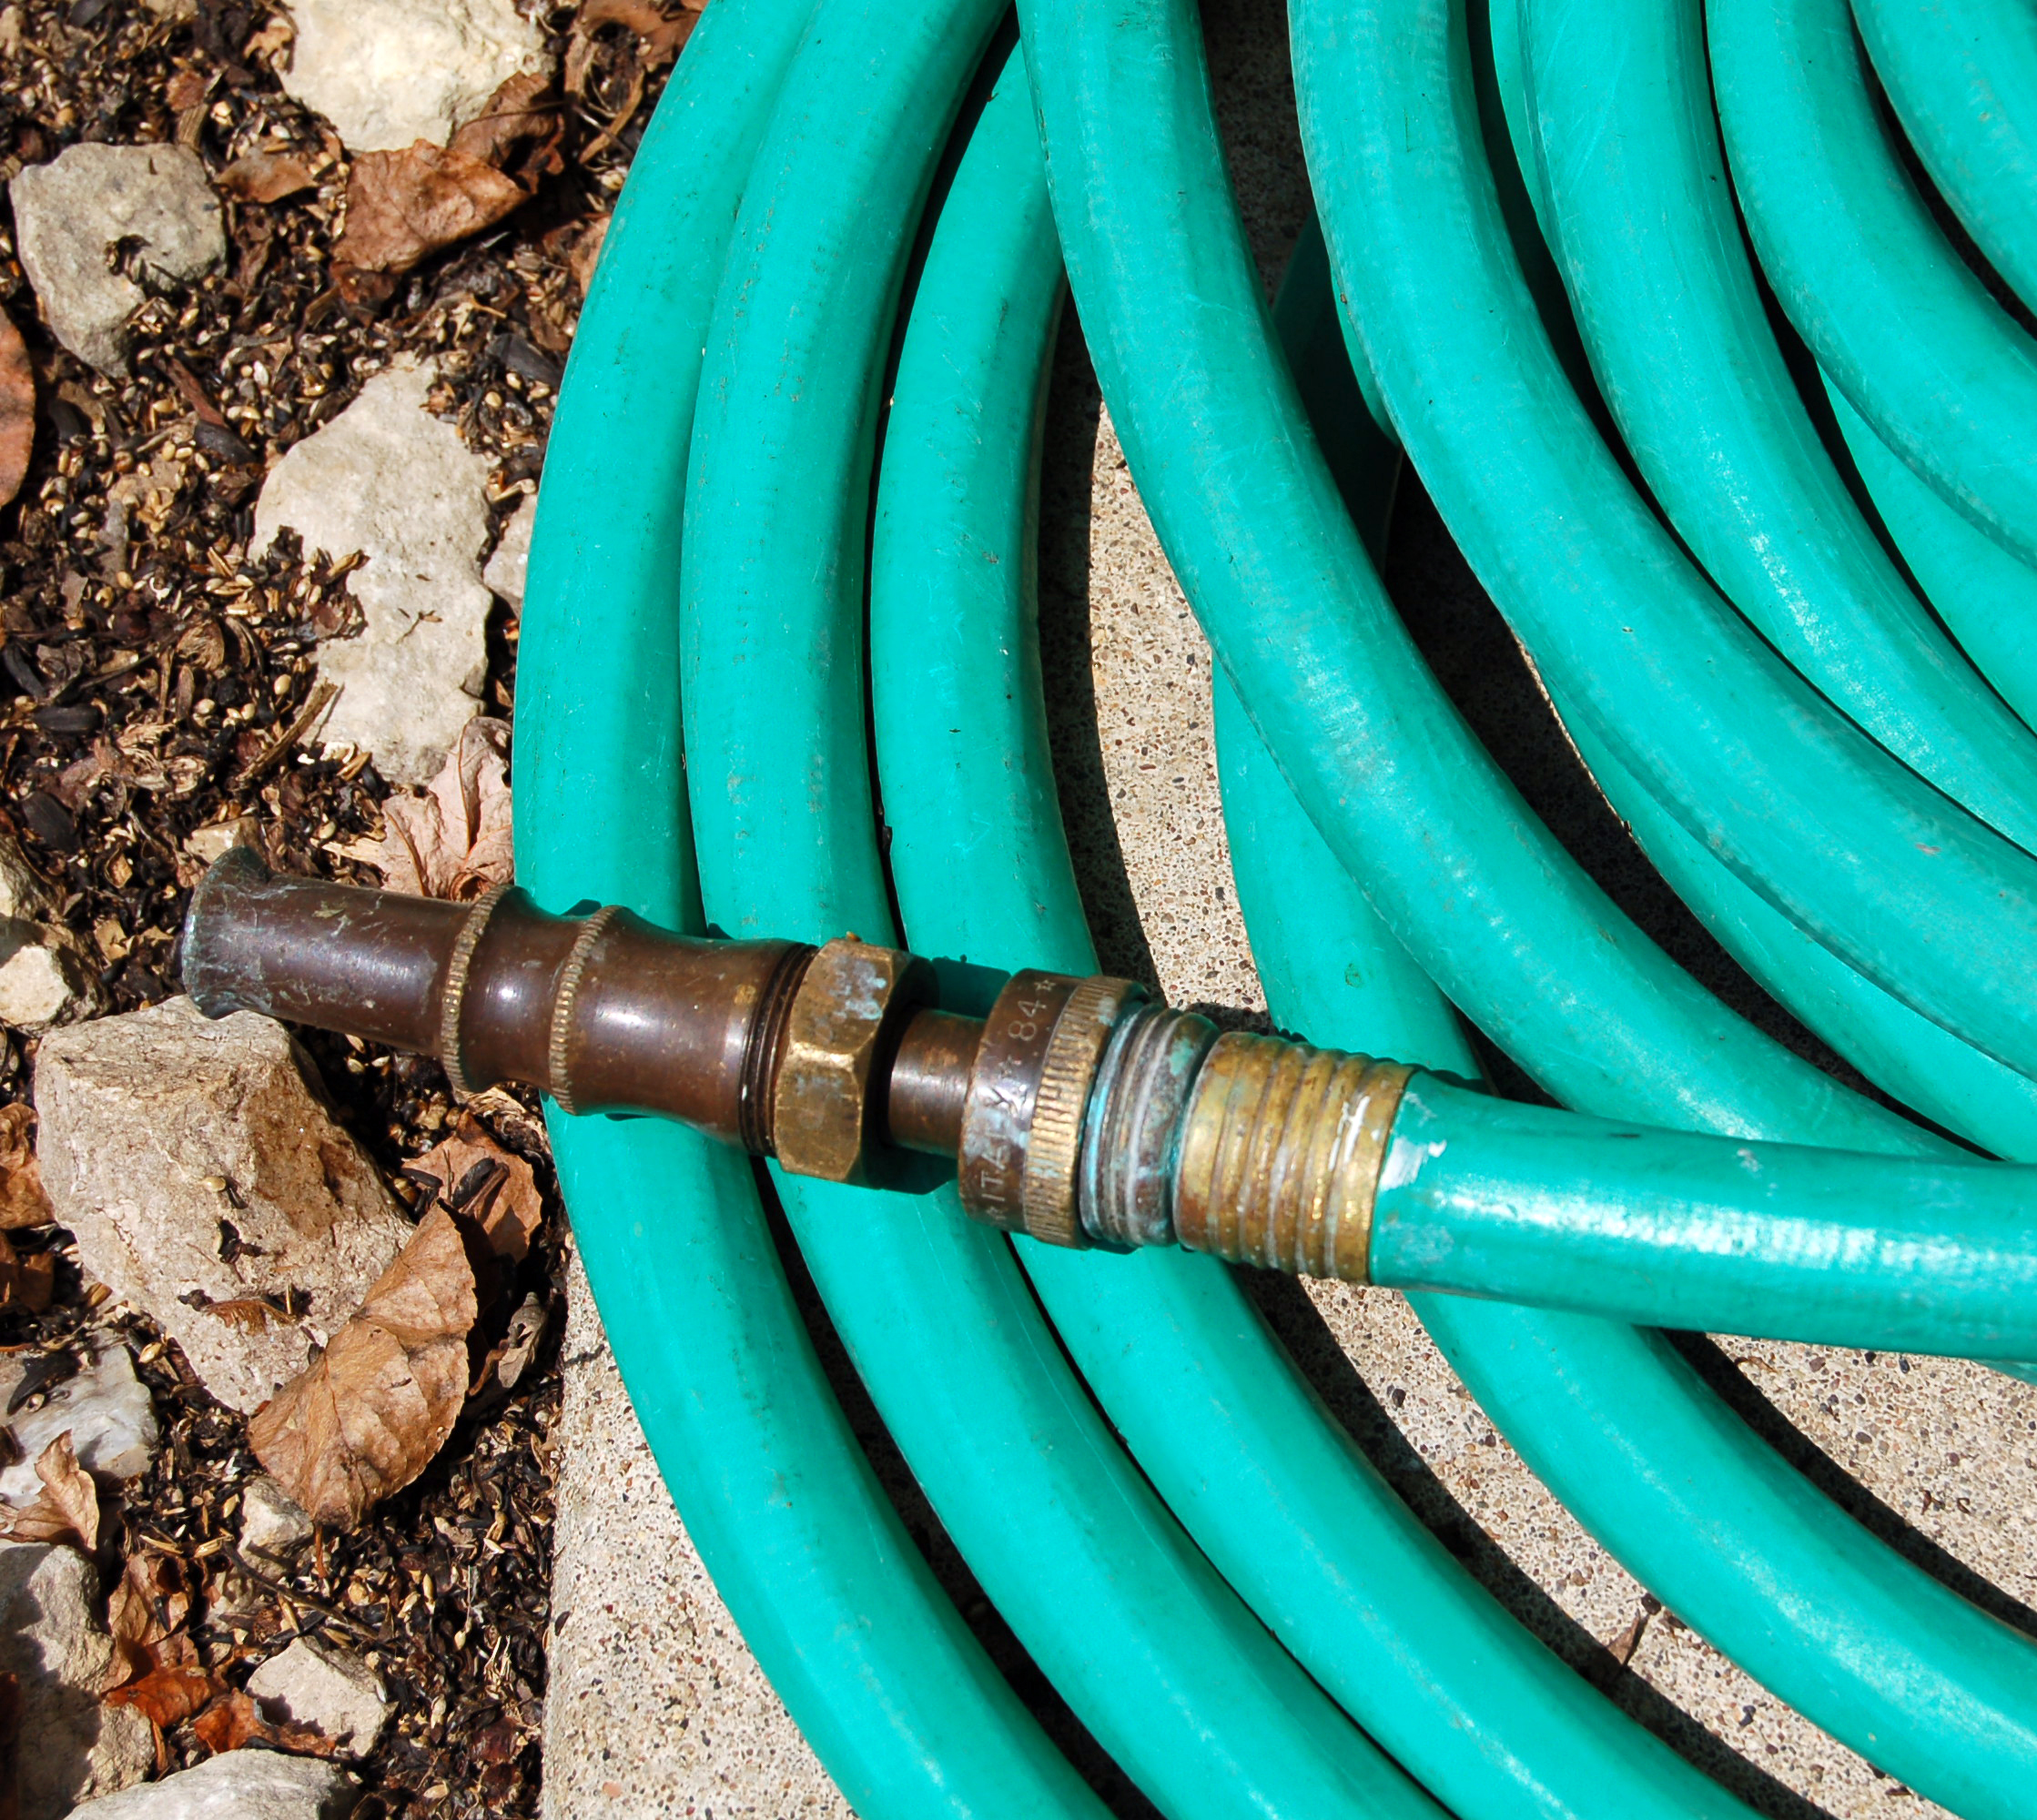
Ornamental Trees Cont.
Watering with a garden hose slowly and deeply will help necessary water reach the root zone. Soaker hoses work well, too. Water mature trees several feet out from the trunk and make sure water is moving through the soil several inches deep into the root zone

Slide 12
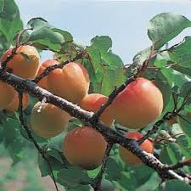
Fruit and Nut Trees
Keeping fruit and nut trees alive during severe water shortages is also possible, although crop production will probably be greatly reduced or stop
To produce a good crop, deciduous fruit and nut trees need adequate water in their root zones continuously from bloom until harvest

Slide 13
Peaches, Plums & Nectarines
Adequate irrigation during the final 4 – 6 weeks before harvest is important to produce fruit. If necessary, reducing water application just prior to this period and after harvest are viable strategies
If little or no irrigation water is available throughout the season, trees may be kept alive by severely cutting scaffolds back to the trunk (dehorning)

Slide 14
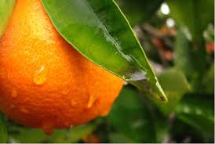
Citrus
Citrus trees need adequate soil moisture during spring to set fruit and steady water in summer and fall to produce acceptable size, numbers, and quality of fruit

Slide 15
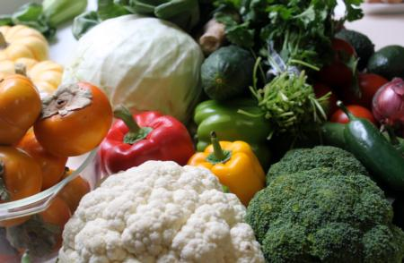
Vegetables
Vegetables are difficult to maintain during a drought. Know the critical watering periods for vegetables and you can target the timing and amount of water to add
As a rule of thumb, water is most critical during the first few weeks of development, immediately after transplanting and during flowering and fruit production

Slide 16
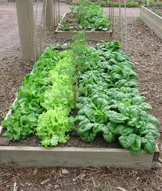
Vegetables Cont.
Tomatoes, beans, and root crops such as carrots require regular watering and are not tolerant to long, dry periods. Vine crops such as squash and zucchini often fare better and can be kept alive with a few waterings once or twice a week through the season

Slide 17
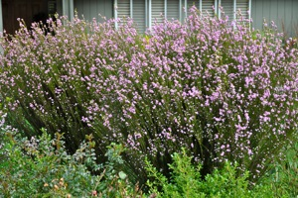
Shrubs
Most established shrubs can survive long periods of dry soil. Thorough spring watering and one or two thorough waterings in the summer keeps most well-established shrubs alive for at least one season

Slide 18
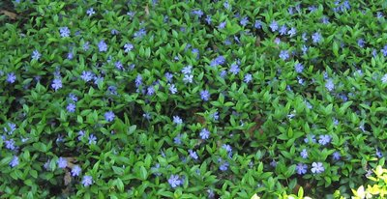
Groundcovers
Groundcovers often survive on about half the amount of water received under optimal conditions, although some dieback may occur
To avoid serious drought stress groundcovers require waterings every 3-6 weeks from Spring through Fall depending on species and soil type and microclimate

Slide 19
Lawns
Warm-season lawns such as bermudagrass and buffalograss are more drought-resistant than cool season grasses such as tall fescue and ryegrass and may come back after several weeks of dryness. Cool season grasses may die within a month or two of receiving no water
Cutting the length of irrigation down to ½ of that recommended in the UC lawn watering guide -http://anrcatalog.ucdavis.edu/pdf/8044.pdf
Watering only once or twice a week may help lawns survive drought

Slide 20
Lawns Cont.
Once a lawn stops receiving adequate moisture, it will gradually turn brown and go dormant over time
A lawn that recently turned brown from drought can often be revived with regular, thorough watering

Slide 21
What Else Can You Do Right Now Without Starting Over?

Slide 22
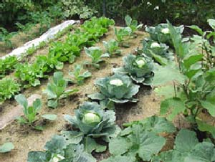
Mulch
Apply 2 – 4 inches of mulch around garden plants and trees to hold water in and reduce soil evaporation
Keep it several inches away from tree trunks!
Make sure to water beneath the mulch

Slide 23
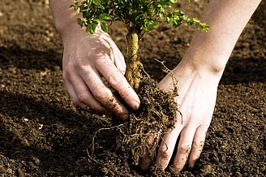
Avoid Planting New Plants
Young plants require frequent irrigation until established and should not be planted during a drought or under water restrictions
Even native plants require continually moist root zones during establishment

Slide 24
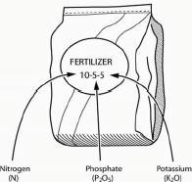
Avoid Overfertilizing
Too much Nitrogen results in lush, weak new growth, and increases the need for even more water
Too much fertilizer can lead to pollution of waterways

Slide 25
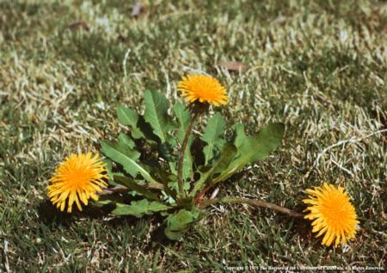
Keep Weeds Out!
Weeds often outcompete garden plants and trees for water
Avoid using chemical herbicides; hand-weed instead. Overuse of pesticides can lead to waterways pollution

Slide 26
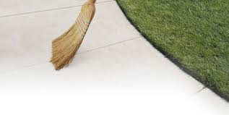
Use a Broom Instead of a Hose to Clean up After Gardening or Pruning
Save water and avoid polluting waterways
Get some exercise!

Slide 27
What About Long Term Solutions?

Slide 28
Long Term Solutions
Once water restrictions are lifted think about replacing all or a portion of your lawn with drip-irrigated water-efficient ornamentals
Hydrozone: place plants with similar water needs together
Before planting, mix compost evenly several inches into garden soil to hold water in longer and decrease the chance of waterway pollution from runoff (clay soils) or draining below the root zone into groundwater (sandy soils)

Slide 29
Long Term Solutions Cont.
Add 2 - 4 inches of mulch on top of garden soil and around trees and shrubs, keeping it several inches away from tree trunks
Consider adding a graywater system if legal in your jurisdiction. (Graywater systems reuse water from washing machines and showers)
Never apply graywater to edibles or edible plant parts!

Slide 30
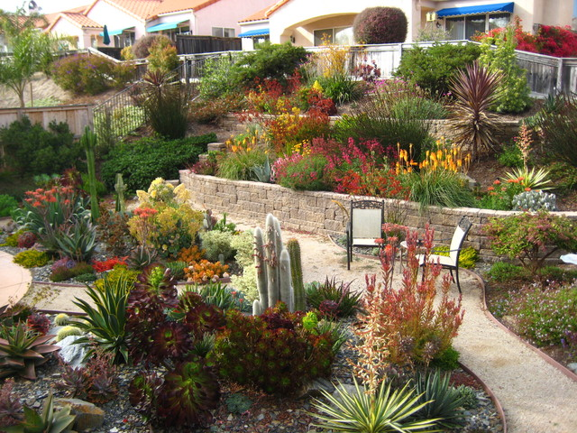
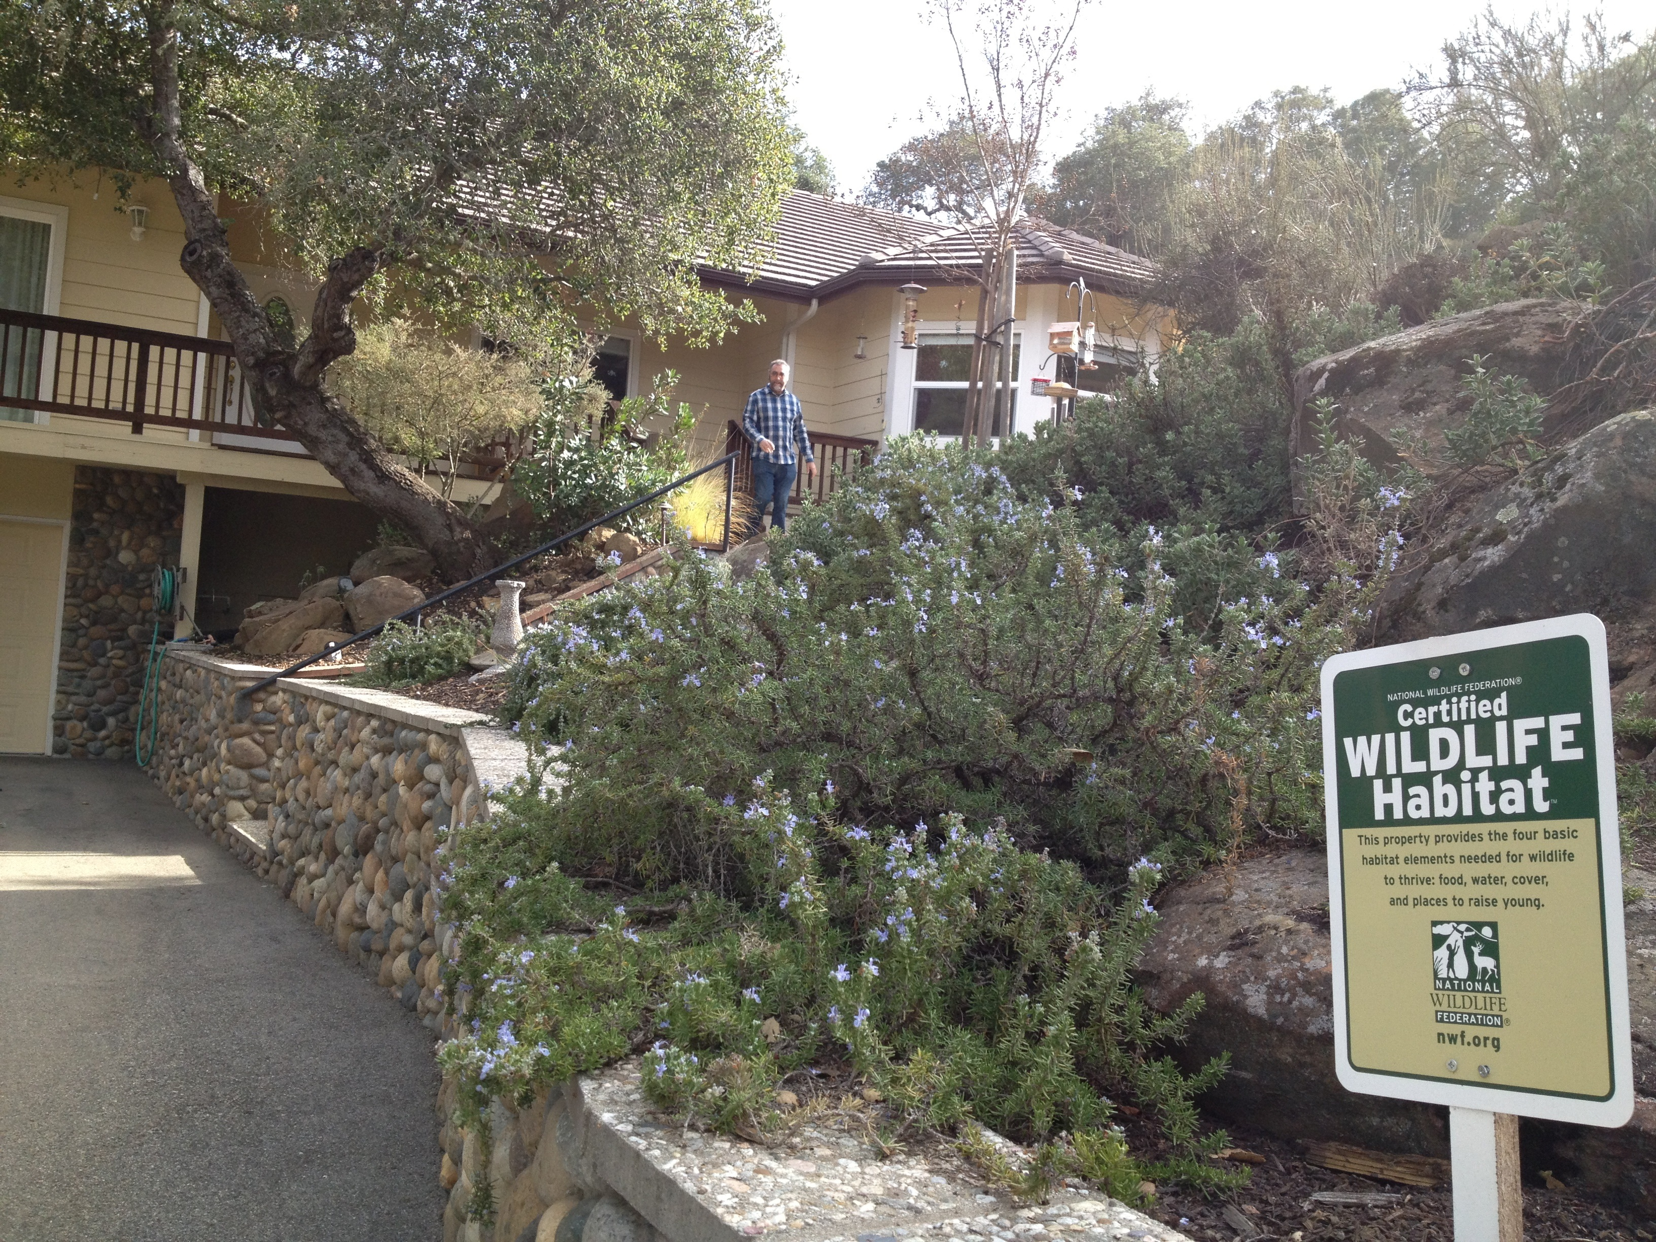
Beautify Your Landscape, Protect the Environment, Save Water, Money, and Time!

Slide 31
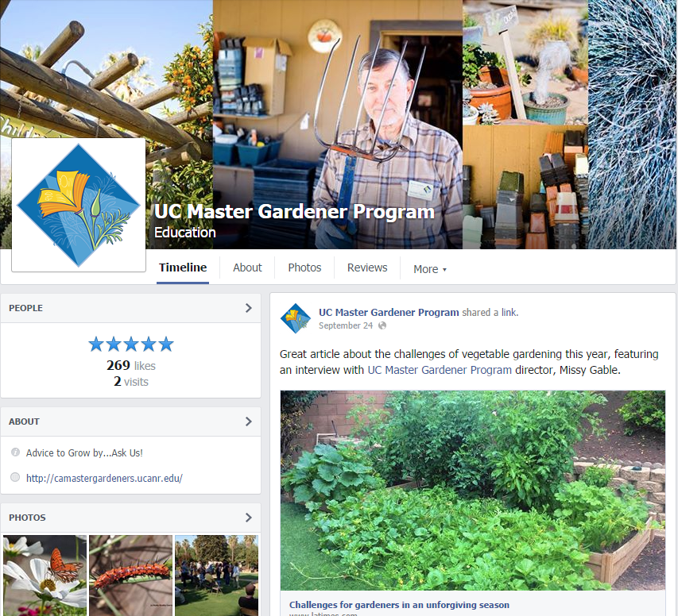
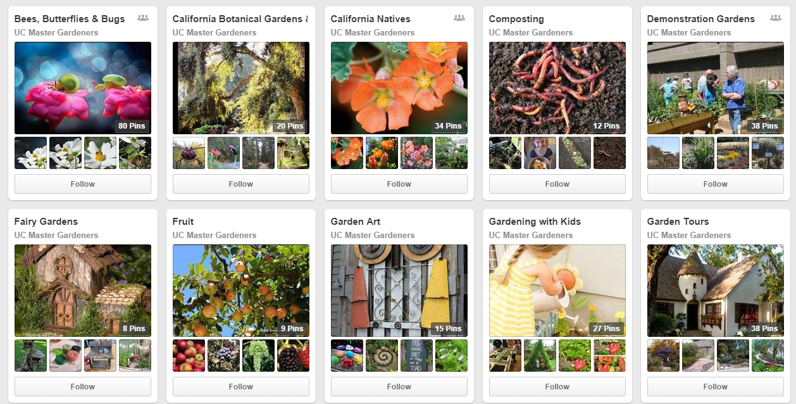

We’ve Gone Social!
Like us …
www.Facebook.com/ UCMasterGardeners
Tweet us …
@UCMasterGarden
Pin us …
Pinterest.com/ UCMasterGarden
Subscribe …
youtube.com/user/ UCMasterGardeners

Slide 32
UCCE Master Gardeners are here to help! Contact us:
Website: [Insert] Phone: [Insert]
Email: [Insert]

Slide 33
Thank you! Questions?

