Slide 1
SEED PROPAGATION
FROM SEED SELECTION TO STARTS
Master Gardener, Stephanie Means

Slide 2
Today’s Presentation
Selecting and Storing Seeds
a) seed preservation through fermentation
Germination :
a) environmental conditions necessary
b)scarification
c) permigating seeds (sprouting) before planting
Environmental factors:
water, oxygen, light and temp
Selecting Planting Median and Containers:
a) sowing seeds
b) transplanting
c) hardening off

Slide 3
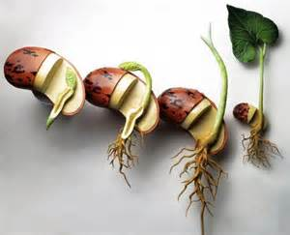
GERMINATION BEGINS
WITH SATISFACTORY CONDITIONS INSIDE
A seed must have a mature embryo containing:
An endosperm, sufficient hormones and auxin.

Slide 4
PLANT HORMONES
Auxins
Gibberellins
Cytokins
Ethylene
Stomata

Slide 5
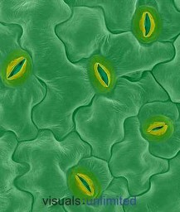
Stomata
Abscisic Acid
regulates and promotes dormancy in shoots and seeds
responsible for dropping off of leaves on deciduous plants and closing of stomata on leaves of plants severely stressed

Slide 6
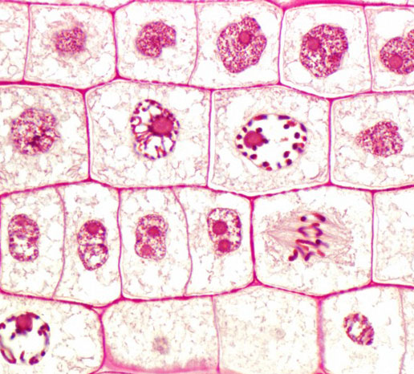
CELL DIVISION- MITOSIS verticle section of an onion root

Slide 7
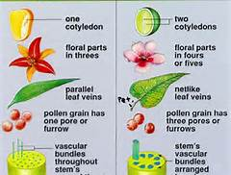
TWO TYPES OF SEEDS
Monocotes and Dicots

Slide 8

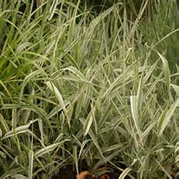
MONOCOTYLEDONS
Grasses, Palms, Lilies, Orchids

Slide 9

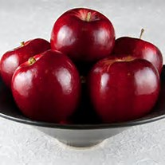
DICOTYLEDONS
Roses, Apples and Pears

Slide 10
Selecting & STARTING SEEDS
Adaptability of selected seeds
Hybrids vs. Heirloom
Propagation in the Dark
BREAKING DORMANCY
Scarify
Seed Stratification
Seed Fermentation
Testing or Sprouting Seeds/Planting

Slide 11
BREAKING DORMANCY IN SEEDS
SCARIFY
SEED STRATIFICATION
SEED FERMENTATION AND CLEANING
TESTING OR PERMIGATING ( SPROUTING)

Slide 12
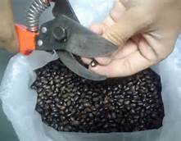
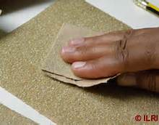
SCARIFICATION
Breaking, Scratching or Softening

Slide 13

ENVIRONMENTAL CONDITIONS
WATER
OXYGEN
LIGHT
TEMPERATURE

Slide 14
THE WOW FACTOR
Water Oxygen Warmth
The seed must have Water to break dormancy
Oxygen. A loose median, well aerated.
A 1/8 inch cover of vermiculite for small seeds.
Most seeds germinate in the Light, morning sun or indirect. Some seeds germinate best in the dark.
Temperature. Most seeds have a minimum and maximum they can tolerate. Planting in favorable temps stimulates optimum growth, which is a warm
65-70 degrees for most plants.

Slide 15
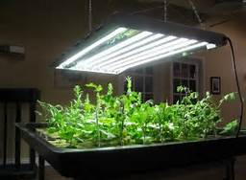
INDOOR GROW LIGHTS

Slide 16
PLANTING CONTAINERS AND MEDIANS
Rule of Thumb
Sterilize 1-9 ratio bleach and water
Fill ¾ “ full & dampen, drain
Plant 2-4 x’s diameter of seed, or cover ¼”
Firm edges. Do not pack.
Mist until 1st true leaves show.
Protect from extreme hot and cold.

Slide 17
GERMINATING MEDIANS
Fine , uniform texture, aerated & loose.
Free of insects & weeds
Low in soluble salts
Able to hold moisture
Recipe
1/3rd peat or crushed shell, 1/3rd sterilized sand, 1/3rd vermiculite or perlite.

Slide 18
CONTAINERS
Wooden-12” x 18” w/2” depth
1/8 “ between bottom boards or holes
Cell packs covered in plastic, or rows of connected cells
Compressed peat pellets, or pots
Milk cartons, Produce or To Go Trays
Get Creative

Slide 19
HARDENING
SLOWING DOWN PLANT GROWTH TO WITHSTAND ENVIRONMENTAL CHANGES
Critical for every crop.
Start 2 weeks before planting outside.
Gradually Lower Temp and Water Intake.
Optimum Temp. 45-50 degrees in shade.
Do Not Allow to Wilt.
Avoid High Winds.

Slide 20
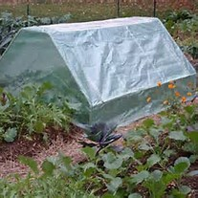
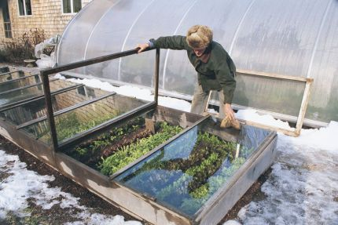
COLD FRAMES FOR HARDENING OFF STARTS

