Slide 1
Federal Crop Insurance: A Program Update
United States Department of
Agriculture
Risk
Management
Agency
Farm Credit Administration
McLean, VA
August 30, 2012

Slide 2
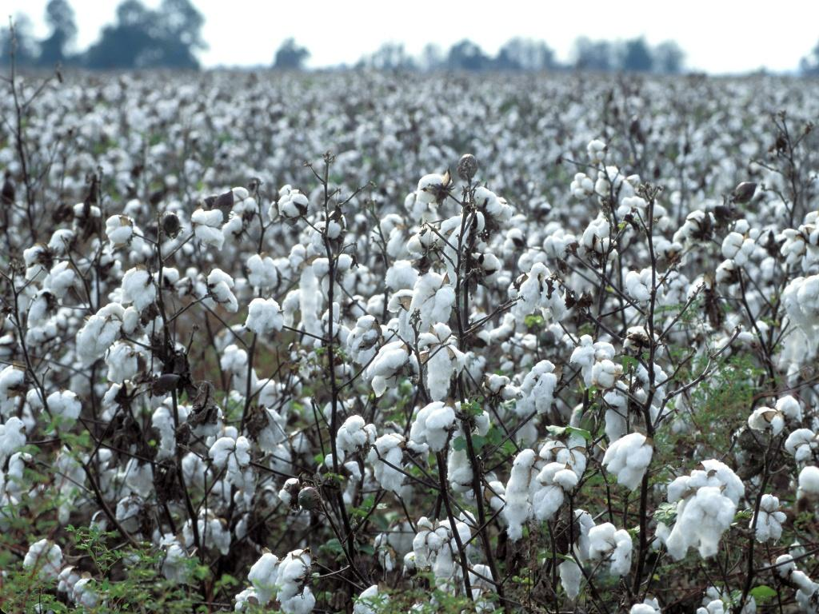
Federal Crop Insurance Program Overview

Slide 3
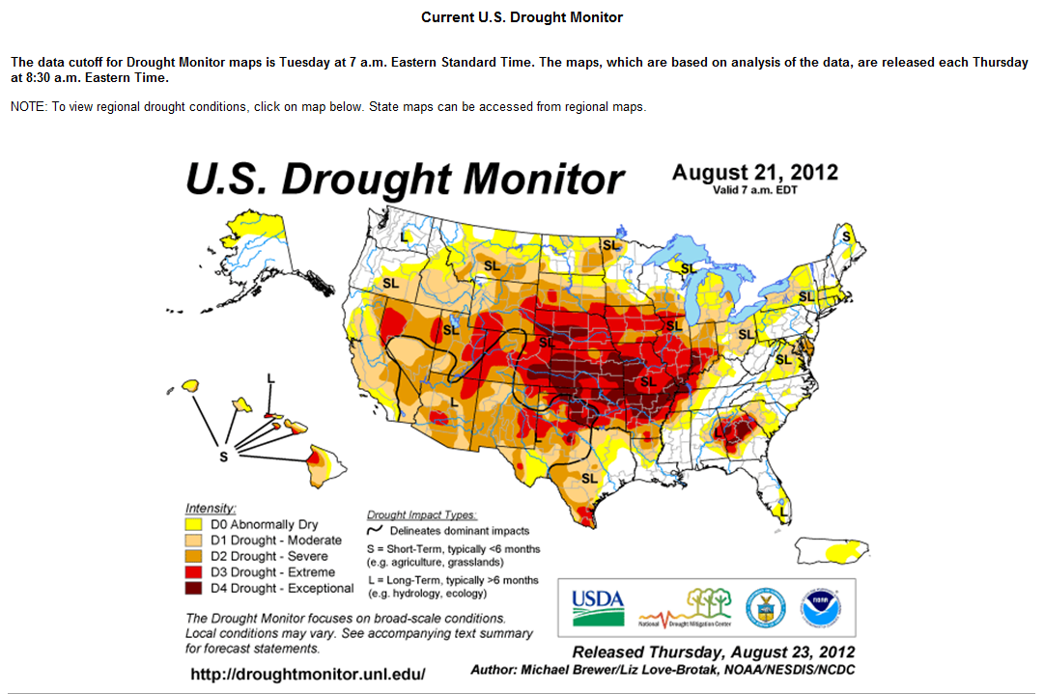

Slide 4
The 2012 Drought
RMA and its private delivery partners are prepared for the 2012 crop year.
There is adequate funding for 2012 losses.
There is an adequate loss adjuster workforce to complete claims.
Although, policies are sold by private companies they are reinsured by the USDA, Federal Crop Insurance Corporation, Risk Management Agency.

Slide 5
The 2012 Drought
Premium Billing Date and Interest Penalty
Cover Crops – Haying and Grazing
Increased Threshold for APH reviews
  $100,000 to $200,000
  Will Continue to monitor

Slide 6
A Snapshot
What’s the current status?
 | 2010 | 2011 | 2012 (so far)
Liability | $78 Billion | $114 Billion | $93.37 Billion
Acres Insured | 256.2 Million | 265 Million | 206 Million
Total Premium | $7.6 Billion | $11.95 Billion | $7.5 Billion
Indemnity (Claims Paid So Far) | $4.2 Billion | $10.84 Billion | $695,600
Loss Ratio | .56 | .91 | .08
William J. Murphy, Administrator
Risk Management Agency
Data current as of July 30, 2012

Slide 7
Premium, Indemnity & Liability
William J. Murphy, Administrator
Risk Management Agency

Slide 8
National Crop Ranking
2011 Crop Ranking by Value
Crop | Crop Liability | Percent of Total
Corn | $51.5 Billion | 45.5%
Soybeans | $25.6 Billion | 22.5%
Wheat | $10.3 Billion | 9.1%
Cotton | $6.7 Billion | 5.9%
Nursery (FG&C) | $2.3 Billion | 2.0%
Citrus | $2 Billion | 1.8%
Rice | $1.2 Billion | 1.1%
Potatoes | $1.0 Billion | 0.9%
All Others | $12.7 Billion | 11.2%
Total | $113.3 Billion | 100.0%

Slide 9
Overview
Liability
Data current as of July 23, 2012
William J. Murphy, Administrator
Risk Management Agency

Slide 10
Overview
Participation
Crop | Plan | Ins Acres | Crop | Plan | Ins Acres | Crop | Plan | Ins Acres
Corn | Group | 2.8 | Soybeans | Group | 1.8 | Rice | Group | 0.0
 | APH | 10.0 |  | APH | 9.1 |  | APH | 0.8
 | Rev | 65.3 |  | Rev | 52.4 |  | Rev | 1.5
 | Total | 78.1 |  | Total | 63.3 |  | Total | 2.3
 | Partic. | 85% |  | Partic. | 84% |  | Partic. | 84%
 | % BUP | 95% |  | % BUP | 94% |  | % BUP | 57%
Cotton | Group | 0.0 | Wheat | Group | 0.1
 | APH | 4.4 |  | APH | 9.3
 | Rev | 9.2 |  | Rev | 38.1
 | Total | 13.5 |  | Total | 47.5
 | Partic. | 94% |  | Partic. | 87%
 | % BUP | 88% |  | % BUP | 93%

Slide 11

FCIC Loss Experience 1981-2011

Slide 12
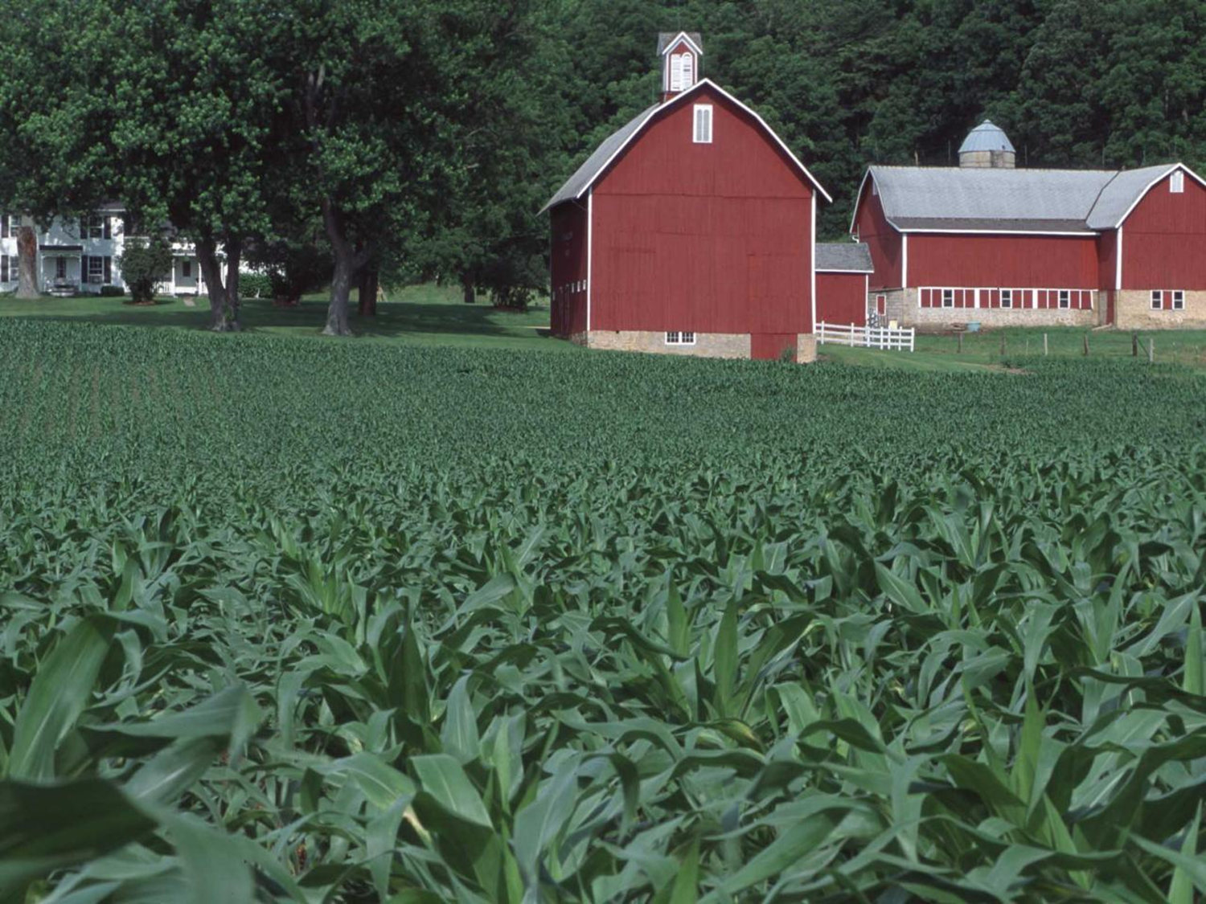
Recent Program Changes

Slide 13
New Program Feature Trend Adjusted Yield
Additive upward adjustment to yields that reflect the long-term trend
Trend will vary by crop and county
Will be expanded into additional crop programs
2013: Corn/Beans, Wheat, Canola, Grain Sorghum, Cotton and Rice

Slide 14
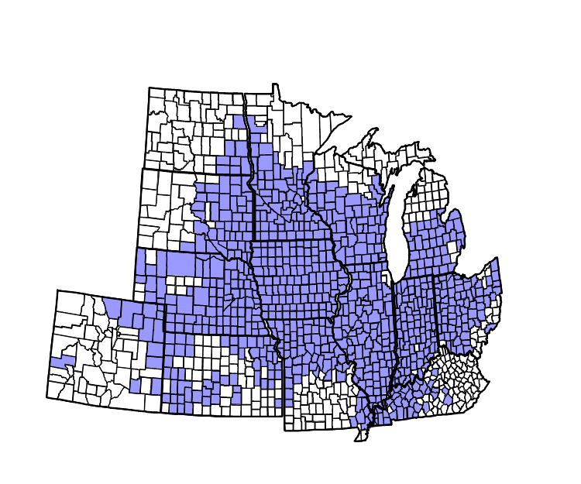
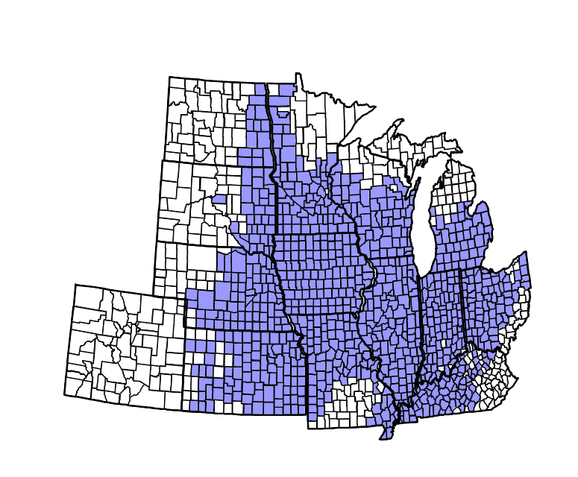
Trend Adjusted Yield
Corn and Soybeans 2012

Slide 15
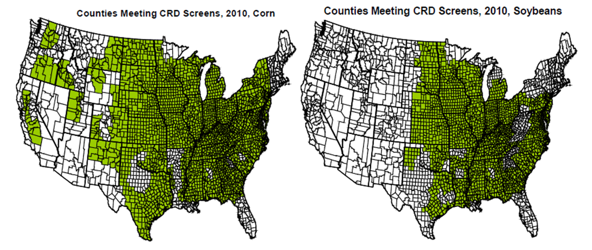
Trend Adjusted Yield
Corn and Soybeans 2013

Slide 16
Whole Farm &
Enterprise Unit Pilot
Authorized by 08 Farm Bill
Gives farmers same dollar subsidy as for basic and optional units, resulting in subsidy increases of more than a third for most coverage levels
Resulted in significant increases in enterprise units from 2008 to 2009 but no increase in whole farm units
Classified as a pilot in the statute. RMA wants next Farm Bill to clarify this

Slide 17
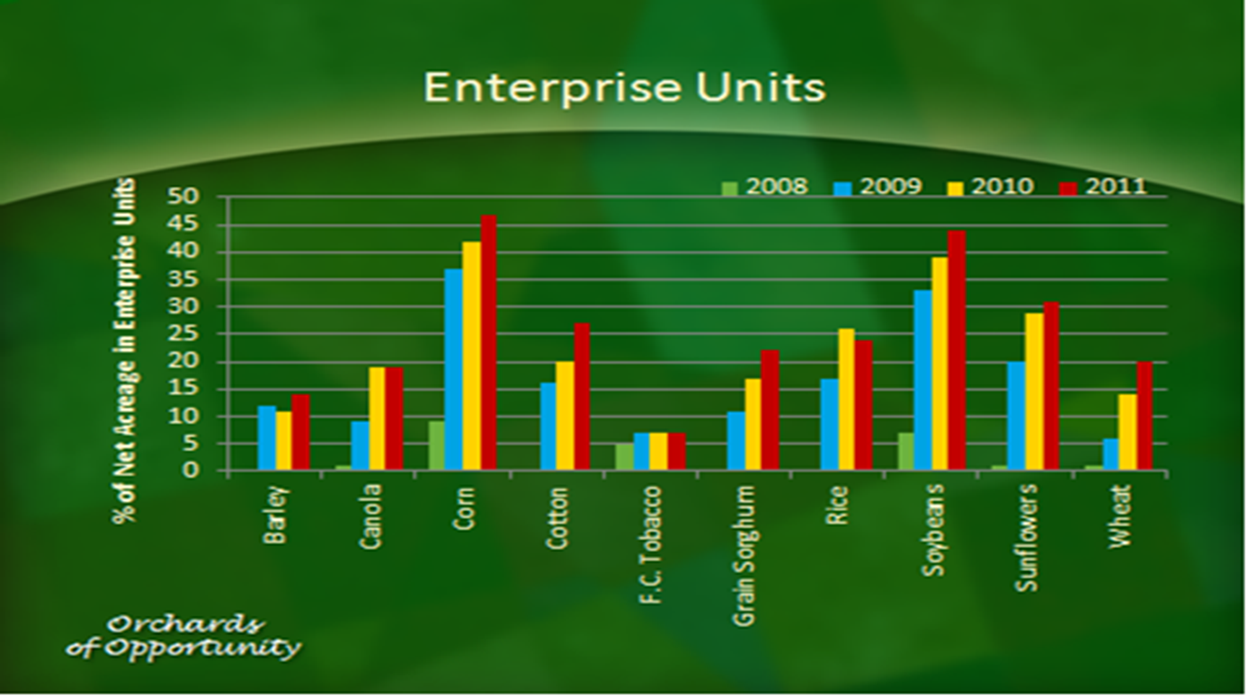
Enterprise Units

Slide 18
APH Review
RMA conducted an internal evaluation of APH program
Fundamental basis of APH program is sound and does not require significant overhaul but
  Does not reflect advances and capabilities in data, technology, etc.
  Opportunity to reduce administrative burden, provide more appropriate insurance guarantees, and improve actuarial efficiency and program integrity

Slide 19
APH Review
APH - Producers report production annually
  Including area-based plans
  Production reporting tied to current year’s policy, not next year’s policy APH database
  Data contained in permanent databases identified by land and by producer - used for establishing guarantees, etc.
  Historical data would not be ‘lost’
  Yields tied to the common land unit

Slide 20
ACRSI Project
High Level Objectives
Provide self-service solutions for producers to participate in USDA programs
  Provide options to report common data
  Consolidate acreage reporting dates
  Standardize requirements to facilitate data sharing across farm programs
  Publish data standards to provide Private Ag Services the option to incorporate

Slide 21
Common Acreage Reporting Dates
In the past year, the joint RMA-FSA team looked at RMA’s 54 ARDs for 122 crops, and FSA’s 17 ARDs for 273 crops, and consolidated them into the 15 common ARDs.
RMA and FSA will implement the July 15 and August 15 common ARDs for certain commodities during 2012. The new common July ARD combines 15, and the August date combines 10, of the previous acreage reporting dates.
The remaining common ARDs will be implemented during the 2013 crop/program year.

Slide 22
Rating Methodology
Rating Methodology Review
RMA contracted for a rate study by Sumaria Systems, Inc.
  Study peer reviewed
  RMA accepted in general the study recommendations, but with limitations
  RMA plans to conduct additional analysis before making further adjustments
  Many corn and soybean producers will see decreased rates, but not all
  Varies by state, but overall a rate decrease around 7% for corn and 9% for soybeans
Additional crops to follow include wheat, cotton, rice, sorghum, potatoes and apples
Ultimate goal is to establish the best rate for the risk faced by producers so each pays their fair share.

Slide 23
Next Steps
Analyze and address reviewer (or other) comments and recommendations
  Replicate reviewer analysis/results, sensitivity analysis, consult with reviewers as needed
  Key issues: Pre-95 adjustment, Weather Weighting
  Make revisions to methodology as appropriate
Complete in time for 2013 crop year
  Apply to wheat (if complete), cotton, rice, others

Slide 24
Premium Billing
The 2008 Farm Bill mandated premium billing dates that occur after August 15 be moved to August 15 beginning with crops falling under the 2012 reinsurance year.
  Not all billing dates occurring after August 15th could be moved to the earlier date due to the normal growing season of the crop
  To the extent practical RMA moved those billing dates to August 15th or some earlier date, where there was sufficient time (e.g., 30 days) after acreage is normally processed for a crop.
  More than 20,750 county/crop programs were impacted by the change.
Additionally, RMA added a special provisions statement to continue to provide a minimum of 30 days from the billing date to when interest would attach on unpaid premium.
  The policy states that interest will start to accrue on the first day of the month following the premium billing date specified in the special provisions.
  The new special provisions statement modifies this to the first day of the month following the premium billing date as long as 30 days have passed.

Slide 25
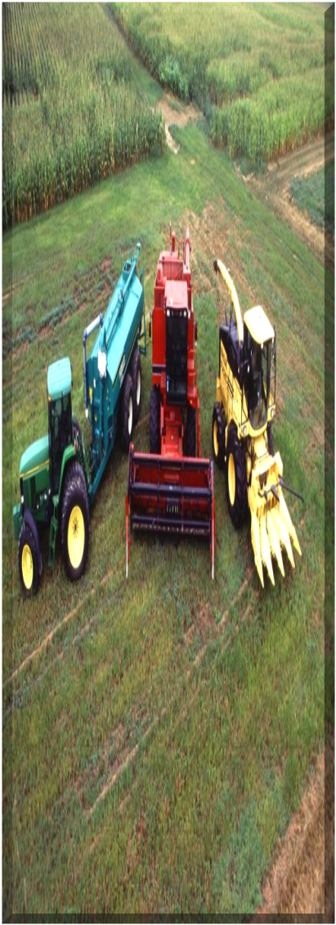
Product Development

Slide 26
New Product Development
Concept Proposals
23 Concept Proposals submitted to FCIC Board
18 Approved for expert review
12 Funded
7 Resubmitted as 508(h)
RMA’s Pilot Programs
22 Pilot Programs Operating
2 Approved for Conversion to Regulatory, including Forage Seed

Slide 27
New Insurance Programs
APH Camelina - 2012
APH Pistachios - 2012
APH Olives - 2012
High Land Risk Endorsement - 2013
Pulse Crop Revenue – 2013?
Downed Rice – 2013?

Slide 28
Planned New Product Development
Combined Area Plans- GRP/GRIP = ARPI
Triticale Program development
  Contracted-in progress
  Within small grains policy
Precision Ag recognized
  Data used in program
Use of Common Land Units
  APH
  Compliance

Slide 29
Regulation Update
2013 Crop Year
  Processing Chili Peppers
  Fresh Market Tomato – Dollar Plan
2014 Crop Year
  Area Risk Protection Insurance Plan
  CAT Endorsement
  Florida Citrus
  Pecan Revenue
  Peaches

Slide 30

Compliance & Enforcement

Slide 31
Data Mining
Efforts of past 6 years yield significant results
CBO: “Over 1.6 billion in cost avoidance since inception”
Application of satellite imaging and remote Doppler radar cited in profession and legal studies and cases
Company participation

Slide 32
Compliance & Enforcement
RMA takes program compliance seriously
RMA has suspended an agent and an adjuster related to ongoing tobacco investigation. Another agent is currently serving jail time. Several additional administrative sanctions are pending for next month against numerous others involved in investigation.

Slide 33
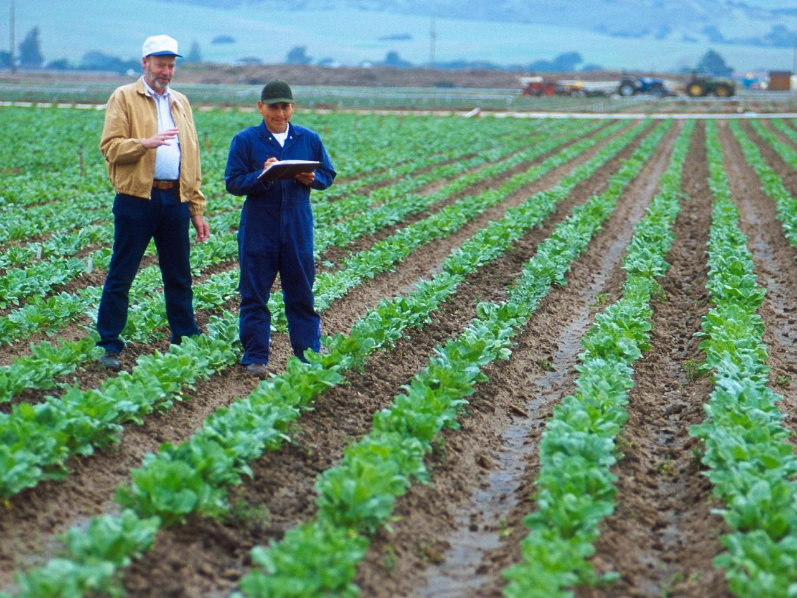
Tobacco Insurance
What is the future of Federal Crop Insurance for Tobacco?

Slide 34
Historically Where Have We Been?
The end of the quota program.
And the beginning of the problems.

Slide 35
Tennessee
Historical Loss Ratios
 | Tobacco | TN All Crops
2005 | 2.04 | 0.46
2006 | 1.80 | 0.55
2007 | 2.28 | 2.35
2008 | 1.47 | 1.03
2009 | 2.00 | 0.65
2010 | 2.04 | 0.93
2011 | 1.85 | 0.53

Slide 36
Tobacco Premiums
Average Paid Premium Per Acre (Dollar$ Per Acre)
 | NC | KY | TN
2005 | $44.42 | $57.39 | $103.65
2006 | $50.00 | $64.10 | $121.93
2007 | $61.05 | $76.72 | $163.17
2008 | $69.26 | $86.27 | $185.27
2009 | $75.29 | $91.84 | $217.75
2010 | $72.34 | $88.15 | $222.37
2011 | $76.17 | $89.22 | $215.76

Slide 37
Tobacco & Crop Insurance
Investigations are ongoing
RMA, OIG, IRS, DOJ are engaged
But resources are diminishing
And enforcement efforts have had little apparent impact

Slide 38
Tobacco & Crop Insurance
Solution?
Advance Notice of Public Rulemaking
  Excessive Risk Identification System (ERIS)
  Use data mining to exclude tobacco growers based on abnormal experience
  Producers could be excluded individually – Target 2014

Slide 39
Thank You
Bill Murphy
Administrator
Risk Management Agency

