Slide 1
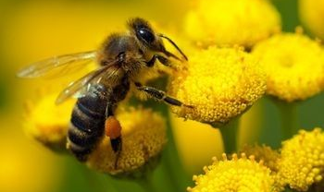
Designing for Bees !

Slide 2
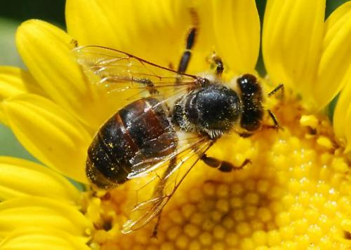
Design a bee -friendly Plant Pallet
Provide continuous bloom throughout the season
Plants preferred by bees
A diversity of flower types –supports a diversity of bees
Native to CA
Drought tolerant

Slide 3
Mix Native Annuals & Perennials
Plant Common Name Bloom Time
Lupinus succulentus Arroyo Lupine Spring
Phacelia tanacetifolia Tansy leaf phacelia Spring
Trifolium wildenovii Tomcat clover Late spring-Summer
Trifolium fucatum Bull clover/Sour clover Late spring
Trichostema lanceolatum Vinegar weed Summer-Late summer
Eschscholzia californica California Poppy Spring
Phacelia californica Ca phacelia/Ca scorpionweed Early summer
Lupinus formosus Lupine Late Spring- Summer
Lotus scoparius Common Deerweed Summer
Grindella camporum Valley Gumplant/Gumweed Summer- Fall
Neal Williams/Department of Entomology UC Davis

Slide 4
Plant Families Bees LOVE!
Asteraceae – Daisy, Aster, Sunflower family- (Erigeron glaucus, Echinacea purpurea, Gaillardia grandiflora, Coreopsis grandiflora, Cosmos binnatus,)
Fabaceae – Legume family
Lamiaceae – Mint, Lavender, Salvia, Thyme,Rosemary (Agastache, Lavandula, Salvia uliginosa)
Polygonaceae – Buckwheat family
Rosaceae – Roses, Apple, Cherry, Strawberry
Scrophulariaceae – Snapdragon, Penstemon
Papaveraceae – California Poppy

Slide 5
What do honey bees pollinate?
Veggies:
Beet, broccoli, brussels sprout, cabbage, carrot, cauliflower, cucumber, eggplant, okra, squash
Fruits:
Apples, apricot, berries, cherry, citrus, melons, pear, plum, tomato, watermelon
Nuts & Seeds:
Almonds, walnuts, hazelnuts, macadamia, sunflower

Slide 6



References for gardeners
http://ccuh.ucdavis.edu/projects/honey-bees
www.pollinator.org
http://www.xerces.org/pollinator-resource-center

Slide 7
