Slide 1
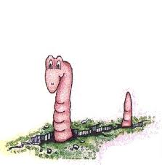
SHEET MULCHING Lawn Removal Method
Steps:
  Water existing lawn until soil is moist
  Put down a thick layer of cardboard (not waxed)
  Add a thick layer of organic material > 12”
    Compost, manure, soil, straw, wood chips
    Must be weed/seed free
    Moisten the layer to speed decomposition
    Let the layers sit for 4 – 6 weeks before planting
What happens under the Mulch?
  Grass/weeds decay and become food for earthworms
  Weeds are too deep to germinate
  Clay soil will drain more rapidly due to increase in organic matter
Nature’s little roto-tiller!
23Jun2012, UCCE Master Gardeners for San Mateo/San Francisco Counties

