Slide 1
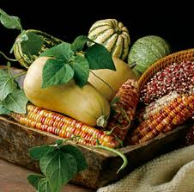

COMPANION PLANTING
Plants that grow well together
- and aid each other

Slide 2

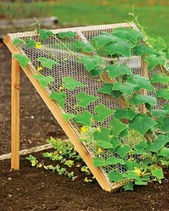
Benefits
Security through Diversity
Habitats – Improve Biological Control
  Attracts Beneficial Insects
  Attracts Pollinators
  Naturally Regulates & Repels Pests
Nitrogen Fixation
Mutual Protection/Assistance
  Shaded Microclimate
  Wind break
  Climbing Support

Slide 3
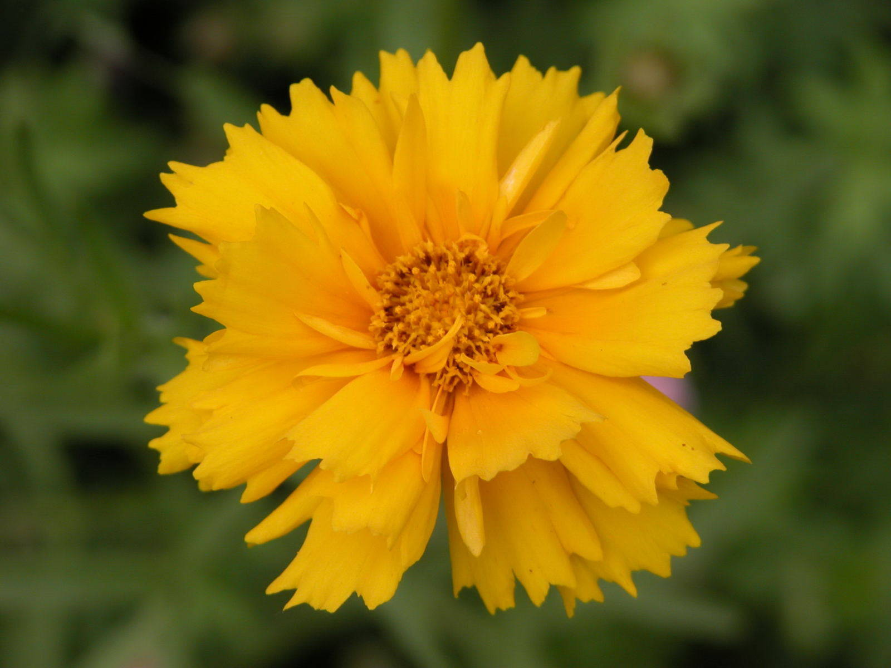
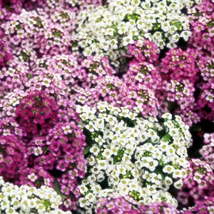
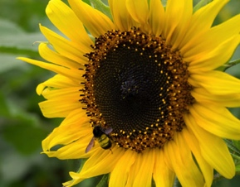
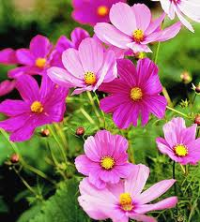
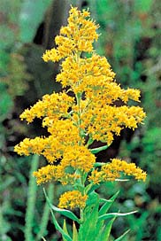
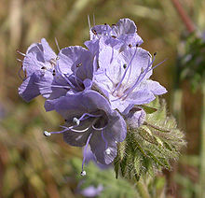
Flowering Companions that Attract Beneficial Insects

