Slide 1
How to Attract beneficials to your garden
Diantha Bell, Marin Master Gardener

Slide 2
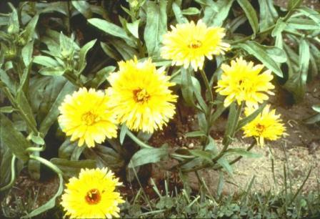
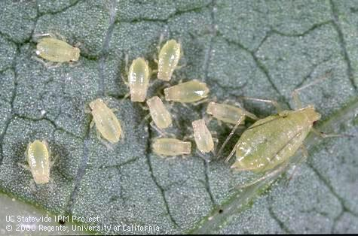
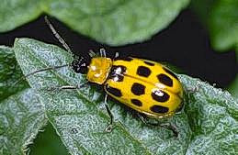
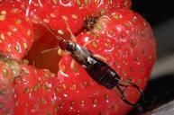
What are beneficials?
Beneficials are plants and animals that discourage unwanted pests and weeds in your garden.
Do these pests damage your precious vegetables and flowers?
Aphids Cucumber Beetles Earwigs

Slide 3
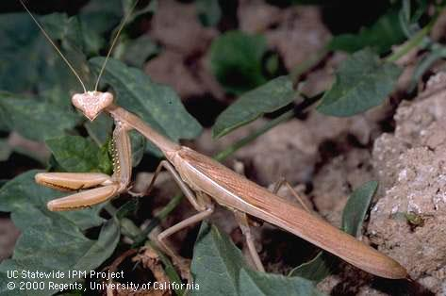
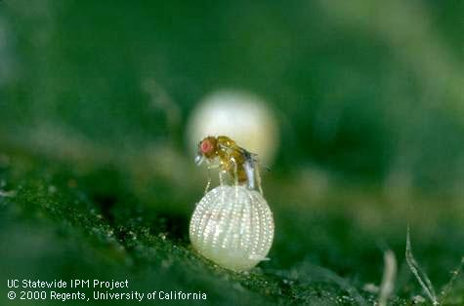
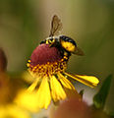
Types of benefials: predators, parasites and pollinators
Predators are beneficials that eat their pray - such as praying mantids.
Parasites or parasitoids are beneficials that live on a pest such as Trichogramma wasps.
Pollinators are benficials that carry pollen from one plant to another such as bees.
Praying Mantid Trichogramma Honey Bee

Slide 4

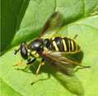
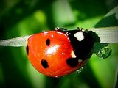
What to do?
Ignore them, pick them off, use insecticidal soaps, botanicals, full throttle pesticides????
Where are the beneficials when you most need them………or how to attract beneficials??
Lady Beetle Praying Mantid Syrphid Fly

Slide 5
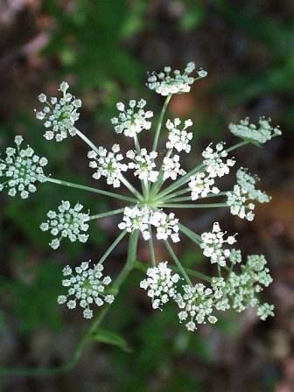
Thank God for Insectaries!
Insectaries are plantings that attract beneficials.
Each beneficial has its favorite insectary plants.
Designing insectaries is an important element of
garden planning.
Identify your insect pests, choose the target beneficials, then select the appropriate insectary plants which should bloom in sequence to insure continual food for the beneficials.
Angelica

Slide 6
How to incorporate an insectary into your existing garden.
Provide a shallow pool(s) where the beneficials can drink.
Use the “French Intensive Garden Plan”, i.e., many separate small islands of four to five sets of the same plant. The insectary islands must be large enough to attract beneficials.
Insectary plant and vegetable islands should be interspersed to allow the beneficials to commute easily amongst them.
Active beneficials do not like to travel very far between food and insectary plants.

Slide 7
Garden design continued
Select insectary plants that provide a gamut of habitats for predators, parasites/parasitoids and pollinators.
Keep insectary and crop islands fairly close to insure easy commuting for your beneficials.
Choose insectary plants that bloom sequentially to maintain appealing habitats and provide beneficials food for much of the year.
Use insectary plants that grow different heights to serve different feeding niches.

Slide 8
Garden Design Continued
Don’t use too much fertilizer that may attract many additional pests.
Letting vegetables in the mustard family go to seed provides good habitat for the beneficials.
Rotate “crop islands” from year to year to discourage pest build up.
Managing small patches of native weeds to attract beneficials is a good environmental practice.

Slide 9
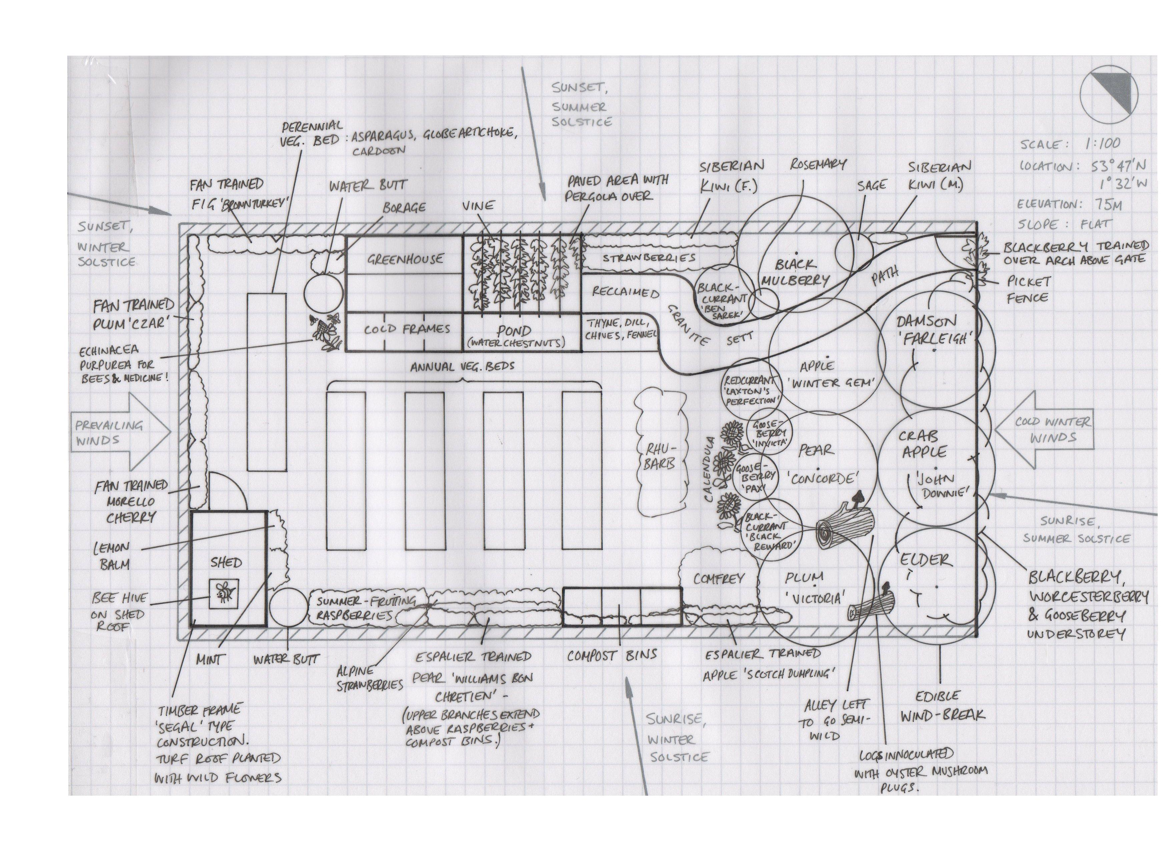
A Reasonably Good Garden Design
Notes:
Discuss integration of insectary plants, fruit trees and veggie beds; good sun exposure, good scale

Slide 10
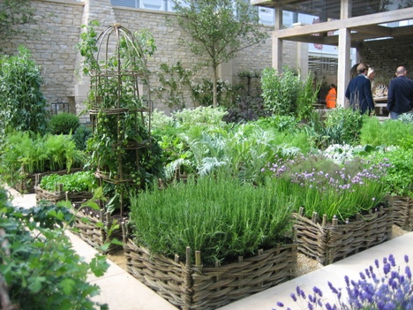
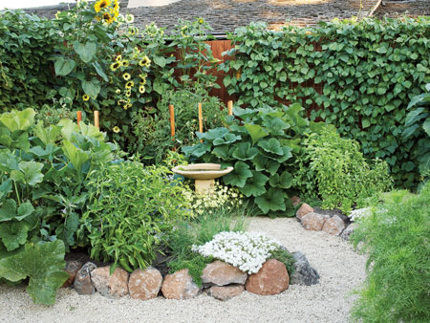
Sample Gardens That Illustrate a Good Integration of Vegetable and Insectary Components
Aesthetic and Very Functional
Organic Garden
French Potager Garden

Slide 11
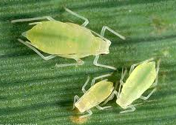
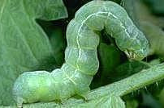
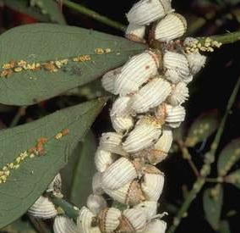
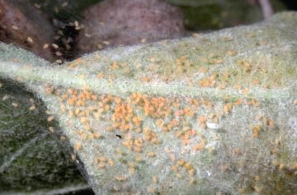
Now let’s connect the pests to the beneficials to the insectary plants.
We’re going to look at five pests: aphids, beetles, caterpillars, mites and scale.
Next we’ll identify beneficials to manage the pests.
Finally we’ll select insectary plants to attract the beneficials.
Caterpillars
Scale
Aphids
Mites
Beetles

Slide 12
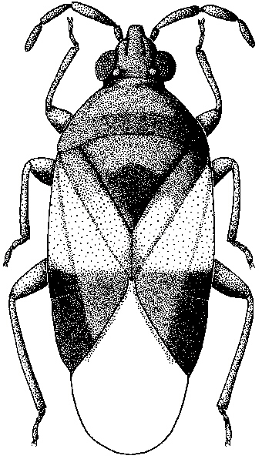
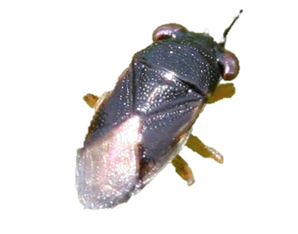
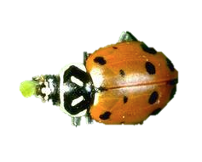
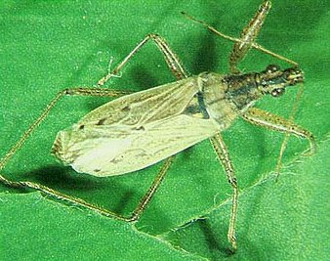
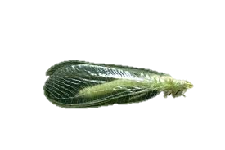
Beneficials for Aphids Insectary Plants
Bigeyed bugs |  | CA Lilac, Coyote Bush, Toyon, CA Buckwheat, Yarrow, Alfalfa
Convergent lady bug |  | Coffeeberry, CA Lilac, Yarrow, CA Aster, Angelica, Milkweed, Alyssum, Morning Glory, Dill, Fennel
Damsel bug |  | Morning Glory, Fennel
Green lacewings |  | Buckwheat, CA Aster, Yarrow, Angelica, Cosmos, Tansy, Sunflowers
Minute pirate bug |  | Toyon, Coyote Bush, Buckwheat, Alyssum

Slide 13
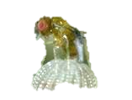
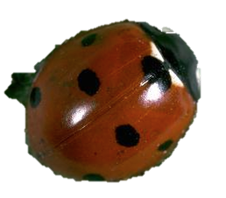
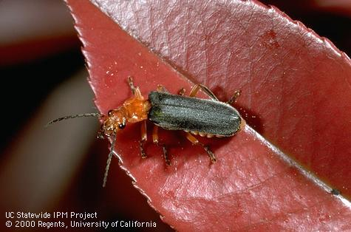
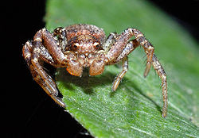
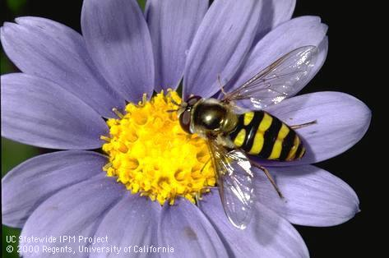
Beneficials for Aphids Insectary Plants
Parasitic Wasps |  | Alyssum, Caraway, Dill, Cosmos and Statice
Seven Spotted Lady Lady Beetle |  | Coffeeberry, CA Lilac, Milkweed, Yarrow, CA Astor, Angelica, Dill, Alyssum
Soldier Beetle |  | Goldenrod, Roses
Crab Spider |  | Evening Primrose
Syrphid Flies |  | Coffeeberry, Coyote Bush, CA Lilac, Lupine, Buckwheat, CA Aster, Statice, Dill, Morning Glory, Sunflowers, Cosmos

Slide 14

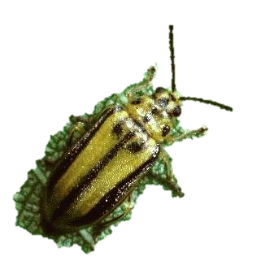
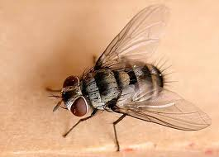
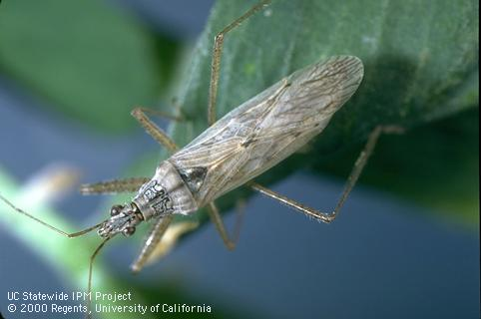
Beneficials for Beetles Insectary Plants
Anaphes Species |  | Sucks blood! No insectary plants.
Elm Leaf Beetle Parasite |  | Angelica, Dill, Fennel, Lovage, Lavender, Nasturiums, Hardy Margarita, Rock Cress, Yarrow, Dwarf Morning Glory, Zinnia, Dandelion, Buckwheat, Clovers
Tachinid Flies |  | Anise, Scabiosa, Yarrow, Cosmos, Sunflowers, Wild Mustards, Oxeye Daisy
Repeats Damsel Bugs Soldier Beetles Spiders

Slide 15
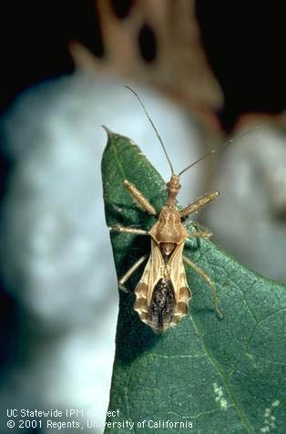
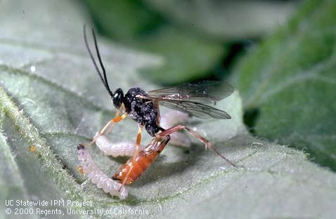
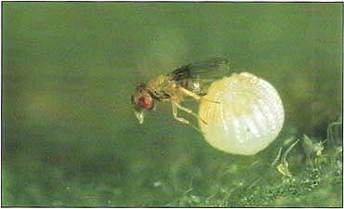
Beneficials for Caterpillars Insectary Plants
Assassin Bug |  | Alfalfa, Camphorweed, Carrot, Goldenrod, Mexican Tea, Oleander, Ragweed
Hyposoter exiguae (caterpillar parasite) |  | Alfalfa, Coffeeberry, Carrot, Coyote Bush, Goldenrod, Oleander, Rue, White Mustard
Trichogramma spp. (egg parasite) |  | Caraway, Chervil, Dill, Fennel, Parsley, Bee Balm, Hardy Margarita, Yarrow, Black-eyed Susan, Cosmos, Targetes, Sunflower, Alyssum
Repeats | Too many species | Bigeyed Bugs, Damsel Bugs, Green lacewings, Minute Pirate Bugs, Spiders, Tachinid flies (See Beneficials for Aphids, Beetles or Caterpillars)
Notes:
http://www.@ucdavis.ucdavis.edu davis.edu/PMG/NE/assassin_bugs.html

Slide 16
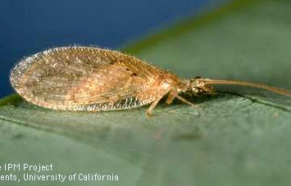
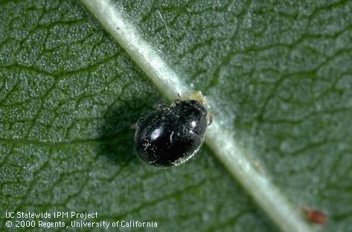
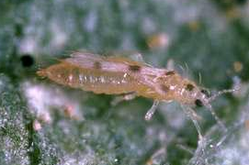
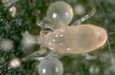
Beneficial for Mites Insectary Plants
Brown Lacewing |  | Angelica, Golden Asters, Goldenrod, Calendula, Sunflowers
Sixspotted Thrips |  | Predator
Spider Mite Destroyer Lady Beetle |  | See other lady beetles, Aphids
Western Predatory Mite |  | Predator
Repeats | Bigeyed Bugs, Damsel Bugs, Green Lacewings, Minute Pirate Bugs (See Beneficials for Aphids, Beetles or Caterpillars)

Slide 17
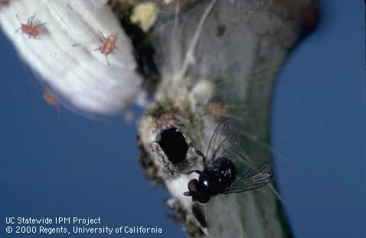
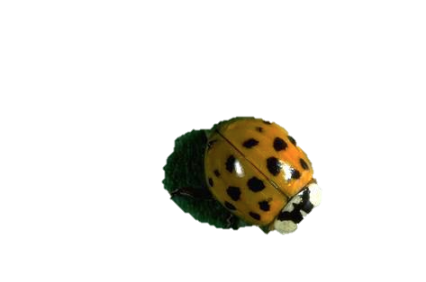
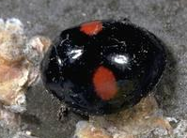
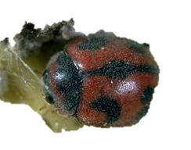
Beneficials for Scale Insectary Plants
Cottony Cushion Scale Parasite |  | Parasite, not a predator such as the Lady Beetle
Multicolored Asian Lady Beetle |  | Carrot Family: Angelica, Anise, Dill, Fennel. Hardy Margarite, Yarrow, Morning Glory, Zinnia, Dandelion
Twicestabbed Lady Beetle |  | See above
Vedalia Beetle |  | See above
Brown Lacewing | Repeat | See Mites

Slide 18
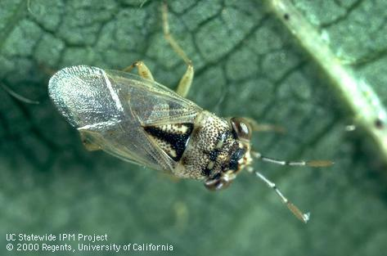
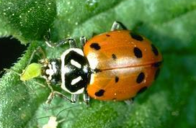
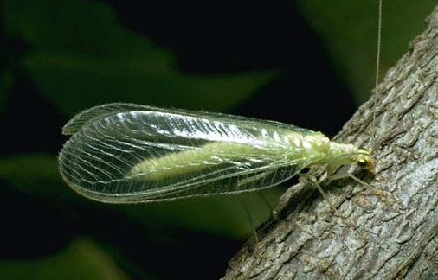
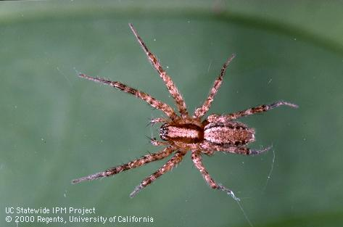
Common Beneficials???????
Notes:
Assassin bug 2. Bigeyed Bug 3. Convergent Lady Beetle 4. Damsel Bug 5. Green Lacewing 6. Mantid
7. Soldier Beetle 8. Syrphid Fly 9. Orb Spider

Slide 19
The Four Major Insectary Plant Families
Carrot Apiaceae | Anise, Angelica, Caraway, Chervil, Cilantro, Coriander, Dill, Fennel, Parsley, Wild Carrot
Daisy Asteraceae | Calendula, Chrysanthemum, Cosmos, Daisy, Dandelion, Echinacea, Sunflowers, Yarrow, Zinnia
Mustard Brassiaceae | Alyssum, Arugula, Candytuft, Rock Cress, Mustard, Kohl Crops
Mint Lamiaceae | Basil, Bee Balm, Catnip, Lavender, Marjoram, Mint, Oregano, Sage

Slide 20
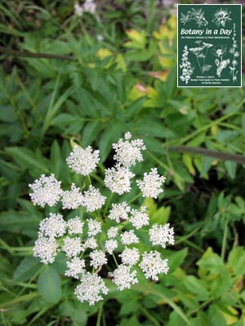
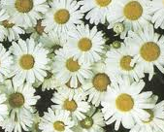
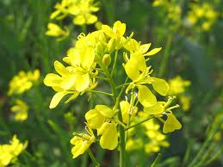
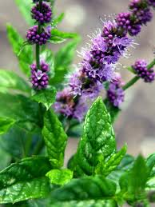
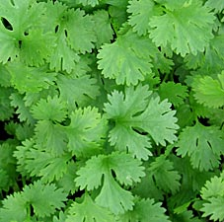







Common Insectary Plants
Carrot Family | Daisy Family | Mustard Family | Mint Family
Daisy
Mustard
Mint
Angelica
Cilantro
Black-eyed Susan
Alyssum
Bee Balm
Cosmos
Dill
Broccoli
Lavender

Slide 21




Questions about Marin Master Gardeners??
Contact to Marin Master Gardeners at this web site:
ucanr.org/sites/MarinMG/

Slide 22
Any Questions?
The Best Source of Information for Beneficials and Insectary Plants, without a doubt:
ipm.ucdavis.edu
( belldj89@comcast.net)

